Slide 1
Instruction, Curriculum, and Assessments for a New Era of Learning: Transforming Math and Science Practice
Jeff C. Marshall
ASCD Conference
March, 2014

Slide 2
Key to Student Success
What is it?
Can you achieve it?
AND, can you consistently recreate it?
Image used with permission: Sarah Joann Photography (2013)

Slide 3
What do students see on the road to success?

Slide 4
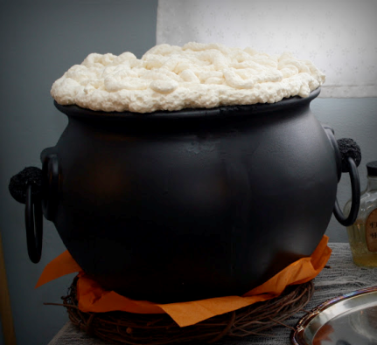
Inputs and Outputs
Inputs:
Standards
Objectives
Curriculum
Instruction/Strategies
Assessments
Outputs:
Student achievement
Student success

Slide 5
Determining Foreground and Background
Notes:
Foreground is pertinent to both student and teacher
Background may be beneficial to the professional in achieving the overall goal but provides little help to the learner in achieving the goal.

Slide 6
Foreground and Background
Foreground are the interactions necessary to foster increased student success
Background is what teachers need to succeed

Slide 7
Standards and Objectives
Standards and objectives are crucial for teachers but students just hear blah, blah, blah—background noise.
Suggestion—try concept maps or essential questions to help frame past, present, and future.

Slide 8
Foreground
Foreground (must provide for students):
Meaning
Value
Relevance
Relationships
Challenge

Slide 9
Background first
We will focus first on the background—in order to improve the foreground experiences of students.

Slide 10
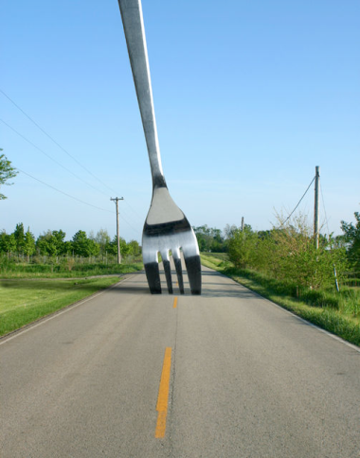
Change is ahead: How will you respond?

Slide 11
Prior Standards: too much & too little clarity

Slide 12
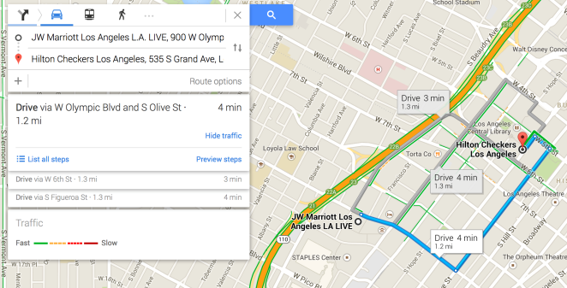
CCSS and NGSS: provide clarity, greater focus, based on learning progressions

Slide 13
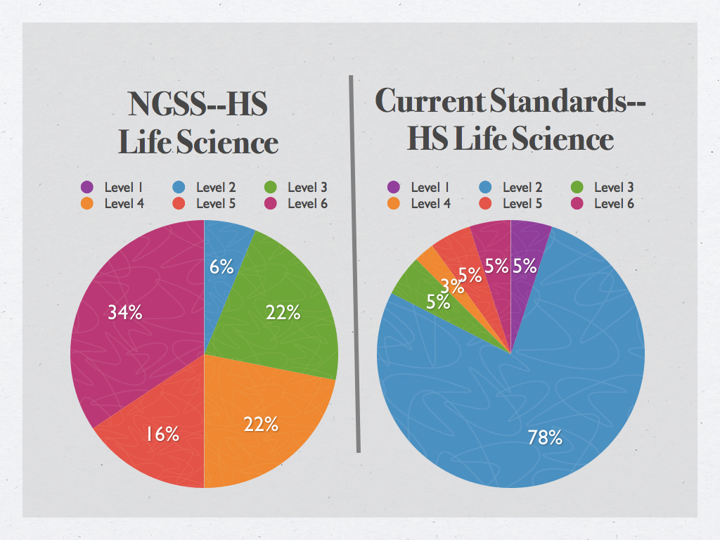
Which classroom would you rather emulate and why?
Current Standards are from SC, but these have been endorsed by Fordham and others among the best and most rigorous in nation.
Notes:
Level 1: remember; Level 2: Understand; Level 3: Apply; Level 4: Analyze; Level 5: evaluate; Level 6: create

Slide 14
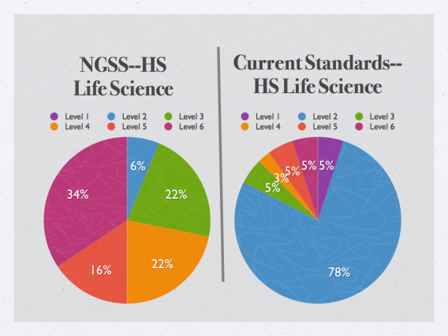
So What?
NGSS: 94% high or mid level vs.
Current: 18% high or mid level
Note: Levels are based on the Revised Bloom’s Taxonomy

Slide 15
What does this mean?
Bar has been MAJORLY raised for ALL!
Must accept this before change will occur.

Slide 16
Evidence-Based Claims
HS-LS4-2. Construct an explanation based on evidence that the process of evolution primarily results from four factors: …
5-LS1-1. Support an argument that plants get the materials they need for growth chiefly from air and water.
CCSS for Math: Practice 3—Construct viable arguments and critique the reasoning of others.

Slide 17
Modeling Phenomena
5-PS1-1. Develop a model to describe that matter is make of particles too small to be seen.
5-LS1-1. Develop and use a model to describe how unequal heating and rotation of the Earth cause patterns of atmospheric and oceanic circulation that determine regional climates.
CCSS for Math: Practice 4—Model with Mathematics (e.g., fraction, area, probability, physical models)

Slide 18
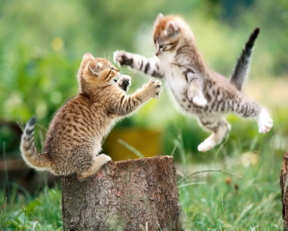
Standards and Instruction: Marriage or Cat Fight

Slide 19
What does instruction look like that supports:
Meaning
Value
Relevance
Relationships
Challenge
But also achieves mastery associated with key concepts
Student Needs and Desires
Teacher Goals and Targets

Slide 20
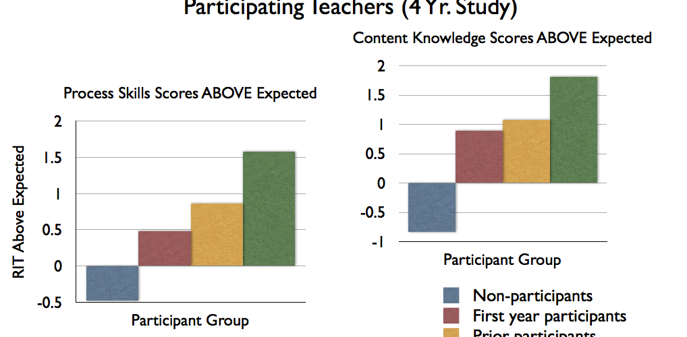

Slide 21
What was responsible for this growth?

Slide 22
Was the strategy?
Lecture
NO!
Direct Instruction
NO !
Hands-On
NO!
Inquiry-Based Instruction
YES!!!

Slide 23
Before you say…great, but it won’t work with my kids?
The data hold true for:
Honors/Average/Remedial
Males/Females
Majority/Minority
Affluent/Poor

Slide 24
What is inquiry-based instruction?

Slide 25
Inquiry-Based Instruction
More than activities
More than engaging students
Intentional instructional process where students are provided experiences to explore before the formal explanation of the concepts or ideas

Slide 26
What does an inquiry-based lesson look like?

Slide 27
E.Q.: What is necessary for life to exist?
Image used with permission: Anna Gorin (2013) www.annagorin.com

Slide 28
Instructional Paradigms
Typical Approach:
Review → Introduce → Model → Practice
Guided Inquiry Approach:
Engage → Explore → Explain → Extend
Role of student in each???

Slide 29
Which of the following are:
living?
non- living?
not able to
determine?

Slide 30
Characteristics of life
Looking at your list of living and non-living, compose the SMALLEST list of required characteristics for something to be living.
(Must all your characteristics be present?)

Slide 31
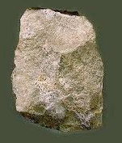
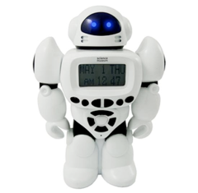
Share and Critique
Share one critical characteristic of living things from list until all characteristics have been presented.
Then test various pictures against the list to see if all items belong.

Slide 32
Share and Critique (continued)
Once the class list is determined share several lists that scientists have compiled (they typically span from 3-10 characteristics).
e.g., List of characteristics of living things:
Composed of Cell(s)
Use Energy
Grow
Reproduce
Respond to the Environment
Adapt to Environment

Slide 33
Do you get it?
Justify whether the following items are or are not living. (Peach pit, bacteria, tennis shoe, and nucleus of cell)
A friend says that water is living. How do you respond and what evidence do you provide to support your claim?
List 5 living things and 5 non-living things (that have not been discussed).
Good opportunity to revisit original list to clear up misconceptions.

Slide 34
Which of the following are:
living?
non- living?
not able to
determine?

Slide 35
Self Inventory
Aren’t I just fine?
Image used with permission: Anna Gorin (2013) www.annagorin.com
Notes:
Past – What did I experience as a learner?
Present – How do I teach now?
Future – Who will I be tomorrow?

Slide 36
How do we know when we have been successful?

Slide 37
EQUIP (Electronic Quality of Inquiry Protocol)
Descriptive rubric that measures 19 things that teachers can control and are linked to student achievement

Slide 38
EQUIP Sample

Slide 39
Key Takeaways
Goals and Value (Background vs. Foreground)
Standards and objectives are helpful in framing our instruction, but value and meaning for students come from what they experience, explore, and explain.
New vs. Old
The old standards focused on knowing, telling, and defining; the new standards focus on modeling, analyzing, and designing. How we show mastery between old and new is very different?
Inquiry
Instruction for the new standards requires engaged, thoughtful students to be able to model complex ideas and provide evidence-based claims. Proficient inquiry-based learning provides a strategy to support the growth of all students.

Slide 40
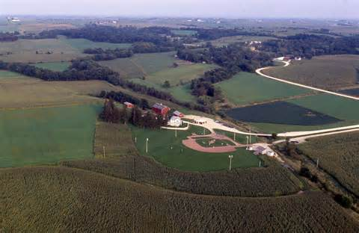
Effective teaching is not a field of dreams where you just envision it and great success will be had.
Good teaching requires:
Intentionality
Perseverance
Reflection
Relevance
Meaning

Slide 41
Contact Information:
Jeff C. Marshall
Clemson University
marsha9@clemson.edu
www.clemson.edu/iim

