Slide 1
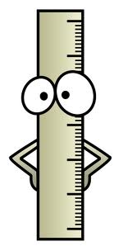
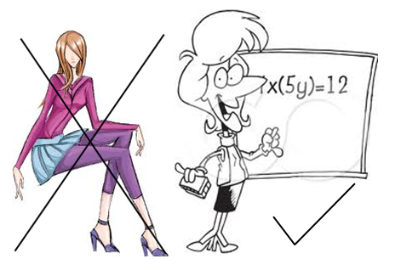
Standards for Mathematical Practice
1. Make sense of problems and persevere in solving them. Mathematically proficient students start by explaining to themselves the meaning of a problem and looking for entry points to its solution. “Does this make sense?” | 5. Use appropriate tools strategically. These tools might include pencil and paper, concrete models, a ruler, a protractor, a calculator… able to identify relevant external mathematical resources, such as digital content located on a website, and use them to pose or solve problems…
2. Reason abstractly and quantitatively. ...to make sense of quantities and their relationships in problem situations: students can both: decontextualize (abstract) and contextualize (specify). | 6. Attend to precision. …try to use clear definitions in discussion with others and in their own reasoning… careful about specifying units of measure… express numerical answers with a degree of precision appropriate for the problem context
3. Construct viable arguments and critique the reasoning of others. …use stated assumptions, definitions, and previously established results in constructing arguments, making conjectures and building logical progressions of statements…. | 7. Look for and make use of structure. …students look closely to discern a pattern or structure… they may sort a collection of shapes according to how many sides the shapes have... can step back for an overview and shift perspective
4. Model with mathematics. …students who can apply what they know are comfortable making assumptions and approximations to simplify a complicated situation, realizing that these may need revision later… | 8. Look for and express regularity in repeated reasoning. …notice if calculations are repeated, and look both for general methods and for shortcuts… maintain oversight of the process, while attending to the details.

