Slide 1
Avoid delays with NIH Awards
Complying with the NIH Public Access Policy
Clemson University

Slide 2
Presenters and Panel Members
Mandy McCaslan and Diana Thrasher
Office of Sponsored Programs
Diana Finkle
Clemson University Library
Casandra Gibson
Office of the Vice President for Research
Karen Lantgios
Grants and Contracts Administration

Slide 3
5 Points to Cover Today
The NIH Public Access Policy
How to Ensure Publications Become Compliant
Overview of The National Center for Biotechnology Information Portal (MyNCBI )
Clemson’s Action Plan for Non-compliant Publications
Review the NIH Research Performance Progress Report (RPPR)

Slide 4
The NIH Public Access Policy

Slide 5
The NIH Public Access Policy Is Mandatory
The Policy implements Division G, Title II, Section 218 of PL 110-161 (Consolidated Appropriations Act, 2008) which states:
The Director of the National Institutes of Health shall require that all investigators funded by the NIH submit or have submitted for them to the National Library of Medicine’s PubMed Central an electronic version of their final, peer-reviewed manuscripts upon acceptance for publication, to be made publicly available no later than 12 months after the official date of publication: Provided, That the NIH shall implement the public access policy in a manner consistent with copyright law.
NIH Guide Notice NOT-OD-08-033
http://grants.nih.gov/grants/guide/notice-files/NOT-OD-08-033.html
NIH Guide Notice NOT-OD-09-071 announces the policy is permanent, per the Consolidated Appropriations Act, 2009
http://grants.nih.gov/grants/guide/notice-files/NOT-OD-09-071.html

Slide 6
Pub Med vs. Pub Med Central
Free resources developed by the U. S. National Library of Medicine
Database of biomedical journal citations, abstracts, and
Links to some full text articles from PMC and publisher websites.
Unique identifier: PMID followed by a series of numbers.
Digital archive of full-text, peer-reviewed journal papers.
Unique identifier: PMCID followed by a series of numbers.

Slide 7
NIH Public Access Policy is Mandatory
What to submit? Final, peer-reviewed manuscripts that are accepted for publication, or published.
When to submit? Upon acceptance for publication
When to make public? No later than 12 months after the official date of publication
Where to make public? The National Library of Medicine’s PubMed Central

Slide 8
NIH Enhanced Public Access Policy
Effective July 1, 2013 on ALL NIH awards.

Slide 9
Other Information
Happening in tandem with the mandate of the Research Performance Progress Reports (RPPR)
RPPR replaces forms PHS 2590 for eSNAP and 416-9 for Fellowships
Upcoming RPPR due dates
May 1, 2013, for Fellowships
May 15, 2013 for SNAP awards
Projects must be in compliance in order to avoid delay in funding

Slide 10
NIH Enhanced Public Access Policy
Next, we will overview how to be compliant in three steps:
Link publications to your NIH grant:
Manuscript files through the NIH Manuscript System (NIHMS)
Full text and final articles through PubMed Central
In My Bibliography of MyNCBI
In the RPPR – live feed of publications from MyNCBI, can associate the grant to the publication, which will feed back to MyNCBI (a two-way feed)

Slide 11
How do you make sure publications become compliant?

Slide 12
How Awardees Comply
1. Address Copyright
Institutions and investigators are responsible for ensuring full compliance with the Public Access Policy (e.g., that any publishing or copyright agreements are consistent with submitting to PMC).
Before an author signs a publication agreement or similar copyright transfer agreement, make sure that the agreement allows the final peer-reviewed manuscript to be submitted to NIH in accordance with the Public Access Policy.
We encourage authors to consider
What submission method will be used?
What version of the paper will be made available on PMC?
Who will submit the paper?
When will it be submitted?
Who will approve the submission?
When can the paper be made public on PMC?

Slide 13
How Awardees Comply
2. Deposit Paper Upon Acceptance for Publication
Method A: Publish in a journal that deposits all NIH-funded final published articles in PMC without author involvement.
Method B: Make arrangements to have a publisher deposit a specific final published article in PMC.
Method C: Deposit the final peer-reviewed manuscript in PMC yourself via the NIHMS.
Method D: Complete the submission process for a final peer-reviewed manuscript that the publisher has deposited via the NIHMS.
3. Cite Article
Include the PMC number (PMCID) for applicable papers in applications, proposals and reports, as described at http://publicaccess.nih.gov/citation_methods.htm

Slide 14
Overview of Submission Methods

Slide 15
How the library can help
Use this interactive tool to find out what steps you need to take:
http://www.surveymonkey.com/s/findpmcid
Get more information about the process from the library website:
- http://libguides.clemson.edu/nih
Contact a librarian if you have questions about searching the databases: http://www.clemson.edu/library/reference/askALibrarian.html

Slide 16
What is My NCBI?

Slide 17
What is My NCBI?
My NCBI is a bibliography management tool integrated with PubMed. My Bibliography is part of My NCBI with Public Access tracking and reporting features.
Key features for our discussion:
Can be linked to eRA Commons account
Build bibliography
Commons linked users can associate publications with NIH grants
Tracks NIH Public Access compliance
The only way to enter publications into RPPR
Other time savers: Delegation, options to share and publish bibliographies, automate searches, etc.

Slide 18
Log in to My NCBI

Slide 20
Things to remember
Need to get PMCID#s for ALL papers to which the NIH Public Access Policy applies.
Policy applies to papers “accepted for publication” (not published) on or after April 7, 2008

Slide 21
Action Plan for Non-compliant Publications

Slide 22
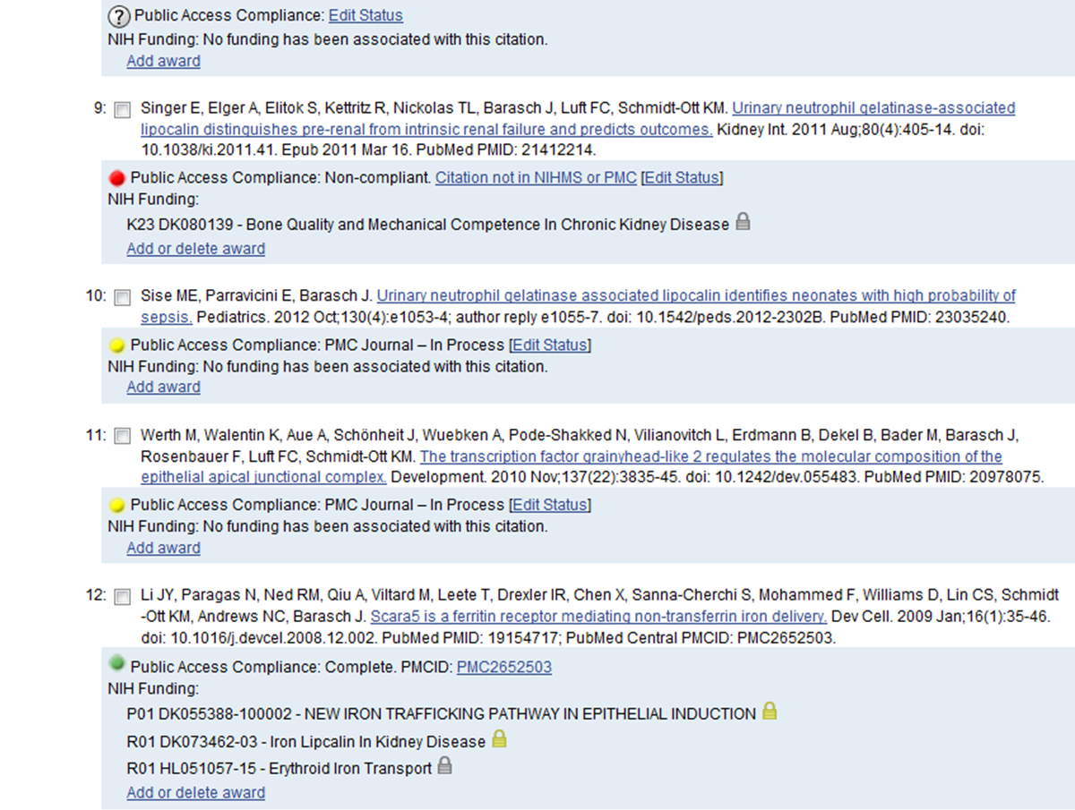
Review the Public Access Compliance status of each citation

Slide 23
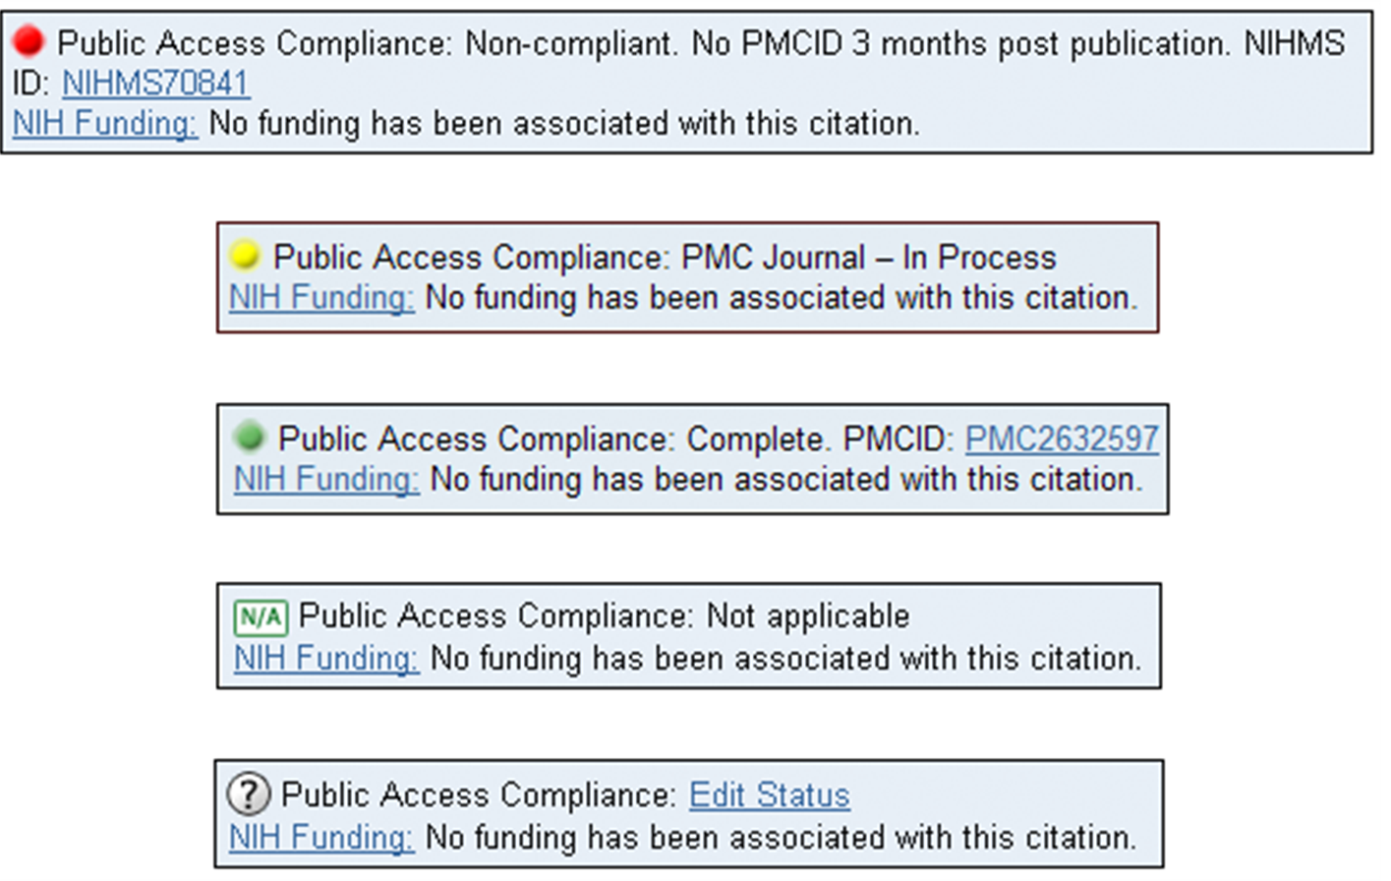

Slide 24
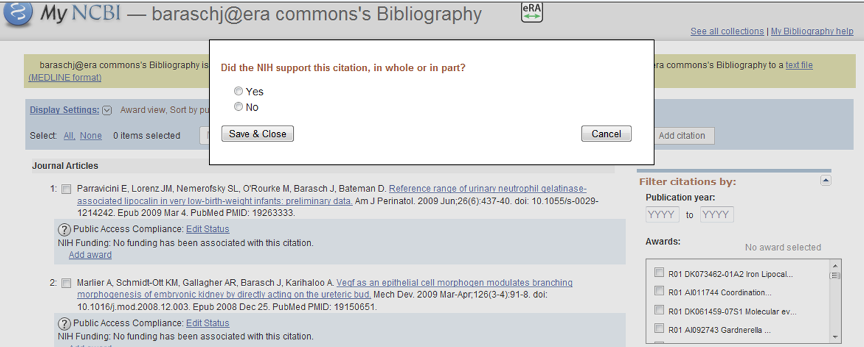
? - Public Access Compliance “No funding has been associated with this citation”

Slide 25
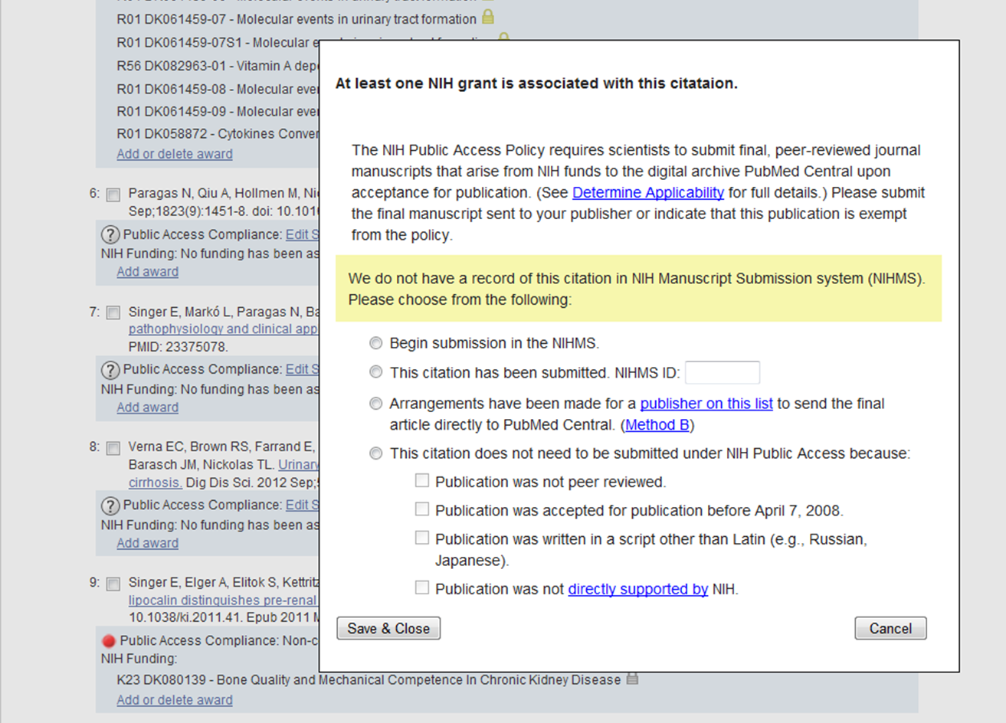
Address any non-compliant citations

Slide 26
Review RPPR

Slide 27
Research Performance Progress Report (RPPR)
http://grants.nih.gov/grants/rppr/
Mandatory Use of the RPPR for SNAP and Fellowship Awards
Electronic format only
Replaces forms PHS 2590 for eSNAP, and 416-9 for Fellowships
Budget start dates on or after July 1, 2013
RPPR due dates
May 1, 2013, for Fellowships
May 15, 2013 for SNAP awards

Slide 28
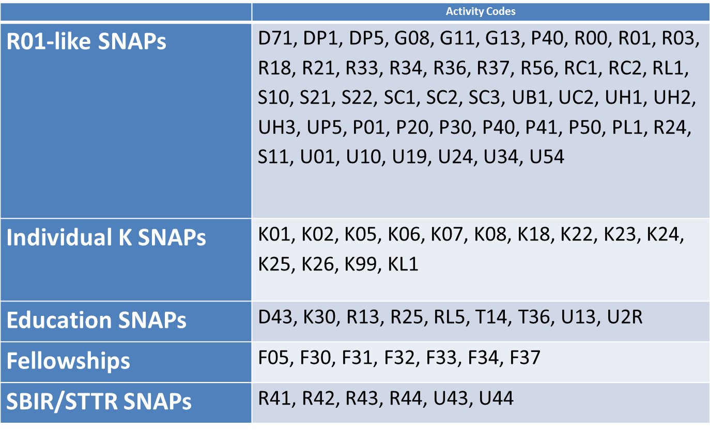
RPPRs Available now

Slide 29
What about non-SNAP awards?
RPPRs will be implemented for non-SNAP late 2013/early 2014
Includes T32s and other complex mechanisms
The progress reports for these grants require budgets, unlike the SNAP awards and fellowships
NIH trying to incorporate the SF424 budget forms into the electronic RPPR, but they are not there yet!
Continue to submit the progress reports for these special grant mechanisms as you have been
Competing progress reports will require a PAPER PDF printout from My NCBI to demonstrate that publications are compliant with the Public Access Policy

Slide 30
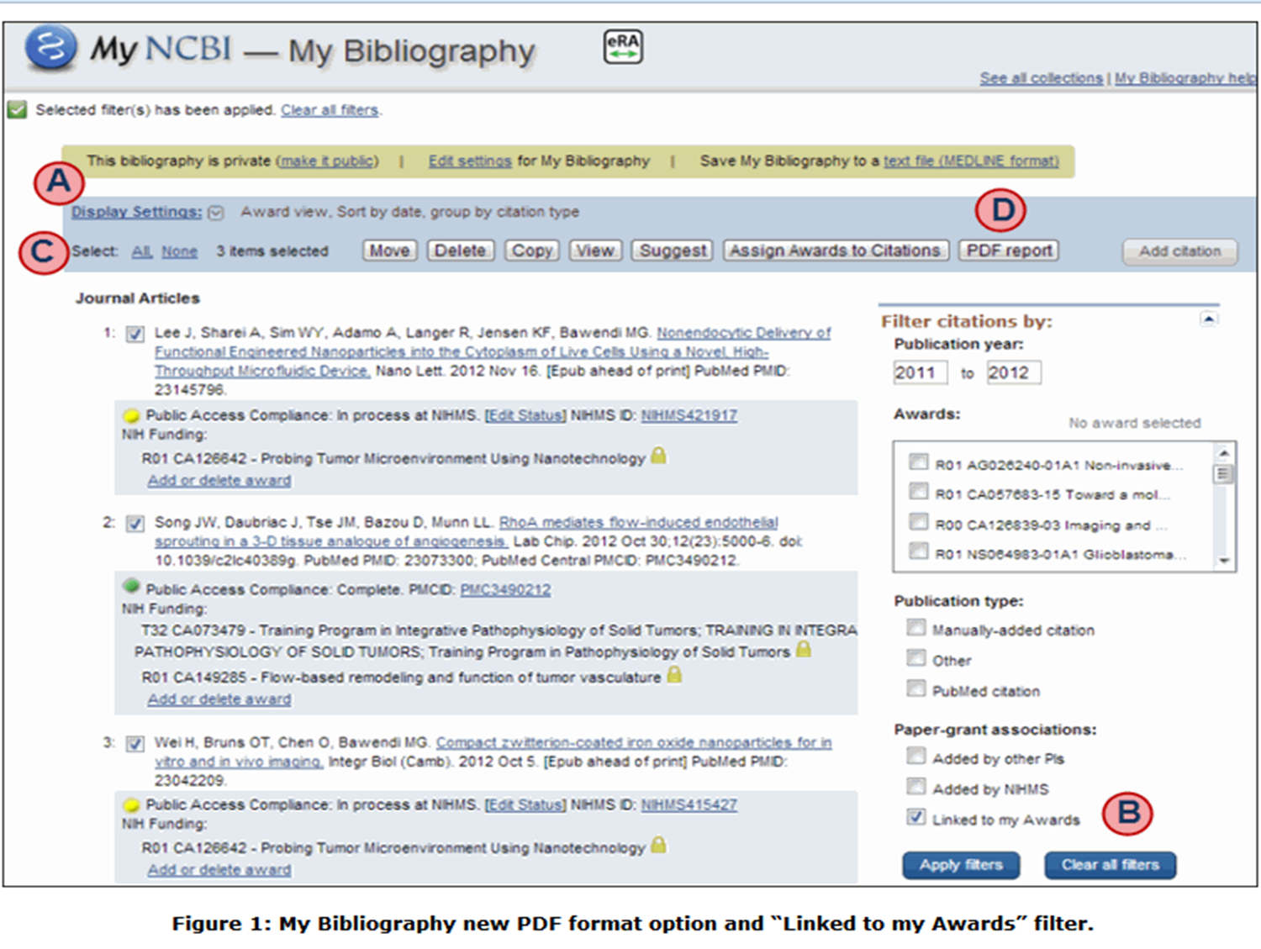

Slide 31
Summary of New Information Requested
Competitive revisions/administrative supplements
Specific location to report aims & accomplishments (B.3)
Foreign Collaborations (sub-awards):
Individual affiliation with foreign organization (D.1)
Dollar amount of award spent in foreign country (E.4) Information about foreign components (G.9)
Participants – role on project
New role-High School Student; slight rewording of other roles (D.1)
Level of Effort
Prior approval request for reduction of >25% for PD/PI or other
individual designated on NoA (D.2.a)
Estimated unobligated balance
Provide estimated amount and description of how funds will be
spent (G.10)

Slide 32
Points to Remember
Special characters not permitted in text boxes
Disregard items marked “Not Applicable”
Round person months to nearest whole number
All uploads must be PDF files

Slide 33
Sample RPPR
http://grants.nih.gov/grants/rppr/rppr_screen_shots.pdf

Slide 34
RPPR and E-Notification
Trigger: When a grantee submits a RPPR to NIH that associates one or more publications with the award for which the public access compliance status is “Noncompliant”.
Recipients: to the PD/PI, with a cc to the OSP, GMS, IC mailbox, and PO.
Response: The grantee may respond to the eNotification via email or through the Progress Report Additional Materials (PRAM) link.

Slide 35
What is PRAM?
Progress Report Additional Materials (PRAM)
An option in the eRA to provide additional materials for a progress report.
Currently, PRAM is ONLY being used to address non-compliant publications.
PRAM will eventually be required.

Slide 36
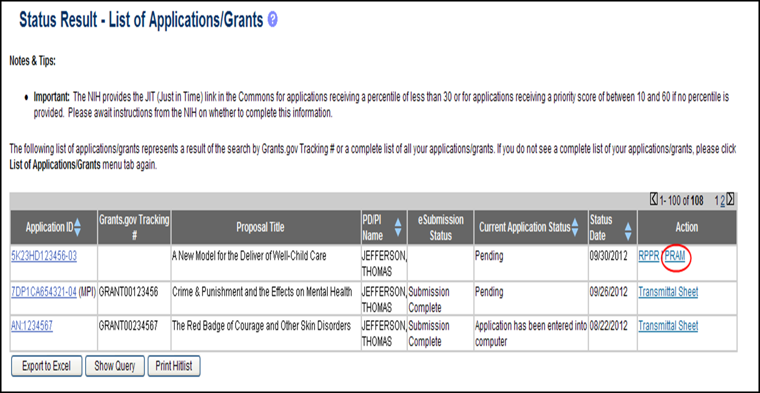
PRAM also available in Status Section of eRA Commons

Slide 37
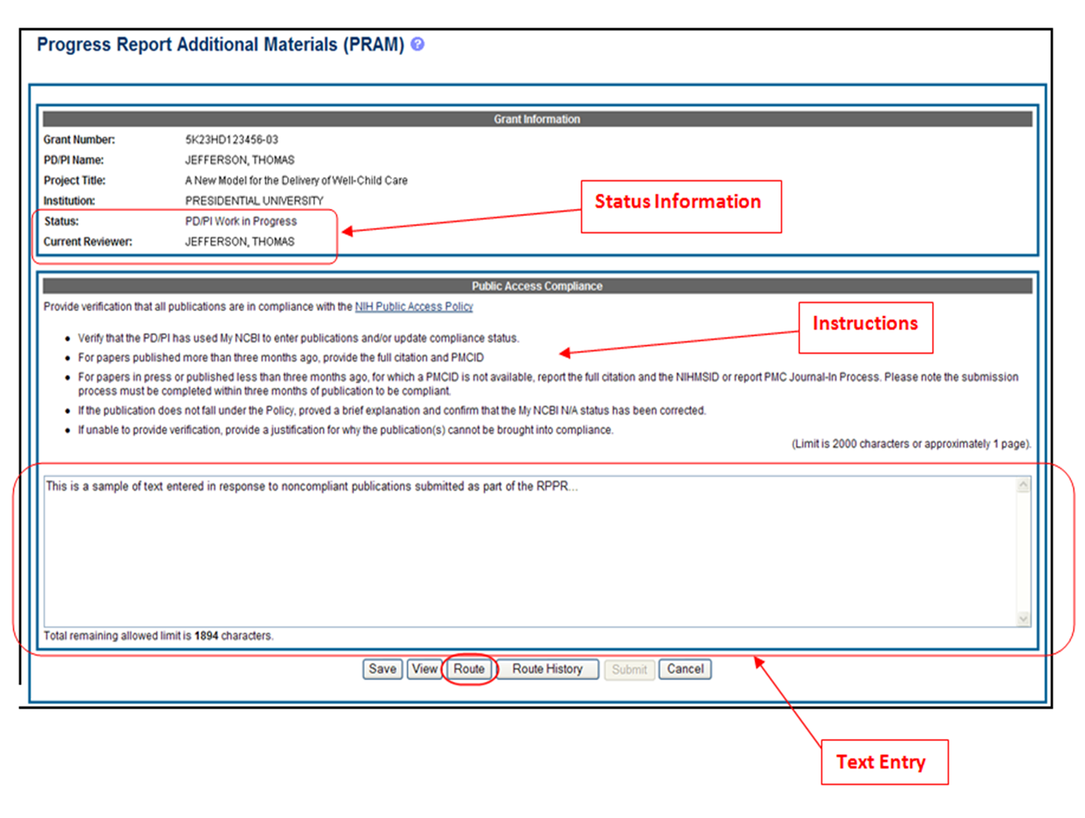

Slide 38
Questions?

Slide 39
Contact Us
Office of Sponsored Programs
cuosp@clemson.edu
Library
dfinkle@clemson.edu and rook@clemson.edu
Compliance
casandg@clemson.edu
Grants and Contracts Administration
klntgs@clemson.edu

Slide 40
Resources
Clemson University Interactive Guide to Finding a PMCID Number
Guidance on complying with the NIH Policy – Clemson University Library
NIH Public Access Policy
Recent podcasts regarding the enhanced Public Access Policy
Public Access Training
Public Access FAQs
RPPR Training Resources
Log in to My NCBI
NIH Research Performance Progress Report (RPPR)
NIH Manuscript Submission System FAQs
NIHMS System Submission Tutorials
For Publishers –FAQs
Video – Approving Submission of an Article in PubMed Central

