Slide 1
------------
STEM Extension Workshop
Clemson University
International Services

Slide 2
Table of Contents
Introduction to STEM OPT Extension
Understanding STEM OPT Extension
STEM OPT Extension Eligibility
Types of Allowable Employment
Third Party and Staffing Agencies
Applying for the STEM OPT Extension
Application Timeline
Application Process
Completing the I-983
Filing for STEM OPT Extension
Benefit of Filing the I-765 Online
Gathering your Application Materials
Completing the I-765 Online
Filing Issues/RFE
Maintaining Status on STEM Extension
While STEM OPT Application is Pending
STEM OPT Reporting Requirements
Unemployment
International Travel
Renewing F-1 Visa
Completing STEM Extension Period
Changing Status to H1-B
Cap-Gap Extension
After STEM Extension and Grace Period

Slide 3
OPT 24-Month STEM Extension Tutorial
Please note that this tutorial is for instructional purposes only.
A STEM OPT application to USCIS is your own personal application. You alone are responsible for timely ﬁling with full documentation, understanding F-1 rules regarding OPT, and properly maintaining F-1 status.
Please review the entire tutorial and contact International Services if you have any questions. Additional STEM OPT guidance can be found on our website.
Return to top

Slide 4
Understanding STEM OPT Extension
STEM OPT Extension Eligibility
Types of Allowable Employment
Third Party and Staffing Agencies
Introduction to STEM Extension
Return to top

Slide 5
Understanding STEM OPT Extension
Students in Science, Technology, Engineering, and Math (STEM) fields may be eligible for an additional 24 months of OPT following the 12-month period of post-completion OPT.
STEM OPT Extension is another benefit of the F-1 visa and is approved by USCIS. USCIS can deny a STEM OPT request if the applicant is found to have violated their status.
Although it is called STEM OPT “Extension”, you are essentially applying for a separate employment authorization that is based on the timeline of your Post-Completion OPT Authorization.
Return to top

Slide 6
STEM OPT Extension Eligibility
Requirements:
See this list of STEM Majors. (You can check the CIP code listed on your I-20.)
According to your Post-Completion OPT:
Have not exceeded 90 days of unemployment.
Are within the last 90 days of your OPT Authorization
You can apply based on any previous STEM degree from an SEVP, accredited U.S. institution within the last 10 years – must be on active Post-Completion OPT to do so.
You must be employed or have a job oﬀer related to your ﬁeld of study from an employer who is registered in the USCIS E-Verify Program.
Your employer should work with you to fully complete the Form I-983
Two 24-month STEM extensions may be granted per lifetime
Return to top

Slide 7
Types of allowable Employment
Must be a paid position.
“Bona-Fide employer-employee relationship.
Must be enrolled in E-Verify
Return to top

Slide 8
Third Party Worksites and Stafﬁng Agencies
Tricky!
The employer that signs the Form I-983 must be the same entity that provides the practical training experience to the student.
The employer has suﬃcient resources and personnel available to provide appropriate training in connection with the STEM opportunity at the location(s) speciﬁed in the Form I-983.
Supervision under remote work must be explained on I-983.
Cannot be supervised by another F-1 Student on OPT or STEM Extension
Return to top

Slide 9
Applying for STEM OPT Extension
Application Timeline
Application Process
Completing the I-983

Slide 10
When Can I Apply for STEM OPT Extension?
STEM OPT Start Date will always be the 1st day after OPT End date
90 days before Post-Completion OPT End date
Post Completion OPT End Date
Must file STEM Extension during this period
cannot file after opt end date
If filed in timely manner, your employment authorization will automatically be extended for 180 days after your OPT EAD end date while your OPT STEM application is pending.
If you have received a Cap-Gap Extension of your I-20, you must still submit your STEM application to USCIS before the expiration of your 12-month EAD.
Return to top

Slide 11
STEM Application Process
1
Work with your employer to complete and sign the I-983
2
Submit the STEM Extension Request e-Form on the iStart Portal
3
Obtain your new I-20 with the STEM Recommendation within 5 business days.
4
Gather your documents and prepare to file your I-765 within 60 days of obtaining your STEM OPT I-20.
5
File your I-765 with USCIS online before your Post-Completion OPT end date.
6
Receive your STEM EAD. You may continue working for up to 180 days while your STEM Extension is pending.

Slide 12
STEM Application Process
4
Gather your documents and prepare to file your I-765 within 60 days of obtaining your STEM OPT I-20.
3
Obtain your new I-20 with the STEM Recommendation within 5 business days.
2
Submit the STEM Extension Request e-Form on the iStart Portal
1
Work with your employer to complete and sign the I-983
6
Receive your STEM EAD. You may continue working for up to 180 days while your STEM Extension is pending.
5
File your I-765 with USCIS online before your Post-Completion OPT end date.
The Form I-983 training plan must clearly articulate the OPT STEM learning objectives and aﬃrm the employer’s commitment to helping you achieve those objectives. To fulﬁll this requirement, you and your employer must complete and sign pages 1-4 of the Form I-983 and submit it to International Services through the iStart Portal. Electronic signatures are now accepted. For additional guidance on completing the I-983 review the I-983 instructions.

Slide 13
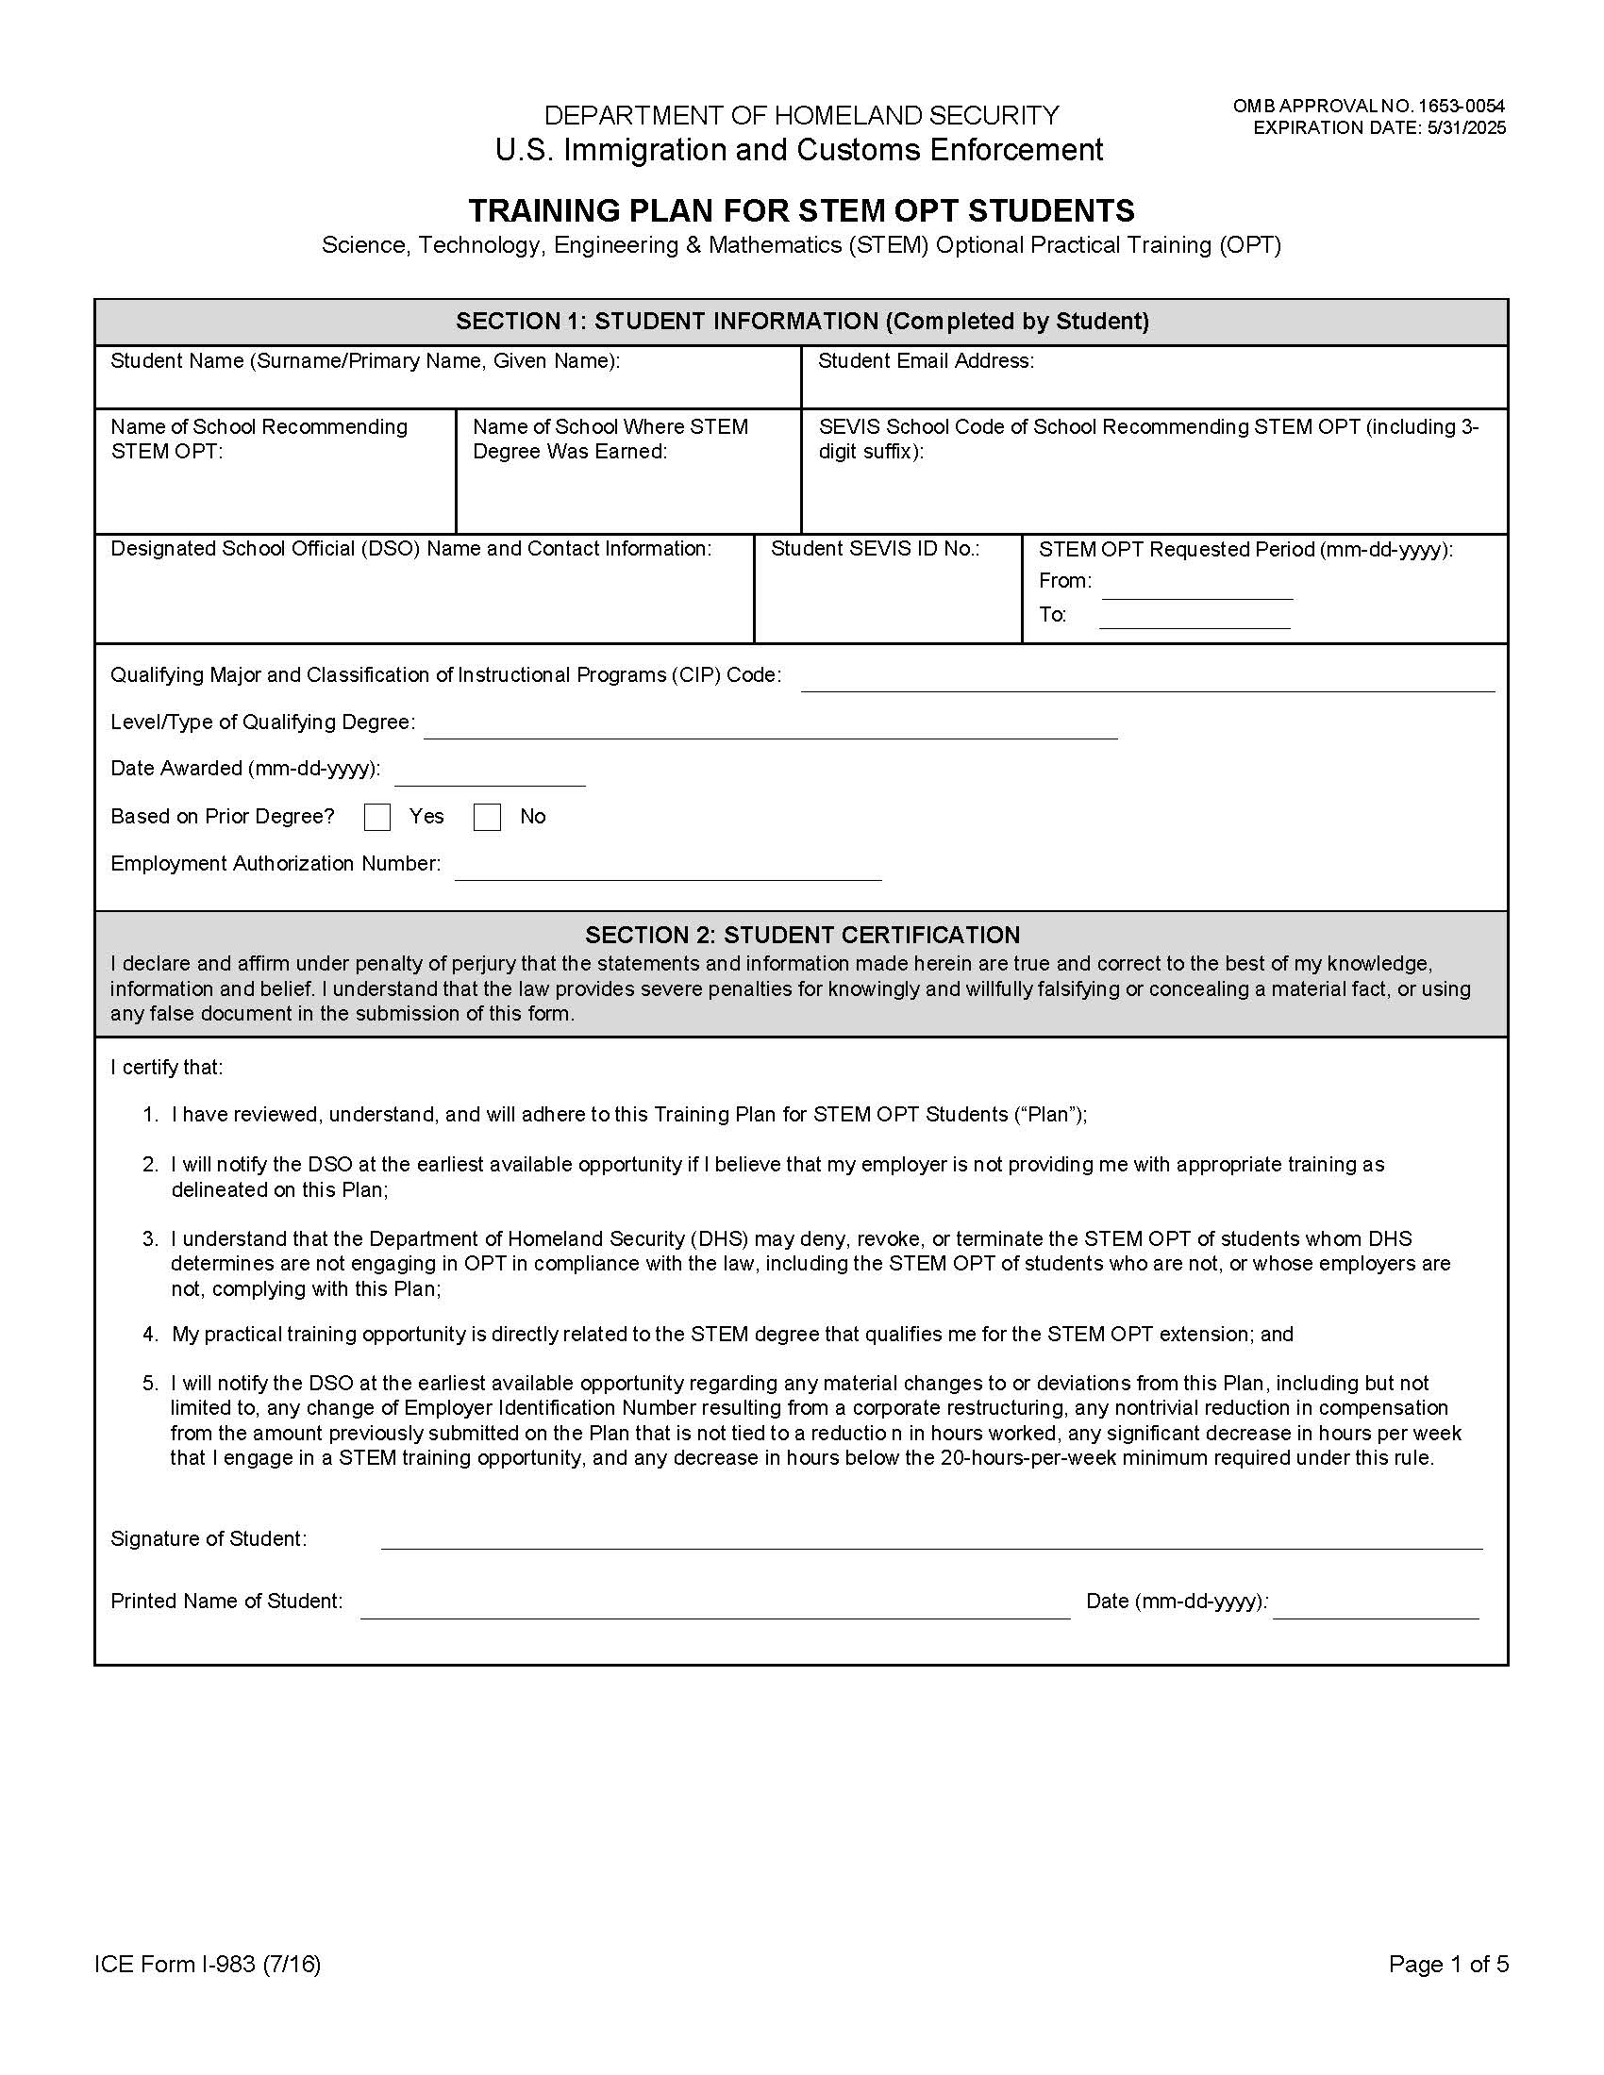
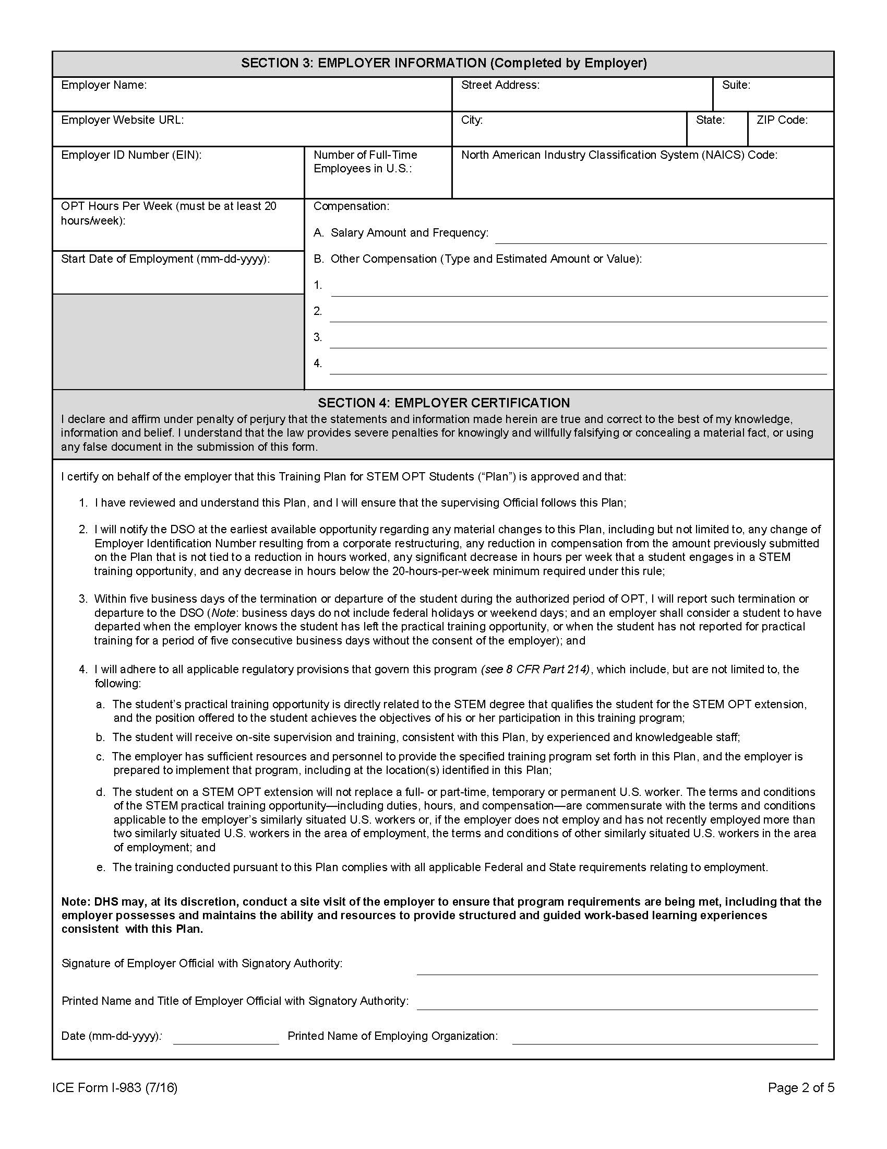
Completing the I-983
Section 1
Section 3
The STEM OPT Requested start date will ALWAYS be the first day after your OPT End Date.
The STEM Authorization end date will be 2 years afterwards.
Use the example listed here.
Always download the most recent Form I-983
Use the Clemson school code found on the ﬁrst page of your I-20. Each Clemson campus has a unique school code, so it is important review your I-20 before completing this section.
If your STEM Degree is from a diﬀerent school (NOT Clemson), you will need to enter the name of the school where you obtained your STEM degree.
Enter DSO Information as shown
List your SEVIS ID as listed on Page 1 of your I-20.
List the name of your major AND the associated CIP Code as listed on your I-20.
Under certain circumstances, an F-1 student may use a STEM degree prior to their most recently-earned degree. This is a rare case and will most likely not apply to you.
Mark “No”.
We will discuss this further in the Online I-765 Filing Instructions slides.
List your graduation date
Your Employment Authorization Number is the USCIS# Listed on your most recent EAD Card.
Clemson DSO, is@clemson.edu, 864-656-3614
N00012121212
12/21/2023
12/20/2025
Industrial Engineering 14.1901
Master’s
12/20/2022
123-456-789

Slide 14
Completing the I-983
Section 1
Section 3
The STEM OPT Requested start date will ALWAYS be the first day after your OPT End Date.
The STEM Authorization end date will be 2 years afterwards.
Use the example listed here.
Always download the most recent Form I-983
Use the Clemson school code found on the ﬁrst page of your I-20. Each Clemson campus has a unique school code, so it is important review your I-20 before completing this section.
If your STEM Degree is from a diﬀerent school (NOT Clemson), you will need to enter the name of the school where you obtained your STEM degree.
Enter DSO Information as shown
List your SEVIS ID as listed on Page 1 of your I-20.
List the name of your major AND the associated CIP Code as listed on your I-20.
Under certain circumstances, an F-1 student may use a STEM degree prior to their most recently-earned degree. This is a rare case and will most likely not apply to you.
Mark “No”.
We will discuss this further in the Online I-765 Filing Instructions slides.
List your graduation date
Your Employment Authorization Number is the USCIS# Listed on your most recent EAD Card.
Clemson DSO, is@clemson.edu, 864-656-3614
N00012121212
12/21/2023
12/20/2025
Industrial Engineering 14.1901
Master’s
12/20/2022
123-456-789

Slide 15
Completing the I-983
Section 1
Section 3
The STEM OPT Requested start date will ALWAYS be the first day after your OPT End Date.
The STEM Authorization end date will be 2 years afterwards.
Use the example listed here.
Always download the most recent Form I-983
Use the Clemson school code found on the ﬁrst page of your I-20. Each Clemson campus has a unique school code, so it is important review your I-20 before completing this section.
If your STEM Degree was from a diﬀerent school (NOT Clemson), you will need to enter the name of the school where you obtained your STEM degree.
In most cases, you will still write Clemson University in this section.
Enter DSO Information as shown
List your SEVIS ID as listed on Page 1 of your I-20.
List the name of your major AND the associated CIP Code as listed on your I-20.
Under certain circumstances, an F-1 student may use a STEM degree prior to their most recently-earned degree. This is a rare case and will most likely not apply to you.
Mark “No”.
We will discuss this further in the Online I-765 Filing Instructions slides.
List your graduation date
Your Employment Authorization Number is the USCIS# Listed on your most recent EAD Card.
Clemson DSO, is@clemson.edu, 864-656-3614
N00012121212
12/21/2023
12/20/2025
Industrial Engineering 14.1901
Master’s
12/20/2022
123-456-789

Slide 16
Completing the I-983
Section 1
Section 3
The STEM OPT Requested start date will ALWAYS be the first day after your OPT End Date.
The STEM Authorization end date will be 2 years afterwards.
Use the example listed here.
Always download the most recent Form I-983
Use the Clemson school code found on the ﬁrst page of your I-20. Each Clemson campus has a unique school code, so it is important review your I-20 before completing this section.
If your STEM Degree is from a diﬀerent school (NOT Clemson), you will need to enter the name of the school where you obtained your STEM degree.
Enter DSO Information as shown
List your SEVIS ID as listed on Page 1 of your I-20.
List the name of your major AND the associated CIP Code as listed on your I-20.
Under certain circumstances, an F-1 student may use a STEM degree prior to their most recently-earned degree. This is a rare case and will most likely not apply to you.
Mark “No”.
We will discuss this further in the Online I-765 Filing Instructions slides.
List your graduation date
Your Employment Authorization Number is the USCIS# Listed on your most recent EAD Card.
Clemson DSO, is@clemson.edu, 864-656-3614
N00012121212
12/21/2023
12/20/2025
Industrial Engineering 14.1901
Master’s
12/20/2022
123-456-789

Slide 17
Completing the I-983
Section 1
Section 3
The STEM OPT Requested start date will ALWAYS be the first day after your OPT End Date.
The STEM Authorization end date will be 2 years afterwards.
Use the example listed here.
Always download the most recent Form I-983
Use the Clemson school code found on the ﬁrst page of your I-20. Each Clemson campus has a unique school code, so it is important review your I-20 before completing this section.
If your STEM Degree is from a diﬀerent school (NOT Clemson), you will need to enter the name of the school where you obtained your STEM degree.
Enter DSO Information as shown
List your SEVIS ID as listed on Page 1 of your I-20.
List the name of your major AND the associated CIP Code as listed on your I-20.
Under certain circumstances, an F-1 student may use a STEM degree prior to their most recently-earned degree. This is a rare case and will most likely not apply to you.
Mark “No”.
We will discuss this further in the Online I-765 Filing Instructions slides.
List your graduation date
Your Employment Authorization Number is the USCIS# Listed on your most recent EAD Card.
Clemson DSO, is@clemson.edu, 864-656-3614
N00012121212
12/21/2023
12/20/2025
Industrial Engineering 14.1901
Master’s
12/20/2022
123-456-789

Slide 18
Completing the I-983
Section 1
Section 3
The STEM OPT Requested start date will ALWAYS be the first day after your OPT End Date.
The STEM Authorization end date will be 2 years afterwards.
Use the example listed here.
Always download the most recent Form I-983
Use the Clemson school code found on the ﬁrst page of your I-20. Each Clemson campus has a unique school code, so it is important review your I-20 before completing this section.
If your STEM Degree is from a diﬀerent school (NOT Clemson), you will need to enter the name of the school where you obtained your STEM degree.
Enter DSO Information as shown
List your SEVIS ID as listed on Page 1 of your I-20.
List the name of your major AND the associated CIP Code as listed on your I-20.
Under certain circumstances, an F-1 student may use a STEM degree prior to their most recently-earned degree. This is a rare case and will most likely not apply to you.
Mark “No”.
We will discuss this further in the Online I-765 Filing Instructions slides.
List your graduation date
Your Employment Authorization Number is the USCIS# Listed on your most recent EAD Card.
Clemson DSO, is@clemson.edu, 864-656-3614
N00012121212
12/21/2023
12/20/2025
Industrial Engineering 14.1901
Master’s
12/20/2022
123-456-789

Slide 19
Completing the I-983
Section 1
Section 3
The STEM OPT Requested start date will ALWAYS be the first day after your OPT End Date.
The STEM Authorization end date will be 2 years afterwards.
Use the example listed here.
Always download the most recent Form I-983
Use the Clemson school code found on the ﬁrst page of your I-20. Each Clemson campus has a unique school code, so it is important review your I-20 before completing this section.
If your STEM Degree is from a diﬀerent school (NOT Clemson), you will need to enter the name of the school where you obtained your STEM degree.
Enter DSO Information as shown
List your SEVIS ID as listed on Page 1 of your I-20.
List the name of your major AND the associated CIP Code as listed on your I-20.
Under certain circumstances, an F-1 student may use a STEM degree prior to their most recently-earned degree. This is a rare case and will most likely not apply to you.
Mark “No”.
We will discuss this further in the Online I-765 Filing Instructions slides.
List your graduation date
Your Employment Authorization Number is the USCIS# Listed on your most recent EAD Card.
Clemson DSO, is@clemson.edu, 864-656-3614
N00012121212
12/21/2023
12/20/2025
Industrial Engineering 14.1901
Master’s
12/20/2022
123-456-789

Slide 20
Completing the I-983
Section 1
Section 3
The STEM OPT Requested start date will ALWAYS be the first day after your OPT End Date.
The STEM Authorization end date will be 2 years afterwards.
Use the example listed here.
Always download the most recent Form I-983
Use the Clemson school code found on the ﬁrst page of your I-20. Each Clemson campus has a unique school code, so it is important review your I-20 before completing this section.
If your STEM Degree is from a diﬀerent school (NOT Clemson), you will need to enter the name of the school where you obtained your STEM degree.
Enter DSO Information as shown
List your SEVIS ID as listed on Page 1 of your I-20.
List the name of your major AND the associated CIP Code as listed on your I-20.
Under certain circumstances, an F-1 student may use a STEM degree prior to their most recently-earned degree. This is a rare case and will most likely not apply to you.
Mark “No”.
We will discuss this further in the Online I-765 Filing Instructions slides.
List your graduation date
Your Employment Authorization Number is the USCIS# Listed on your most recent EAD Card.
Clemson DSO, is@clemson.edu, 864-656-3614
N00012121212
12/21/2023
12/20/2025
Industrial Engineering 14.1901
Master’s
12/20/2022
123-456-789

Slide 21
Completing the I-983
Section 1
Section 3
The STEM OPT Requested start date will ALWAYS be the first day after your OPT End Date.
The STEM Authorization end date will be 2 years afterwards.
Use the example listed here.
Always download the most recent Form I-983
Use the Clemson school code found on the ﬁrst page of your I-20. Each Clemson campus has a unique school code, so it is important review your I-20 before completing this section.
If your STEM Degree is from a diﬀerent school (NOT Clemson), you will need to enter the name of the school where you obtained your STEM degree.
Enter DSO Information as shown
List your SEVIS ID as listed on Page 1 of your I-20.
List the name of your major AND the associated CIP Code as listed on your I-20.
Under certain circumstances, an F-1 student may use a STEM degree prior to their most recently-earned degree. This is a rare case and will most likely not apply to you.
Mark “No”.
We will discuss this further in the Online I-765 Filing Instructions slides.
List your graduation date
Your Employment Authorization Number is the USCIS# Listed on your most recent EAD Card.
Clemson DSO, is@clemson.edu, 864-656-3614
N00012121212
12/21/2023
12/20/2025
Industrial Engineering 14.1901
Master’s
12/20/2022
123-456-789

Slide 22
Completing the I-983
Section 1
Section 3
The STEM OPT Requested start date will ALWAYS be the first day after your OPT End Date.
The STEM Authorization end date will be 2 years afterwards.
Use the example listed here.
Always download the most recent Form I-983
Use the Clemson school code found on the ﬁrst page of your I-20. Each Clemson campus has a unique school code, so it is important review your I-20 before completing this section.
If your STEM Degree is from a diﬀerent school (NOT Clemson), you will need to enter the name of the school where you obtained your STEM degree.
Enter DSO Information as shown
List your SEVIS ID as listed on Page 1 of your I-20.
List the name of your major AND the associated CIP Code as listed on your I-20.
Under certain circumstances, an F-1 student may use a STEM degree prior to their most recently-earned degree. This is a rare case and will most likely not apply to you.
Mark “No”.
We will discuss this further in the Online I-765 Filing Instructions slides.
List your graduation date
Your Employment Authorization Number is the USCIS# Listed on your most recent EAD Card.
Clemson DSO, is@clemson.edu, 864-656-3614
N00012121212
12/21/2023
12/20/2025
Industrial Engineering 14.1901
Master’s
12/20/2022
123-456-789

Slide 23
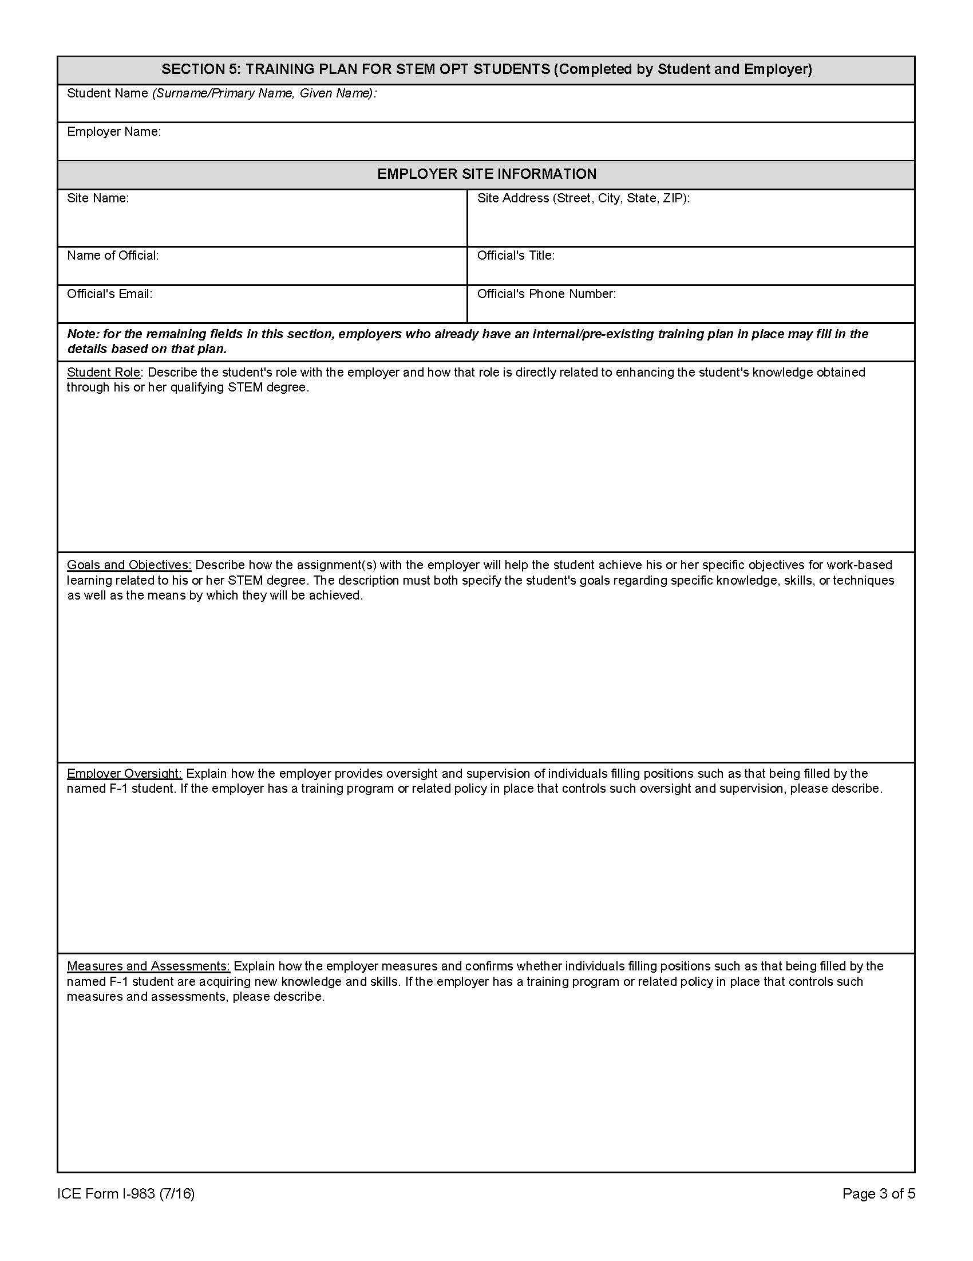
Completing the I-983
Section 4
Section 5
Section 3
This should be your employer’s mailing address or headquarters
The employer’s EIN, NAICS Code and E-Verify Number are 3 different numbers.
Contact your HR Department to get these numbers.
EIN and NAICS Code are listed on the I-983 while the E-Verify Number is to be listed on the I-765.
List your Employer’s name as listed in E-Verify System.
This refers to the start of your STEM OPT Training, NOT the general start date of employment with your company.
This should be on or after the Requested STEM OPT authorization start date
listed on page 1.
Enter the dollar amount of salary, stipend, and/or other compensation, and the frequency of pay (per hour, per week, bi‐weekly, monthly)
The Employer Official with Signatory Authority, is an appropriate individual in the employer’s organization who is familiar with the student’s goals and performance and has signatory authority for the employer, and should be the one to review the certification and affirm the statement with their signature. This may or may not be your direct supervisor.
$75,000 Annually
12/21/2023
$100 Monthly Phone Stipend

Slide 24
Completing the I-983
Section 4
Section 5
Section 3
This should be your employer’s mailing address or headquarters
The employer’s EIN, NAICS Code and E-Verify Number are 3 different numbers.
Contact your HR Department to get these numbers.
EIN and NAICS Code are listed on the I-983 while the E-Verify Number is to be listed on the I-765.
List your Employer’s name as listed in E-Verify System.
This refers to the start of your STEM OPT Training, NOT the general start date of employment with your company.
This should be on or after the Requested STEM OPT authorization start date
listed on page 1.
Enter the dollar amount of salary, stipend, and/or other compensation, and the frequency of pay (per hour, per week, bi‐weekly, monthly)
The Employer Official with Signatory Authority, is an appropriate individual in the employer’s organization who is familiar with the student’s goals and performance and has signatory authority for the employer, and should be the one to review the certification and affirm the statement with their signature. This may or may not be your direct supervisor.
$75,000 Annually
12/21/2023
$100 Monthly Phone Stipend

Slide 25
Completing the I-983
Section 4
Section 5
Section 3
This should be your employer’s mailing address or headquarters
The employer’s EIN, NAICS Code and E-Verify Number are 3 different numbers.
Contact your HR Department to get these numbers.
EIN and NAICS Code are listed on the I-983 while the E-Verify Number is to be listed on the I-765.
List your Employer’s name as listed in E-Verify System.
This refers to the start of your STEM OPT Training, NOT the general start date of employment with your company.
This should be on or after the Requested STEM OPT authorization start date
listed on page 1.
Enter the dollar amount of salary, stipend, and/or other compensation, and the frequency of pay (per hour, per week, bi‐weekly, monthly)
The Employer Official with Signatory Authority, is an appropriate individual in the employer’s organization who is familiar with the student’s goals and performance and has signatory authority for the employer, and should be the one to review the certification and affirm the statement with their signature. This may or may not be your direct supervisor.
$75,000 Annually
12/21/2023
$100 Monthly Phone Stipend

Slide 26
Completing the I-983
Section 4
Section 5
Section 3
This should be your employer’s mailing address or headquarters
The employer’s EIN, NAICS Code and E-Verify Number are 3 different numbers.
Contact your HR Department to get these numbers.
EIN and NAICS Code are listed on the I-983 while the E-Verify Number is to be listed on the I-765.
List your Employer’s name as listed in E-Verify System.
This refers to the start of your STEM OPT Training, NOT the general start date of employment with your company.
This should be on or after the Requested STEM OPT authorization start date
listed on page 1.
Enter the dollar amount of salary, stipend, and/or other compensation, and the frequency of pay (per hour, per week, bi‐weekly, monthly)
The Employer Official with Signatory Authority, is an appropriate individual in the employer’s organization who is familiar with the student’s goals and performance and has signatory authority for the employer, and should be the one to review the certification and affirm the statement with their signature. This may or may not be your direct supervisor.
$75,000 Annually
12/21/2023
$100 Monthly Phone Stipend

Slide 27
Completing the I-983
Section 4
Section 5
Section 3
This should be your employer’s mailing address or headquarters
The employer’s EIN, NAICS Code and E-Verify Number are 3 different numbers.
Contact your HR Department to get these numbers.
EIN and NAICS Code are listed on the I-983 while the E-Verify Number is to be listed on the I-765.
List your Employer’s name as listed in E-Verify System.
This refers to the start of your STEM OPT Training, NOT the general start date of employment with your company.
This should be on or after the Requested STEM OPT authorization start date
listed on page 1.
Enter the dollar amount of salary, stipend, and/or other compensation, and the frequency of pay (per hour, per week, bi‐weekly, monthly)
The Employer Official with Signatory Authority, is an appropriate individual in the employer’s organization who is familiar with the student’s goals and performance and has signatory authority for the employer, and should be the one to review the certification and affirm the statement with their signature. This may or may not be your direct supervisor.
$75,000 Annually
12/21/2023
$100 Monthly Phone Stipend

Slide 28
Completing the I-983
Section 4
Section 5
Section 3
This should be your employer’s mailing address or headquarters
The employer’s EIN, NAICS Code and E-Verify Number are 3 different numbers.
Contact your HR Department to get these numbers.
EIN and NAICS Code are listed on the I-983 while the E-Verify Number is to be listed on the I-765.
List your Employer’s name as listed in E-Verify System.
This refers to the start of your STEM OPT Training, NOT the general start date of employment with your company.
This should be on or after the Requested STEM OPT authorization start date
listed on page 1.
Enter the dollar amount of salary, stipend, and/or other compensation, and the frequency of pay (per hour, per week, bi‐weekly, monthly)
The Employer Official with Signatory Authority, is an appropriate individual in the employer’s organization who is familiar with the student’s goals and performance and has signatory authority for the employer, and should be the one to review the certification and affirm the statement with their signature. This may or may not be your direct supervisor.
$75,000 Annually
12/21/2023
$100 Monthly Phone Stipend

Slide 29
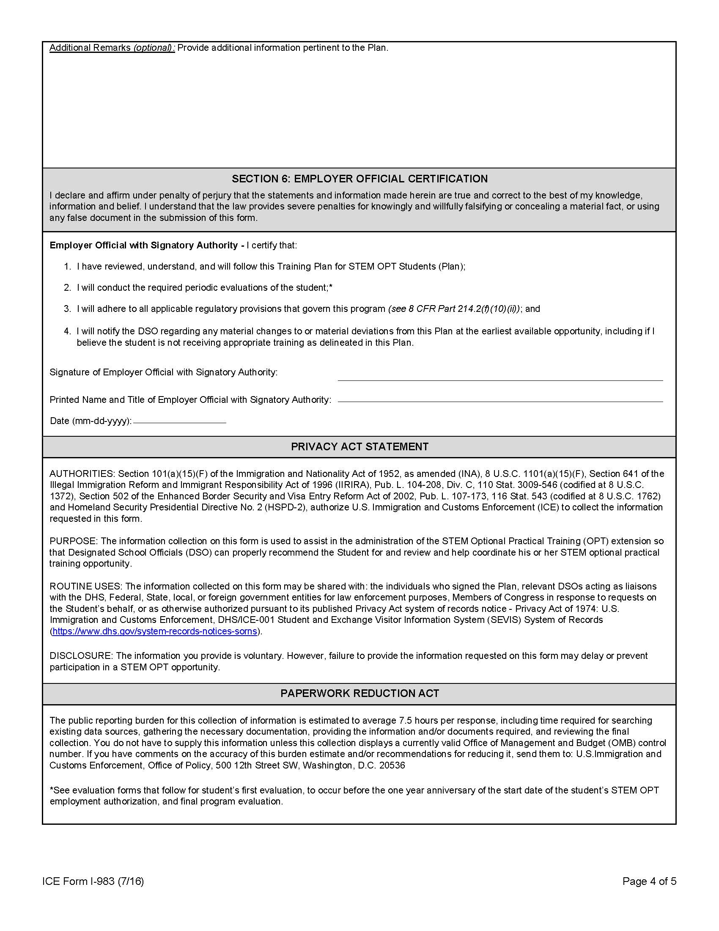
Completing the I-983
Section 5
Section 6
The individual who signs this section may be the same official who signed the Employer Certification in Section 4, or it may be another official. An employee with signatory authority for the employer should review the certification and affirm the statement with their signature.
Enter the Employer Name as listed in E-Verify. This should match the information you listed in Section 3.
The information listed in this box of Section 5 must match the information you list on the STEM Extension Request e-Form in your iStart Portal. This will be reflected in your SEVIS Record.
This may be either the same as the employer’s name in section three OR the name of the subsidiary or branch where you will be physically working.
List the physical site of employment where you will be going into work each day. This may be different from the company headquarters listed in Section 3.
This should be the name of your supervisor who is familiar with and will monitor your goals and performance. This person may be diﬀerent from the employer oﬃcial in section 4 of your I-983.
Notes:
Add info on section 6

Slide 30
Completing the I-983
Section 5
Section 6
The individual who signs this section may be the same official who signed the Employer Certification in Section 4, or it may be another official. An employee with signatory authority for the employer should review the certification and affirm the statement with their signature.
Enter the Employer Name as listed in E-Verify. This should match the information you listed in Section 3.
The information listed in this box of Section 5 must match the information you list on the STEM Extension Request e-Form in your iStart Portal. This will be reflected in your SEVIS Record.
This may be either the same as the employer’s name in section three OR the name of the subsidiary or branch where you will be physically working.
List the physical site of employment where you will be going into work each day. This may be different from the company headquarters listed in Section 3.
This should be the name of your supervisor who is familiar with and will monitor your goals and performance. This person may be diﬀerent from the employer oﬃcial in section 4 of your I-983.
Notes:
Add info on section 6

Slide 31
Completing the I-983
Section 5
Section 6
The individual who signs this section may be the same official who signed the Employer Certification in Section 4, or it may be another official. An employee with signatory authority for the employer should review the certification and affirm the statement with their signature.
Enter the Employer Name as listed in E-Verify. This should match the information you listed in Section 3.
The information listed in this box of Section 5 must match the information you list on the STEM Extension Request e-Form in your iStart Portal. This will be reflected in your SEVIS Record.
This may be either the same as the employer’s name in section three OR the name of the subsidiary or branch where you will be physically working.
List the physical site of employment where you will be going into work each day. This may be different from the company headquarters listed in Section 3.
This should be the name of your supervisor who is familiar with and will monitor your goals and performance. This person may be diﬀerent from the employer oﬃcial in section 4 of your I-983.
Notes:
Add info on section 6

Slide 32
Completing the I-983
Section 5
Section 6
The individual who signs this section may be the same official who signed the Employer Certification in Section 4, or it may be another official. An employee with signatory authority for the employer should review the certification and affirm the statement with their signature.
Enter the Employer Name as listed in E-Verify. This should match the information you listed in Section 3.
The information listed in this box of Section 5 must match the information you list on the STEM Extension Request e-Form in your iStart Portal. This will be reflected in your SEVIS Record.
This may be either the same as the employer’s name in section three OR the name of the subsidiary or branch where you will be physically working.
List the physical site of employment where you will be going into work each day. This may be different from the company headquarters listed in Section 3.
This should be the name of your supervisor who is familiar with and will monitor your goals and performance. This person may be diﬀerent from the employer oﬃcial in section 4 of your I-983.
Notes:
Add info on section 6

Slide 33
Completing the I-983
Section 5
Section 6
The individual who signs this section may be the same official who signed the Employer Certification in Section 4, or it may be another official. An employee with signatory authority for the employer should review the certification and affirm the statement with their signature.
Enter the Employer Name as listed in E-Verify. This should match the information you listed in Section 3.
The information listed in this box of Section 5 must match the information you list on the STEM Extension Request e-Form in your iStart Portal. This will be reflected in your SEVIS Record.
This may be either the same as the employer’s name in section three OR the name of the subsidiary or branch where you will be physically working.
List the physical site of employment where you will be going into work each day. This may be different from the company headquarters listed in Section 3.
This should be the name of your supervisor who is familiar with and will monitor your goals and performance. This person may be diﬀerent from the employer oﬃcial in section 4 of your I-983.
Notes:
Add info on section 6

Slide 34
Completing the I-983
Section 5
Section 6
The individual who signs this section may be the same official who signed the Employer Certification in Section 4, or it may be another official. An employee with signatory authority for the employer should review the certification and affirm the statement with their signature.
Enter the Employer Name as listed in E-Verify. This should match the information you listed in Section 3.
The information listed in this box of Section 5 must match the information you list on the STEM Extension Request e-Form in your iStart Portal. This will be reflected in your SEVIS Record.
This may be either the same as the employer’s name in section three OR the name of the subsidiary or branch where you will be physically working.
List the physical site of employment where you will be going into work each day. This may be different from the company headquarters listed in Section 3.
This should be the name of your supervisor who is familiar with and will monitor your goals and performance. This person may be diﬀerent from the employer oﬃcial in section 4 of your I-983.
Notes:
Add info on section 6

Slide 35
Online
Filing for STEM OPT Extension
Gathering your Application Materials
Filing the I-765 Online
Filing Benefits, Issues and RFEs

Slide 36
Filing I-765 Online
There are two options for submitting your STEM OPT application:
Filing Online: If you are submitting your application online you will complete the I-765 through the USCIS portal.
Filing through the mail: Not recommended.
Both submission options require the STEM OPT requested I-20 before filing with USCIS.
Return to top

Slide 37
Beneﬁts of Filing I-765 Online
It reduces the amount of applicant errors that may occur.
You receive updates on your application through the USCIS portal.
Your application is received by USCIS immediately.
It reduces delays and complication with mailing logistics.
You receive your receipt notice immediately upon submission of your application.
You can contact USCIS directly via the secure message center.
You can upload documents directly to your account.
You can respond to RFEs online instead of through the mail.
Return to top

Slide 38
Gathering Your Application Materials
Create a USCIS Online Account if you have not already and upload the documents below.
Do NOT submit your online application to USCIS until you receive your STEM OPT I-20 from our oﬃce.
One virtual U.S. passport-style photo
Form I-94
Previously issued EAD card(s) (both sides) or government-issued ID such as passport if you have not previously been issued an EAD
Copy of your oﬃcial or unoﬃcial transcript and degree certiﬁcate showing the level and program of study
Copy of I-20 Form requesting STEM OPT within 60 days of issuance. Ensure you review and sign your I-20!
Prepare funds for online payment of application fee.
Return to top

Slide 39
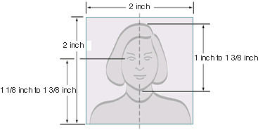
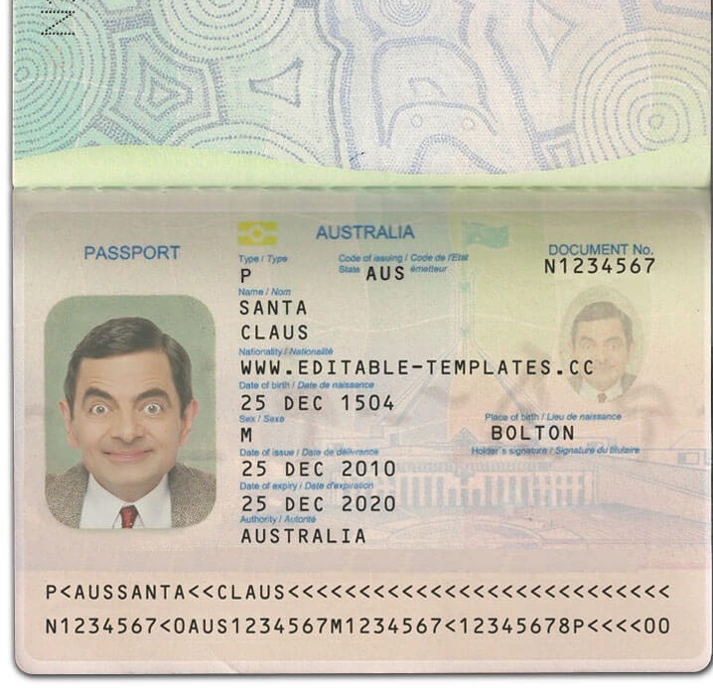
Passport Photos
This is referring to a passport style photo, not the biographical information page on your physical passport.
Return to top

Slide 40
Creating a USCIS Online Account
Please click here for the separate tutorial on creating your USCIS Online Account. Note this will be a copy of the slides from a USCIS Webinar presented during their initial release of the online filing option and may be outdated.
Return to top

Slide 41
Completing the I-765 Online
Eligibility Category:
Foreign nationals under various immigration statuses may file the I-765 online, based on certain eligibility categories.
For STEM OPT Extension:
Use code (c)(3)(C) STEM Extension
Return to top

Slide 42
Completing the I-765 Online
Premium Processing Option:
Not required
Guarantees a response within 30 days.
Does not guarantee an approval.
Additional cost of $1,500, subject to change.
May apply at a later time.
Return to top

Slide 43
Completing the I-765 Online
Required for STEM OPT:
Degree Level + Name,
Employer name as listed in E-Verify
Matching E-Verify Number
IMPORTANT: The EIN and NAICS Code are listed on I-983. The E-Verify Number is listed on I-765. ALL 3 NUMBERS ARE DIFFERENT.
Return to top

Slide 44
Completing the I-765 Online
Reason for Applying:
Initial permission to accept employment
Select that you have previously filed Form I-765
You will be asked to provide a copy of your Post-Completion OPT EAD Card later
Return to top

Slide 45
Completing the I-765 Online
Other Information:
Your A-Number is the USCIS # listed on your Post-Completion OPT EAD Card
Your USICS Online Account should be populated automatically if you have filed an application online previously.
Return to top

Slide 46
Completing the I-765 Online
Institution Accreditation is RARELY needed:
Under certain circumstances, an F-1 student may use a STEM degree that is prior to the one listed on your most recent I-20.
Please speak with an Advisor regarding this option.
You may skip this section on the I-765.
If you receive a pop-up warning, skip again and continue.
Return to top

Slide 47
Completing the I-765 Online
The most common reasons students complete the Additional Information Section:
Most recently entered the US on a passport that is no longer valid and you have a renewed passport.
Not having enough space on an item number to list the full response.
Return to top

Slide 48
Most Common Issues and RFEs
Rejection: A rejection occurs when USCIS cannot accept your STEM OPT application, most likely due to a payment error. In the case of a rejection, your payment will not be processed.
RFE: If there is a problem with your application, the USCIS may send you a notice by mail called a “Request for Evidence (RFE).” An RFE does not mean that your application has been rejected. It simply means that you need to send in additional documents before your EAD can be issued. Getting an RFE will delay the process of your application.
Denial: A denial occurs when your OPT application is sent to a Service Center for processing and the adjudicator discovers that you are ineligible for OPT. USCIS will process your payment for a denial.
It is at USCIS’s discretion to issue the student an RFE. The adjudicator may either issue and RFE or deny your application if there are errors or missing information.
If you receive an RFE, rejection, or denial, contact International Services immediately to determine what your next steps should be.
Return to top

Slide 49
Most Common Issues and RFEs
Application submitted late
The OPT application must be received by the USCIS before your OPT End-date.
Copy of OPT I-20 is too old or not provided
New applications: USCIS must receive you complete STEM OPT application no later than 60 days after the STEM OPT I-20 issue date on page 1 of the I-20
Your STEM Application will be denied if you do not provide your STEM OPT I-20.
Resubmission after OPT rejection or denial: If your OPT is rejected or denied please notify International Services. In some cases you will need to request a new OPT I-20 recommendation from International Services before you resubmit your OPT application. USCIS must receive your new, complete OPT re-application no later than 60 days after the OPT issue date on page 1 on the I-20
I-765 problems – MOST COMMON REASON:
E-Verify Number incorrect.
IMPORTANT: The EIN and NAICS Code are listed on I-983. The E-Verify Number is listed on I-765. ALL THREE NUMBERS ARE DIFFERENT.
Return to top

Slide 50
Maintaining Status on STEM OPT Extension
Pending STEM Extension Application
STEM OPT Reporting Requirements
Unemployment
International Travel
Renewing F-1 Visa

Slide 51
While STEM Application is Pending
If filed in timely manner, your employment authorization will automatically be extended for 180 days after your OPT EAD end date while your OPT STEM application is pending.
Can I change employers while my STEM Application is Pending? While permitted, it is risky and not recommended. If you still wish to change employers, please complete the following steps:
Speak with an IS Advisor FIRST.
Submit your STEM OPT Extension e-Form on you iStart Student Portal with your updated employment information.
We will issue a new I-20 Form for you with the updated employer’s information.
Provide a letter to USCIS explaining the reason for the update to your application along with a copy of the new I-20 Form. Your letter should include your receipt number so that USCIS can match the new documentation with your currently pending case.
Return to top

Slide 52
Maintaining Status: OPT Reporting Requirements
There are significantly more Reporting Requirements for STEM OPT compared to Post-Completion OPT:
A report is due every 6 months from the Start Date of your STEM Authorization Period, regardless of Employment Status or Employment Start Date.
Material Changes to I-983
Changing Employers
Reduction in compensation not tied to a reduction in hours worked.
Information listed on page 3, section 5 of the I-983 such as:
Your site of employment (where you go to work each day).
Name of official.
Job roles/responsibilities listed in boxes of same section.
Annual and Final Evaluations
Return to top

Slide 53
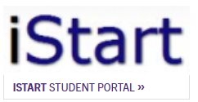
Maintaining Status: OPT Reporting Requirements
You will receive periodic reminders from SEVP (do-not-reply.SEVP@ice.dhs.gov).
This is NOT A SCAM!
The SEVP Portal is only used to view and update your address and contact information.
You cannot submit your Validation Report through your SEVP Portal.
All Reports are made through the STEM Reporting e-Forms group within the F-1 Practical Training tab in the iStart Portal.
Return to top

Slide 54
Maintaining Status: OPT Reporting Requirements 6-Month Validation Reports
STEM OPT students must submit a validation report to International Services every six months starting from the date the 24-month extension begins and ending when the student’s F-1 status ends.
4 validations in total over 24-month OPT STEM Extension time.
Check your STEM OPT start date and mark your calendar for each 6-month interval of your STEM Extension for your reporting deadlines.
Students on STEM OPT have a 10-day grace period to submit their validation reports.
Return to top

Slide 55
Maintaining Status: OPT Reporting Requirements Material Changes to I-983:
Change in employer address or supervisor.
Any change of the employer’s Employer Identiﬁcation Number, (i.e., the company’s Federal Tax ID number) resulting from a change in the employer’s ownership or structure.
Any reduction in your compensation that is not tied to a reduction in hours worked.
Any signiﬁcant decrease in hours per week that you engage in a STEM training opportunity.
Changes to the employer’s commitments or your learning objectives as documented on the Form I-983.
Return to top

Slide 56
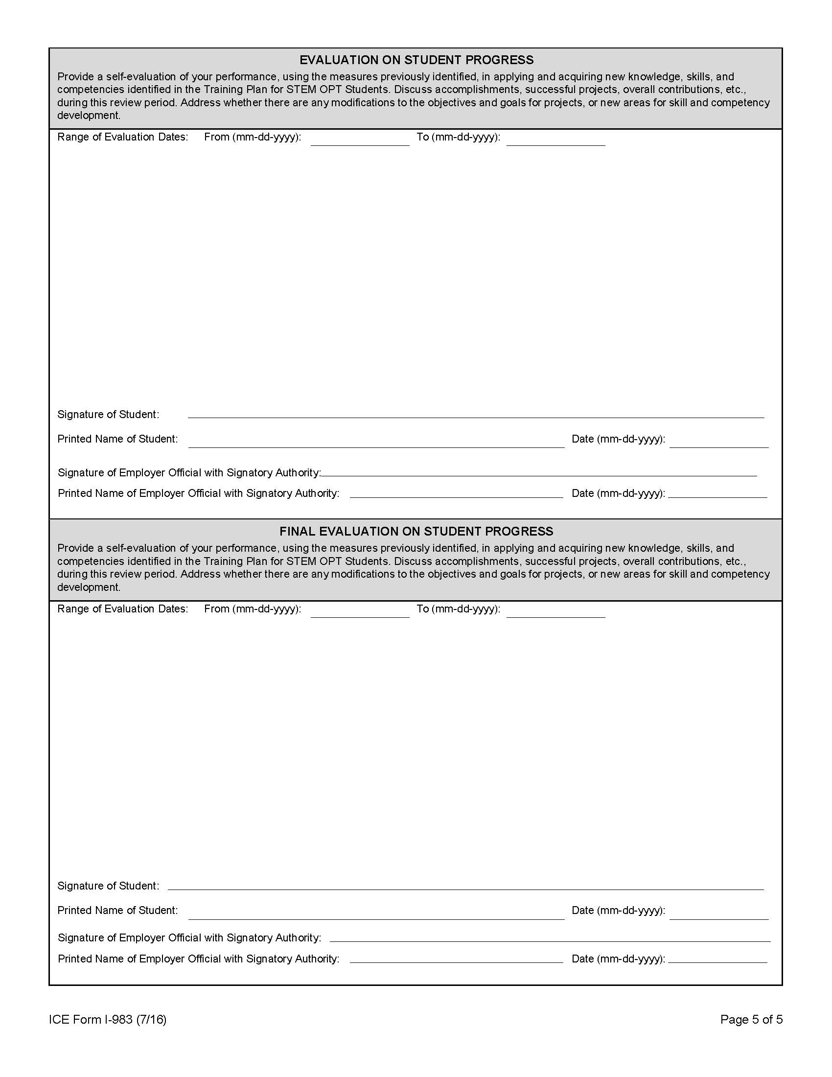
Maintaining Status: OPT Reporting Requirements Annual Evaluations
Maintaining Status: OPT Reporting Requirements Final
The annual evaluation is to be completed after one year on the STEM extension. Students are expected to submit their evaluation, validate their employer information, and upload a receipt of the Annual STEM OPT Fee of $200 to International Services via the STEM OPT Employment Update e-Form in order to meet this reporting requirement.
The ﬁnal evaluation will be due in the following situations:
At the end of your two years of STEM OPT
When ending employment with an employer (termination or changing employers).
When changing to another status and ending your F-1 STEM OPT (H1-B or other status).

Slide 57
Maintaining Status: OPT Reporting Requirements Annual Evaluations
Maintaining Status: OPT Reporting Requirements Final
The annual evaluation is to be completed after one year on the STEM extension. Students are expected to submit their evaluation, validate their employer information, and upload a receipt of the Annual STEM OPT Fee of $200 to International Services via the STEM OPT Employment Update e-Form in order to meet this reporting requirement.
The ﬁnal evaluation will be due in the following situations:
At the end of your two years of STEM OPT
When ending employment with an employer (termination or changing employers).
When changing to another status and ending your F-1 STEM OPT (H1-B or other status).

Slide 58
Maintaining Status: OPT Reporting Requirements Unemployment
STEM OPT students are required to report the termination of their practical training experience within 10 days of the event regardless of whether or not new employment has been obtained.
Federal regulations limit unemployment while on Optional Practical Training. Students who are granted a 24-month STEM OPT extension are allowed an additional 60 days of unemployment beyond the initial post-completion OPT limit of 90 days. This means that students who receive an approved 24-month STEM OPT extension will receive a total of 150 days of allowable unemployment, 90 days during the initial period of post-completion OPT plus an additional 60 days during the extension period.
Return to top

Slide 59
Maintaining Status: OPT Reporting Requirements Unemployment
Your OPT and your F-1 status may be terminated if:
Students who have accrued more than 150 days of unemployment during STEM extension OPT period.
Failure to submit 6-Month Validation Report in time.
This is considered a negative termination. To avoid your SEVIS record being auto-terminated, you should depart the U.S. before exceeding your unemployment days and submit the Departure Veriﬁcation e-form in the iStart Portal.
Return to top

Slide 60
Maintaining Status: OPT Reporting Requirements Reporting Timeline Example
Post-Completion OPT End Date January 14, 2024
STEM OPT Extension Start Date of January 15, 2024
DUE DATE | ITEM DUE
July 15, 2024 | 6-Month Validation Report Due
January 14, 2025 | 12-Month Validation Annual Evaluation Report Due (first box on last page of I-983) Annual $200 STEM OPT Fee.
July 15, 2025 | 18-Month Validation Report Due
January 14, 2026 | 24-Month Validation Report Final Evaluation Report Due (second box on last page of I-983).
Return to top

Slide 61
Traveling on STEM OPT
Travel after program completion, but before the EAD card is received
There is a higher risk associated with travel and return while your STEM OPT is pending after the program completion date. If there are any problems with your application, you may not be able to respond to USCIS in a timely manner, which could delay processing of your EAD.
If your STEM OPT application is denied while outside the U.S., you will not be able to re-enter the U.S. in F-1 status and will not be able to re-apply for OPT.
Travel after the EAD card is received
Avoid long absences from the U.S. during the STEM OPT period. Time spent outside of the U.S. while unemployed by a U.S. employer counts toward your 90 days of unemployment.
Attempting to re-enter the U.S. close to the expiration date of your STEM OPT can be risky.
You must not enter the U.S. in a status other than F-1. This may result in the loss of your OPT eligibility.
Return to top

Slide 62
Maintaining Status: International Travel
We recommend you provide all four items below to re-enter the US after a temporary departure:
Non-expired F-1 visa
I-20 with OPT approval on page 2 & a travel signature no older than 6 months
Employment Authorization Document (EAD) card
Job oﬀer letter or continuing employment letter
Return to top

Slide 63
Renewing Your Visa on OPT
If you are traveling abroad and your F-1 visa has expired, you must obtain a new F-1 visa before returning to the U.S. When going to your visa interview bring the documents below.
Valid passport (at least 6 months in the future)
Valid STEM OPT I-20 with a travel signature from within the last 6 months
STEM EAD card
Proof of current STEM OPT employment
Evidence of suﬀicient funds
Any additional documentation as required by US Consulate.
Return to top

Slide 64
Fraudulent Reporting
It is important that the employment information reported in the iStart Portal is true and accurate since it will be recorded in SEVIS.
Reporting fraudulent information can have a negative impact on your immgration record including possible SEVIS record termination.
Return to top

Slide 65
Completing STEM Extension Period
Changing Status to H1-B
Cap-Gap Extension
After STEM OPT and Grace Period

Slide 66
Changing Status to H1-B
While on Post-Completion OPT
Filing for H1-B and STEM Extension at the same time:
Permitted but may cause complications in your SEVIS record – consult with immigration attorney.
If you file for both, you must still file for a STEM OPT Extension before your OPT EAD expires, even if Cap-Gap Extension has already been applied to record (see next slide).
Must submit Departure Verification e-Form under the International Office tab in your iStart Portal, when approved for COS.
While on STEM Extension OPT
Considerations for Changing to H1-B while on STEM Extension:
Must submit Departure Verification e-Form under the International Office tab in your iStart Portal, when approved for COS.
If any of your periodic Validation Reports are due within 30 days of your COS effective date, you must submit the Departure Verification e-Form beforehand.
Final Evaluation will still be needed, regardless of employment timeline.
Return to top

Slide 67
Cap-Gap Extension
This extends your employment authorization beyond its current expiration date until your Change of Status effective date occurs.
Eligibility:
Students whose sponsoring employer is Cap-Subject:
higher education institutions
non-profit organizations that are associated with a higher education institution
non-profit research organizations
government organizations
Students whose petition was filed as Change of Status NOT Consular Processing.
Consular Processing requires you to depart the US, obtain the Visa stamp, and return under your new Visa category.
You will be maintaining F-1 Status and STEM Reporting requirements until you re-enter.
Return to top

Slide 68
After STEM OPT and Grace Period
60 day grace period to depart the U.S. after the STEM OPT end date
Not eligible to work after STEM OPT end date
Transfer to new degree program
If transferring before STEM OPT EAD end date, authorization ends on the SEVIS transfer release date.
Begin a new degree program at Clemson University
Submit an I-20 Amendment e-Form in your iStart Portal, requesting a Change of Education Level.
Change of Status
Remember to maintain Reporting Requirements
Return to top

Slide 69
Please contact our office if you have any questions
is@clemson.edu
864-656-3614
Schedule an Advising Appointment HERE

