Slide 1

Safe and Ethical Use of Artificial Intelligence (AI) in Research
Safe and Ethical Use of Artificial Intelligence (AI) in Research
Office of Research Development
Friday, March 26, 2026

Slide 2

Agenda
ORD Reminder
Goals of the Workshop
Perspective of Research Integrity
ERA
Pre-Workshop Survey Results
Group Discussion

Slide 3
ORD Overview
Faculty
Support
Institutional
Advancement
Funding Landscape
Offer early career training (CAREER Academy, NIH Accelerator)
Provide proposal development support
Run workshops/info sessions
Manage R-Initiative funding opportunities
Provide networking opportunities such as TigerSphere
Manage proposal repository
Support CU mission and Clemson Elevate goals for research
Build highly effective interdisciplinary teams for large grant proposals
Position Clemson to leverage its strengths to enhance its research portfolio
Coordinate with research development staff across campus to achieve synergies
Monitor changes in agency priorities and programs
Strategically position faculty to be more competitive in a constantly shifting grants environment
Administer limited submissions process
Foster nimbleness in faculty responses to funding opportunities

Slide 4

Workshop Goals
Not meant to scare you!
Latest guidelines
Varying perspectives
Open dialogue and exchange

Slide 5
Perspective of ResEarch Integrity
Robin Tyndall
Director, office of research compliance
Research integrity officer

Slide 6
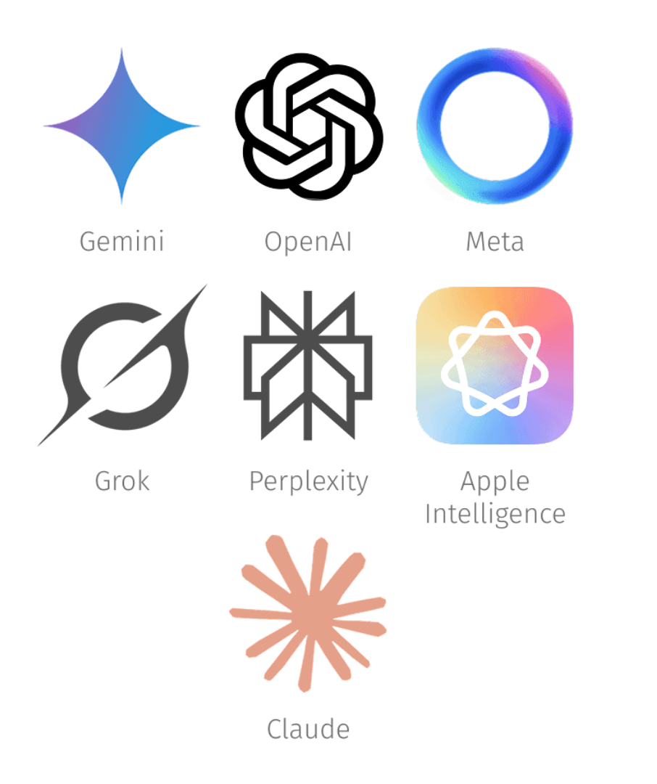
Considerations
Sponsor restrictions
Exposure of your unpublished data/Intellectual property
Publisher requirements
Commitments to human subjects
Other considerations
Allegations of misconduct

Slide 7

Sponsor restrictions - NIH
NIH: Supporting Fairness and Originality in NIH Research Applications
NIH will not consider applications that are either substantially developed by AI, or contain sections substantially developed by AI, to be original ideas of applicants.
If the detection of AI is identified post award, NIH may refer the matter to the Office of Research Integrity to determine whether there is research misconduct while simultaneously taking enforcement actions including but not limited to disallowing costs, withholding future awards, wholly or in part suspending the grant, and possible termination.

Slide 8

Sponsor restrictions - NSF
NSF: Notice to research community: Use of generative artificial intelligence technology in the NSF merit review process | NSF - U.S. National Science Foundation
To safeguard the integrity of the development and evaluation of proposals in the merit review process, this memo establishes guidelines for its use by reviewers and proposers:
  NSF reviewers are prohibited from uploading any content from proposals, review information and related records to non-approved generative AI tools.
  Proposers are encouraged to indicate in the project description the extent to which, if any, generative AI technology was used and how it was used to develop their proposal.

Slide 9
Unpublished data and Intellectual Property
Using a non-Clemson approved public AI tool for data analysis is essentially dumping your unpublished data in the public domain
  Your data could be referenced by the same AI tool (with model training) or a third-party tool (even with model training disabled) for another user.
  Could your data be used in someone else’s publication without your consent?
  IP rights could be nullified.
  You could violate sponsor/collaborator requirements.
  You could violate you Data Management Plan conditions.
Clemson guidance: Academic and Research AI Usage Quick Guide

Slide 10
Publisher requirements
Elsevier: Generative AI policies for journals
  “Authors should disclose the use of AI Tools for manuscript preparation in a separate AI declaration statement in their manuscript upon submission and a statement will appear in the published work.”
IEEE: Author Guidelines for Artificial Intelligence (AI)-Generated Text - IEEE Open
  “The use of content generated by artificial intelligence (AI) in an article (including but not limited to text, figures, images, and code) shall be disclosed in the acknowledgments section of any article submitted to an IEEE publication.”
Nature: Artificial Intelligence (AI) | Nature Portfolio
  “Use of an LLM should be properly documented in the Methods section (and if a Methods section is not available, in a suitable alternative part) of the manuscript.”
  “While legal issues relating to AI-generated images and videos remain broadly unresolved, Springer Nature journals are unable to permit its use for publication.”

Slide 11

Commitments to human subjects
If you conduct research with human subjects,
You collect private, identifiable information from living persons, or
You work with data specimens or data sets that contain personal identifiers
you were subject to IRB review. Persons likely consented to providing their data to you or you provided a Data Use Agreement for access.
What did you commit to them regarding privacy/ confidentiality?
Will the use of AI to analyze their data violate that commitment?
Risk of noncompliance
Risk of data breach
Risk of participant complaint
This Photo by Unknown Author is licensed under CC BY-SA-NC
Notes:
If you conduct research with human subjects (you collect private, identifiable information from living persons or you work with data specimens or data sets that contain personal identifiers), you were subject to IRB review. Persons likely consented to providing their data to you or you provided a Data Use Agreement for access. What did you commit to them regarding privacy/confidentiality? Will the use of AI to analyze their data violate that commitment? There is are risks of noncompliance, data breach, and/or participant complaint.

Slide 12
Other considerations
Reproducibility of processes/results.
  How will you show how you arrived at your results if you were questioned?
2. Animal rights groups are mining public data to identify data points for ramping up activism.
  Clemson is on the receiving end of FOIA requests
  Will your unpublished data show up in a query?
3. Are all collaborators on the project in agreement for the use of AI?

Slide 13

Research Misconduct
Fabrication
Falsification
Plagiarism
in proposing, performing, or reviewing research
or in reporting research results
This Photo by Unknown Author is licensed under CC BY

Slide 14

Definition of Research Misconduct
RESEARCH MISCONDUCT means fabrication, falsification, or plagiarism, whether committed by an individual directly or through the use or assistance of other persons, entities, or tools, including artificial intelligence (AI)-based tools, in proposing or performing research funded by NSF, reviewing research proposals submitted to NSF, or in reporting research results funded by NSF.
This Photo by Unknown Author is licensed under CC BY
Notes:
Remember what th

Slide 15

Research Misconduct Definitions
Research Misconduct
Fabrication is making up data or results or recording or reporting made-up data or results.
Falsification is manipulating research materials, equipment, or processes, or changing or omitting data or results such that the research is not accurately represented in the research record.
Plagiarism is the appropriation of another person’s ideas, processes, results, or words without giving appropriate credit.
- CU Policy

Slide 16
Integrity review
An allegation that a text was written by AI is not an allegation of misconduct, BUT
  Did it hallucinate citations/images/data?
  Is there an indication text was lifted from something without credit?
If you claim to have written it, you can be accused of misconduct.
iThenticate scans for plagiarism
ImageTwin scans for plagiarism/falsification
  AI detection is an additional scan
  Confidence level is my starting point

Slide 17
Summary
Use Clemson approved AI tools as default
Disclose to appropriate parties
  Sponsors
  Collaborators
  Human participants
Be familiar with Clemson’s guidance on appropriate use of AI Academic and Research AI Usage Quick Guide
Stay current on policies and guidance issued by University

Slide 18
AI Guidelines and Survey Questions Addressed
Mike Bryant
Daniel Harris
ERA, Division of Research

Slide 19
CU Data Classification and Approved AI Use Chart

Slide 20
Clemson Guidance on AI Use
Use Clemson guidance in this order:
  Classify the data
  Confirm the AI tool is approved for that data type and use case
  Apply any tighter sponsor, IRB, journal, export control, or contract rules

Slide 21
CU Data Classification Chart
CU class | Typical examples | AI use signal | Note
Public | Published research data Public-facing web content Public policies/maps | Generally allowed in public AI tools or Clemson-approved tools Still verify outputs and avoid unnecessary identifiers | Lower risk Good for brainstorming, summarizing public docs, agendas/templates
Internal Use | Non-public policies or training Internal emails, memos, budgets, reports Unpublished research data at owner discretion | Use only in Clemson-approved services if approved for that data type Minimize details; remove identifiers when possible | Do not paste into public AI tools Proposal drafts often fall here or higher
Confidential | PII, addresses, personal contacts HR records Identified survey/assessment data | Use with caution and only in explicitly approved Clemson environments Confirm retention, access controls, and training protections | High sponsor/IP/reputation risk When unsure, stop and check before using AI
Restricted | FERPA, PHI, CUI Export-controlled data SSNs, payment/bank data, passport/visa data | Assume no AI use unless explicitly approved Public tools are not appropriate | Highest risk Includes many regulated and contract-restricted research contexts

Slide 22
Bottom Line for Faculty
Use AI freely only with Public information or in explicitly approved Clemson environments for the relevant data type
Do not paste proposal text, unpublished results, sponsor-restricted material, human subjects data, or export-controlled information into public AI tools
For research and proposal work, the stricter rule wins: sponsor terms, IRB, journal rules, contracts, and export controls override general AI guidance
Ask before using AI:
  What is the data classification?
  Is the tool Clemson-approved for that data type?
  Do sponsor, IRB, export control, or IP terms add tighter limits?

Slide 23

Pre-Workshop Survey
Purpose: to assess how faculty/staff are using AI in the research process, what tools they’re using, what challenges/opportunities they’ve come across
18 responses

Slide 24
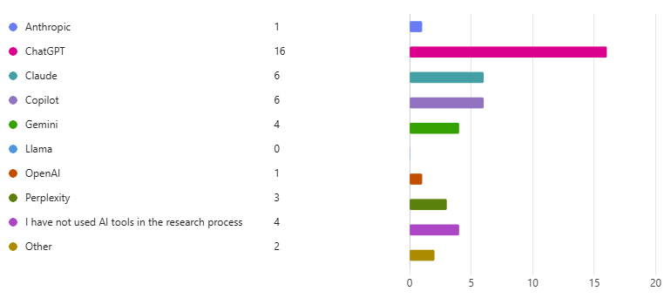
Tools Used
  ChatGPT
  Claude
  Copilot

Slide 25
AI Use
Concentrated in support tasks, not core methodological work:
  Editing documents, idea generation, and literature review
Next most common applied use is data analysis
Coding, proposal preparation, creating presentations, and writing manuscripts
More advanced uses like study design and survey/interview design are rare
  Suggests adoption is still mostly at the assistant/support level

Slide 26
AI Challenges
The biggest challenge is reliability:
  Hallucinations, inaccuracies, or fake/mismatched citations/references
Next is uncertainty about safe, ethical, and effective use:
  Not knowing the boundaries or best practices
Concerns beyond tool quality to research culture and education:
  Worry about student learning, overreliance, and broader social effects
A few mention workflow fit/usability issues:
  Not liking the tool experience or struggling to interpret AI-generated statistical suggestions
Little evidence that respondents see AI as “plug-and-play”:
  Still want/need guardrails and judgment

Slide 27
AI in Research Opportunities
Speed and efficiency:
  Time savings, faster searching/synthesis, or streamlining administrative work
Writing support is the next major benefit:
  Editing, drafting, idea generation, or manuscript improvement
Literature review/search:
  Finding related work faster
Data analysis, coding, and qualitative-data pattern finding/visualization
Still hesitation around ethics or disciplinary fit, especially in fields where AI feels less useful or less accepted

Slide 28

AI in Research Wishes…
Simplify/automate administrative tasks
Handle tasks involving manual repetition and aren’t dependent on critical thinking
Help with references/citations
Data simulation
Help ensure validity of research output
Not hallucinate
Training/discoverability gap: “I don’t know what I don’t know”

Slide 29
Anything Else About Use of AI in Research…
Different platforms are more suited for different tasks and purposes
Concerns regarding how to use AI ethically/responsibly
Concerns that AI tools are taking away from the learning process in favor of a “quick fix”
How to acknowledge/cite AI use
How to understand the “thinking” process AI uses to arrive at answers
Tool fit as task-specific: different platforms seem better for different jobs, and some people want more academic-specific tools and guidance

Slide 30

Group Discussion
What lessons have you learned in working with AI?

Slide 31

Group Discussion - Solutions
Have you found any solutions to the challenges mentioned earlier in using AI?

Slide 32

Where should Clemson go from here…

Slide 33

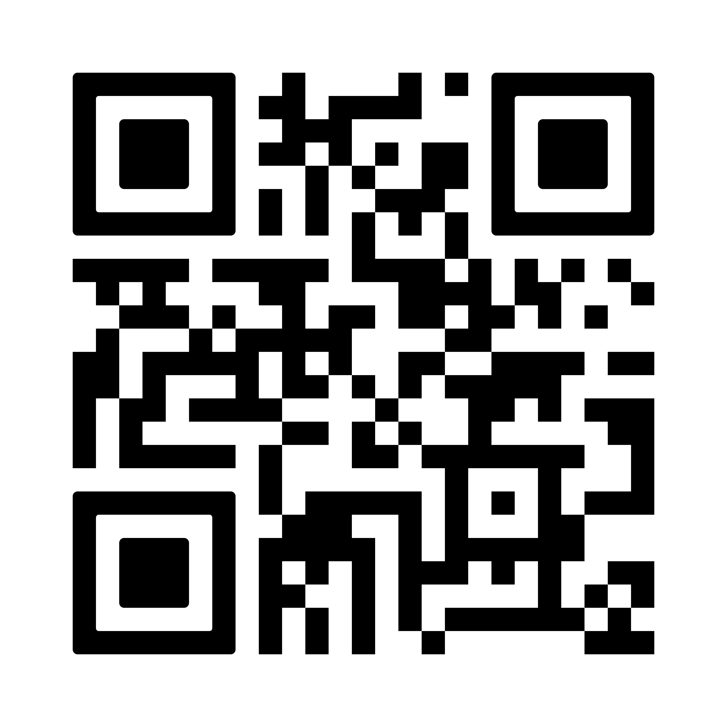
Wrap Up
QUESTIONS?
Office hours:
Thursdays 10:30-11:30
STI 238 or online at clemson.zoom.us/my/janejacobi
VPRORD@clemson.edu
ORD Website:

