Slide 1
Demystifying EPSCoR Opportunities
Office of Research Development
October 9, 2025

Slide 2
Agenda
Demystifying EPSCoR – Dr. Dan Noneaker, Clemson
SC EPSCoR – Dr. Nadim Aziz, SC EPSCoR
SC NASA EPSCoR – Dr. Steve Creager, Clemson

Slide 3


Demystifying EPSCoR
DEMYSTIFYING EPSCoR
Dr. Nadim Aziz
SC EPSCOR
Dr. Steve Creager
Clemson University
Dr. Dan Noneaker
Clemson University

Slide 4
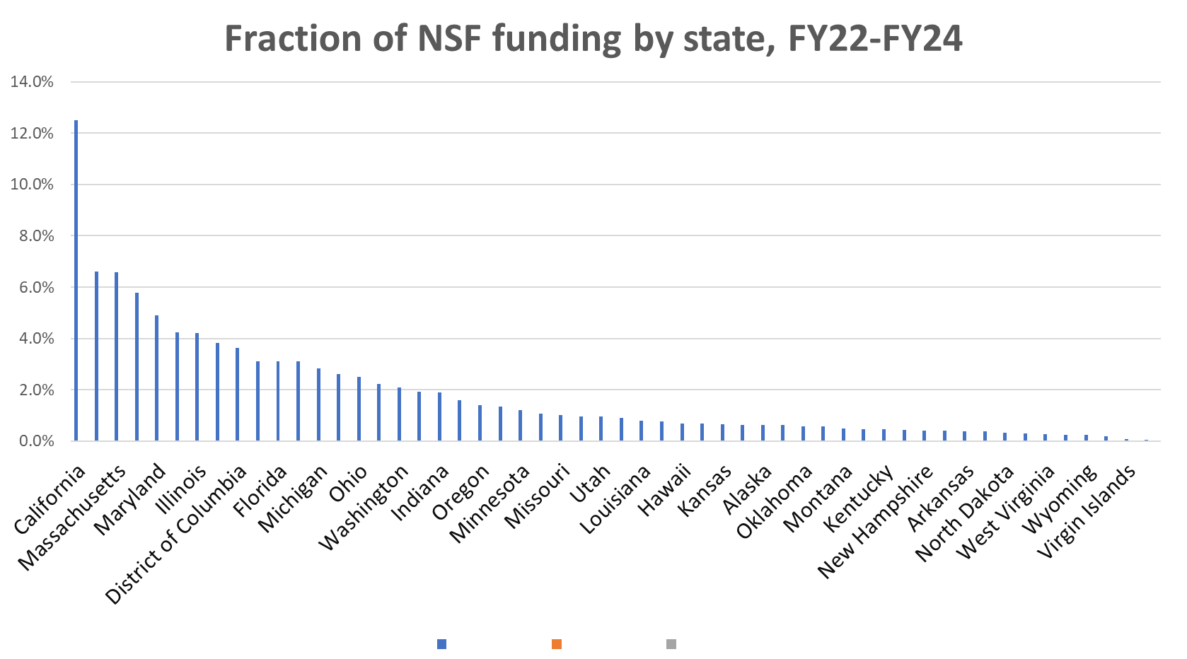
Fraction of NSF Funding by State
SOUTH CAROLINA
US States & Territories

Slide 5
Motivation, History of EPSCoR/IDeA Programs
Concern: geographical concentration of federal R&D funding
1977: National Science Board study highlights concern
1979: NSF Experimental Program to Stimulate Competitive Research (EPSCoR) funded ($1 million)
1988: US statute establishes purpose for EPSCoR
1991-1996: Four additional EPSCoR agencies (DOD, DOE, NASA, USDA) & NIH Institutional Development Award (IDeA)
2017: “Experimental” changed to “Established” in title
Each state/territory qualifying for an agency’s EPSCoR/IDeA program is designated a jurisdiction within that program.

Slide 6
NSF EPSCoR Jurisdictions

Slide 7
Funding of EPSCoR and IDeA by Agency
AGENCY | FY23 ENACTED | FY24 ENACTED | FY25 CR | FY26 HOUSE APPROPs | FY26 SENATE APPROPS
NSF | $245 M | $250 M | $250 M | $250 M | $255 M
NIH | $426 M | $431 M | $431 M | TBD | TBD
DOD | $20 M | $20 M | $20 M | TBD | $30 M
DOE | $35 M | $35 M | $35 M | $35 M | TBD
NASA | $26 M | $26 M | $26 M | $26 M | $26 M
USDA | $68 M* | $67 M* | $67 M* | 15%* | 15%*
TOTAL | $820 M | $828 M | $828 M
Each rounded to nearest million. (Rounding error in TOTAL.) FY26 appropriations status as of July 24.
*15% of NIFA AFRI total.

Slide 8

NSF EPSCoR Programs
NSF EPSCoR (FY25: $250M, 28 jurisdictions)
  Research Infrastructure Improvement (RII) programs
  EPSCoR Research Fellowships
  Co-funding for EPSCoR-jurisdiction proposals to other NSF programs

Slide 9

NIH IDeA Programs
NIH IDeA (FY25: $427M, 24 jurisdictions)
  IDeA Networks of Biomedical Research Excellence (INBRE)
    USC School of Medicine Columbia administers state’s award
  Centers of Biomedical Research Excellence (COBRE)
  IDeA Clinical and Translational Research Program
  IDeA Regional Entrepreneurship Development (I-RED)
  Co-funding for R01 and R15 awards

Slide 10

DOD EPSCoR (DEPSCoR) Programs
DEPSCoR (FY25: $25M, 37 jurisdictions)
  Research Collaboration Thrust
  Capacity Building Thrust
  Co-funding for DOD DURIP, YIP programs

Slide 11

DOE EPSCoR Programs
DOE EPSCoR (FY25: $35M, 27 jurisdictions)
  Implementation Grants
  Building EPSCoR-State/National Laboratory Partnerships
  Co-funding of DOE Office of Science Early Career Awards

Slide 12

NASA EPSCoR Programs
NASA EPSCoR (FY25: $26M, 27 jurisdictions)
  SC NASA EPSCoR Office: College of Charleston
  More detail later in presentation

Slide 13

USDA EPSCoR Programs
USDA EPSCoR (FY25: ~$60M, 26 jurisdictions)
  Food and Agricultural Science Enhancement (FASE) Grants
  15% of total Agriculture and Food Research Initiative (AFRI) funding

Slide 14
SC EPSCoR
Dr. Nadim Aziz
Director of SC EPSCoR

Slide 15
Helping Increase South Carolina’s Research Capabilities
Nadim M. Aziz
www.scepscor.org

Slide 16

Jurisdictions
SC EPSCoR Mission
Improve South Carolina’s Research Capabilities

Slide 17
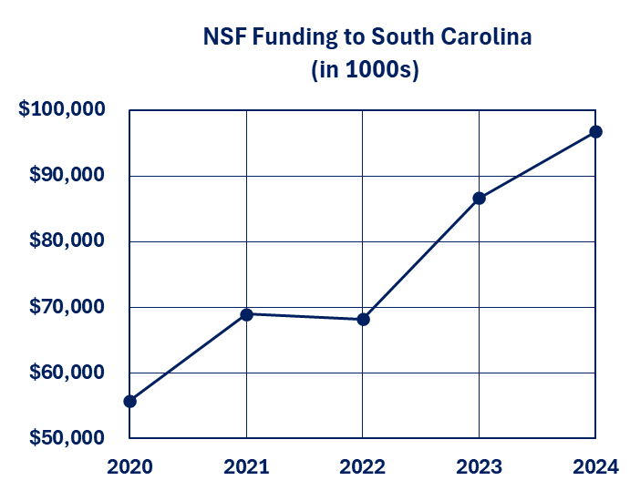
NSF EPSCoR Eligibility
  Jurisdiction must receive less than 0.75% of all NSF funding
  Calculated over the previous five years
  Subtract NSF EPSCoR RII and Conference/Workshop funding
  Subtract NSF funding to other federal agencies in the jurisdiction
  SC received (FY20 - FY24)
  NSF funding = $376,327,000
  NSF EPSCoR funding = $25,579,000
  NSF funding to federal agencies in SC= $77,466,000
  Total NSF funding = $40,132,476,000
  SC % of adjusted NSF funding = 0.68%

Slide 18
SC EPSCoR State Committee
Timothy Stemmler, Chair | Vice President for Research | Medical University of South Carolina
Nadim Aziz | Director | SC EPSCoR
Mark Barnes | Science & Technology Deputy Associate Laboratory Director | Savannah River National Lab
Sonja Barkley | Manager of Innovation and Entrepreneurship | South Carolina Department of Commerce
Ken Deans | President and CEO | Health Sciences of South Carolina
Tanju Karanfil | Senior Vice President for Research, Scholarship and Creative Endeavors | Clemson University
William Kirkland | President and CEO | South Carolina Research Authority
Mike Matthews | Associate Vice President for Research | University of South Carolina
Prakash Nagarkatti | Senior Research Advisor to the President | University of South Carolina
Daniel Noneaker | Associate Dean for Research | Clemson University
Seth Pritchard | Interim Dean, School of Natural and Environmental Sciences | College of Charleston
Susie Shannon | President and CEO | SC Council on Competitiveness
Kelly Steinhilper | Vice President for Communications and Strategy | South Carolina Technical College System
Louis Whitesides | Vice President for Research | South Carolina State University
Private HBCUs | Vacant | Vacant

Slide 19
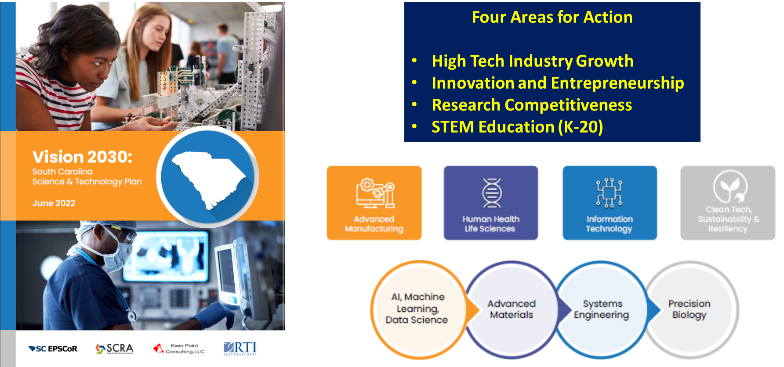
Vision 2030: South Carolina Science and Technology Plan
Notes:
Additional fields highlighted in the graphic are advanced manufacturing; human health life sciences; information technology; clean tech, sustainability & resiliency; AI, machine learning, and data science; advanced materials; systems engineering; and precision biology.

Slide 20
Investment Strategies
  Focused EPSCoR Collaborations (FEC). Requires collaboration with other EPSCoR Jurisdictions (Topic: Building capacity towards use-inspired research)
  Faculty Research Fellowships for junior faculty
  E-CORE – Supports jurisdictions in building capacity in one or more targeted research infrastructure cores that underlie the jurisdiction's research ecosystem
  E-RISE – Supports the incubation of research teams and products in a scientific topical area that links to research priorities identified in the submitting jurisdiction’s approved Science and Technology (S&T) Plan.
  EPSCoR Graduate Fellowship Program (EGFP)

Slide 21

NSF EPSCoR Collaborations for Optimizing Research Ecosystems
(E-CORE)
E-CORE aims to build capacity in one or more targeted research infrastructure cores within an EPSCoR jurisdiction's research ecosystem.
$10M over four years (renewable)
Diverse academic institutions and government, industry, and nonprofit partners
Leverage partnerships to meet core research infrastructure needs
Grow self sustaining research ecosystems
Address challenges and opportunities in research infrastructure
Build capacity
Develop pathways to broaden participation

Slide 22
NSF EPSCoR Research Incubators for STEM Excellence
(E-RISE)
E-RISE aims to developing and implementing sustainable networks of diverse research teams to collaborate on critical jurisdictional research priorities.
$8M over four years (renewable)
Research capacity-building within a chosen research topic;
Development of a skilled workforce
Culture of collaboration and engagement
Integrate the research with societal impacts
Promote sustainability
Build a Jurisdiction-wide network teams of researchers
Develop high quality hypothesis or problem-driven research projects
Develop effective STEM education and workforce development opportunities

Slide 23
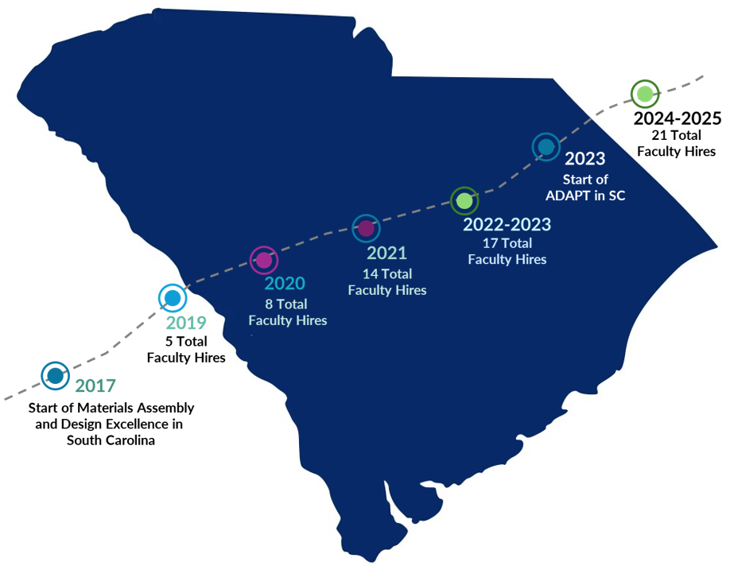
Faculty Hiring in SC
Since 2017, SC
was awarded 2
NSF EPSCoR RII Track 1 Awards leading to the hiring of 21 faculty members at research universities, PUIs and HBCUs.
(Total faculty hires since 2009: 43)
Statewide Faculty Hires by Track 1 Funds 2017 - 2025

Slide 24
SC EPSCoR Source of Funding and Operation
State Appropriations
  Most SC EPSCoR funds are from the state
  Supports activities to increase South Carolina research capabilities
  Supports operation
Federal Funds
  From the NSF EPSCoR Track 1 awards
  Supports operation
Operation
  Housed at the South Carolina Research Authority (SCRA)
  Clemson University is fiscal agent for the Track 1 since 2023
  USC is still the fiscal agent for a few projects from the previous Track 1
SC EPSCoR Office
Nadim Aziz
(Director)
Megan Souter
(Grants and Contracts Manager)
Steve Ramirez
(Communications Manager)
Admin. Coordinator (Vacant)

Slide 25
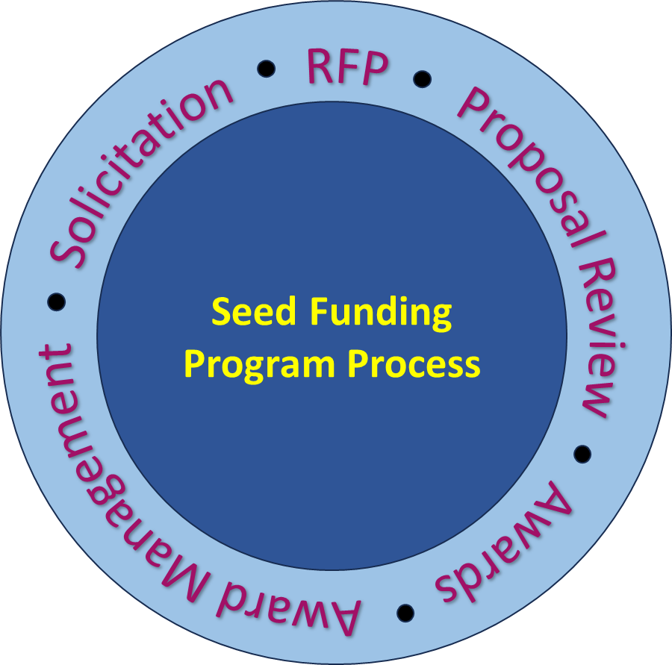
SC EPSCoR Funding Programs
GAIN - Grants for Applications in Industry and Networking - to encourage research by junior faculty from research universities in areas of the Track 1 project.
GAIN-CRP - Grants for Applications in Industry and Networking Collaborative Research Program - to encourage research collaboration between research universities and PUIs in areas of the ADAPT in SC project.
SPARK - STEM Pathways for Advancement, Research, and Knowledge program that aims to increase the number of students interested in STEM degrees.
Phase-0 - to encourage and support South Carolina small businesses in their proposal development activities to compete effectively for SBIR and STTR Federal funding.
Other initiatives depending on available resources and need

Slide 26
Seed Funding to Support ADAPT in SC and S&T Plan
(2 years)
Program | Focus | Max Amount per Proposal* | Proposals Funded | Recent Changes
GAIN | Research PI (Single Investigator) | $60,000 | 6 | Additional $15,000 allowed for Clinical/Industry Collaborator
GAIN CRP | Research PI + at least 1 Co-PI (CRU/PUI Collaboration) | $70,000 | 7 | Additional $15,000 allowed for Clinical/Industry Collaborator
SPARK | Increasing interest in STEM degrees | $25,000 | 5 | Award amount increased to $25,000
Phase-0 | Small Business | $10,000 | 5 | No Change
  *Indirect Cost and student tuition are not allowed

Slide 27
GAIN Program
Purpose of the GAIN program
  Provide seed funds to investigators to pursue funding from federal sources and others
Topics
  Must be aligned with the ADAPT in SC Project
Who May Apply?
  Single investigators from Clemson, USC or MUSC
  Early career faculty – less than 10 years in academic position
  Allows the inclusion of a clinician or and industry collaborator
Funding Amount per Award
  $60,000 (for up to 18 months)
  Up to an additional $15,000 can be included for a clinician or the industry collaborator.

Slide 28
GAIN CRP Program
Purpose of the GAIN CRP program
  Provide seed funds to investigators to pursue funding from federal sources and others
Topics
  Must be aligned with the ADAPT in SC Project
Who May Apply?
  Faculty from any SC college or university
  Must be a collaboration between R1 and PUI
  Allows the inclusion of a clinician or an industry collaborator
Funding Amount per Award
  $70,000 (for up to 18 months)
  Up to an additional $15,000 can be included for a clinician or the industry collaborator.

Slide 29
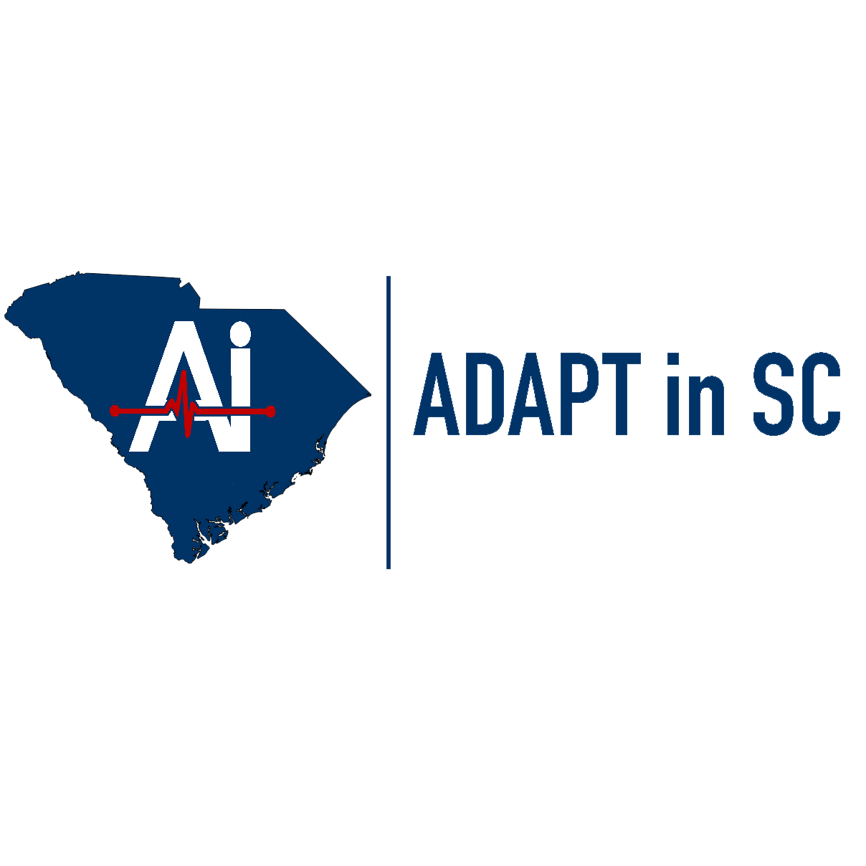
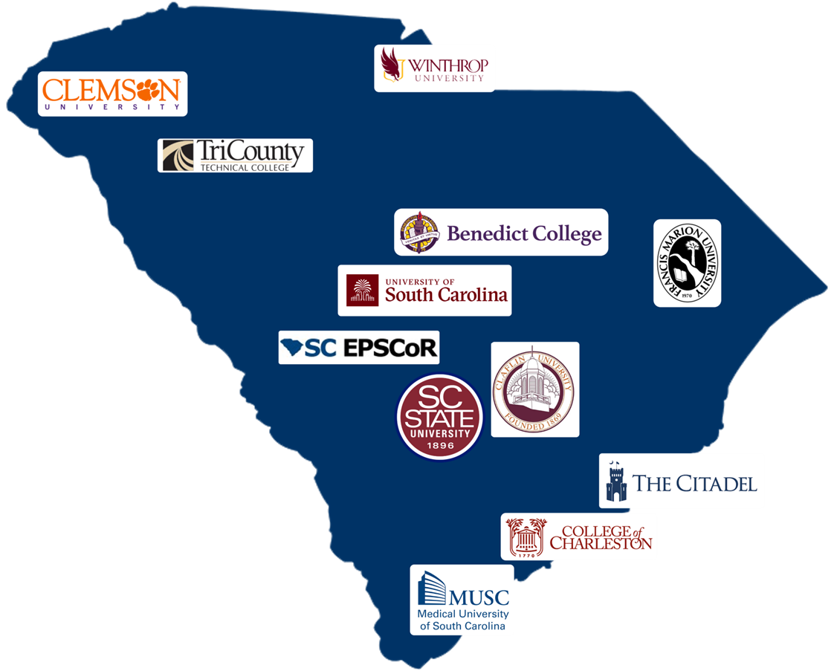
ADAPT in SC
AI-enabled Devices for the Advancement of Personalized and Transformative Healthcare in South Carolina
Supported by the National Science Foundation Award #OIA-2242812
($20 million)
Cost-Share
($4 million)

Slide 30

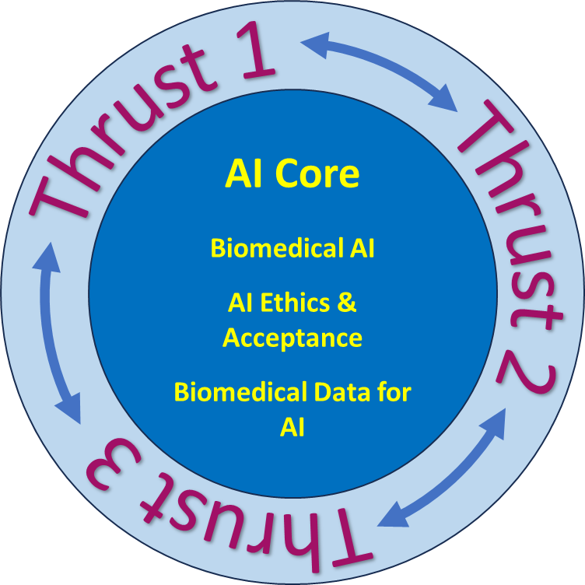


ADAPT in SC Project Areas
Thrust 1
XAI-Enabled Biomedical Devices for Diagnostic and Planning Applications
Thrust 2
DL-Imaging Model Enabled Biomedical Devices for Personalized Prognostic and Treatment Applications
Thrust 3
DT-Enabled Biomedical Devices for Rehabilitation and Therapy

Slide 31
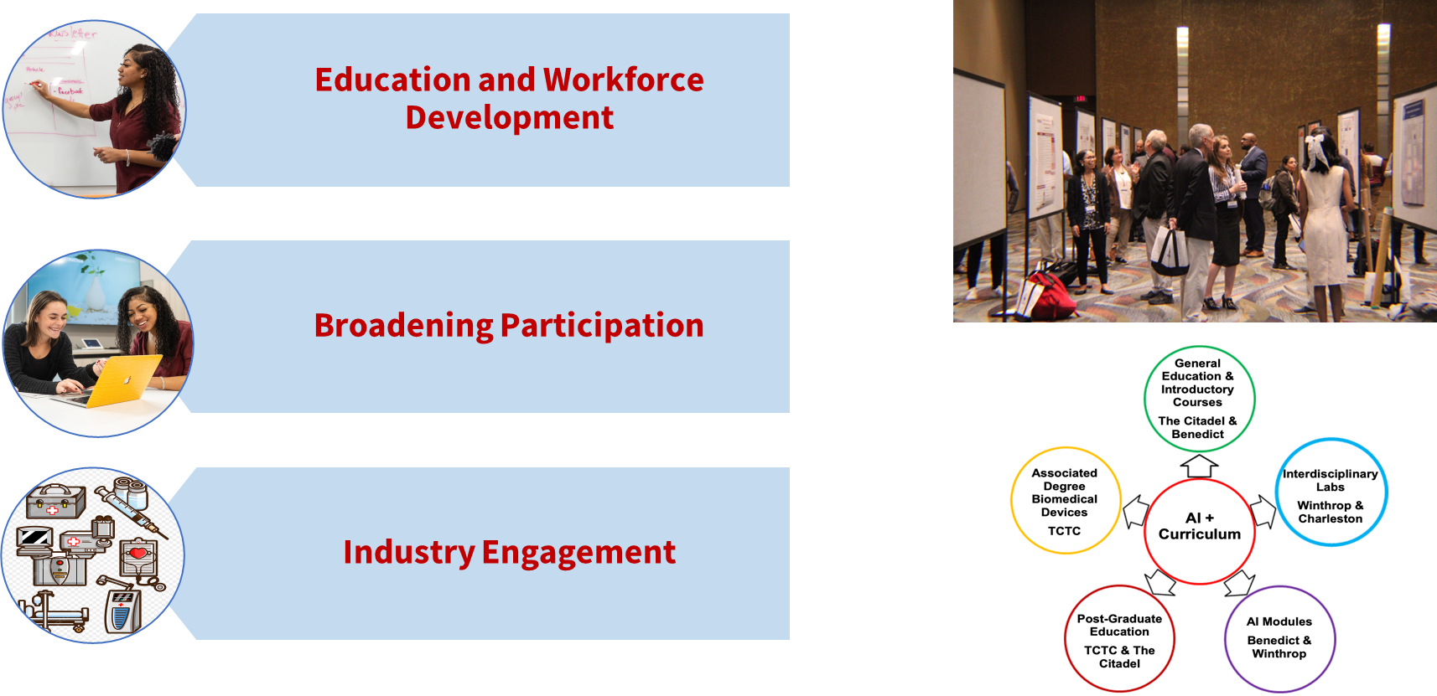
ADAPT in SC Project Areas (con’t)
Notes:
The figure also include a diagram of AI + curriculum. The Citadel and Benedict are involved in general education and introductory courses; Winthrop and Charleston are involved in interdisciplinary labs; Benedict and Winthrop are involved in AL modules; TCTC and The Citadel are involved in post-graduate education; and TCTC is involved in associated degree biomedical devices.

Slide 32
GAIN and GAIN CRP Research Topics
Biomedical AI
Development of theoretical foundations of biomedical AI, AI-ready data acquisition and preprocessing, multimodal data fusion technologies, deep learning algorithms, physics-informed ML models, and software tools to facilitate the use of mechanistic and AI models, sometimes with limited amounts of data.
XAI-enabled Biomedical Devices for Diagnostic and Planning Applications
Use of explainable AI (XAI) to improve the explainability of the diagnostic or treatment decisions made from multimodal clinical data to provide insights into important causal factors and to obtain domain experts’ trust, high prediction accuracy, and safe, continuous workflows from initial diagnosis to treatment end.

Slide 33
GAIN and GAIN CRP Research Topics (con’t)
DL-Imaging Model-Enabled Biomedical Devices for Personalized Prognostic and Treatment Applications
Creation of DL models for AI-enabled biomedical devices for prognosis and/or treatment from limited data. The research should aim to advance the field of AI-enabled medical devices for prognosis and/or treatment. The primary outcome should be fundamental knowledge that governs generating high-performance, generalizable DL algorithms from limited data.
DT-Enabled Biomedical Devices for Rehabilitation and Therapy
The use of AI-enabled digital twins (DTs) to develop a system for an individual patient so that various available rehabilitation treatment regimens or active medical treatment pathways can be monitored and analyzed, and the outcome inferenced.

Slide 34
SPARK Program
Purpose of SPARK program
  Provide seed funds to support activities that increases student’s interest in STEM
Topics
  Must be aligned with Vision 2030: South Carolina Science and Technology Plan
  Engaging undergraduate students in research, conferences, meetings and symposia, other creative ideas
Who May Apply?
  Faculty from any SC college or university
Funding Amount per Award
  $25,000 (for up to 18 months)

Slide 35
Phase-0 Program
Purpose of Phase-0 program
  Provide funds to investigators to submit SBIR/STTR proposals
Topics
  Must be aligned with Vision 2030: South Carolina Science and Technology Plan
Who May Apply?
  Small businesses from South Carolina
Funding Amount per Award
  $10,000 (for up to 18 months)
  If topic is aligned with the ADAPT in SC project, the PI may request an additional $3,000 for and undergraduate student internship

Slide 36
Proposal Submission Deadlines
Program | Focus | Proposals Due
GAIN | Research PI (Single Investigator) | September 11, 2025
GAIN CRP | Research PI + at least 1 Co-PI (CRU/PUI Collaboration) | December 4, 2025
SPARK | Increasing interest in STEM degrees | October 9, 2025
Phase-0 | Small Business | January 15, 2026

Slide 37
Special Initiatives
Stimulus Research Program (2017)
To increase research collaboration between research universities and PUIs/HBCUs
(Two-year awards at $300k/award)
Funded Four Projects involving 10 colleges and universities
Faculty Research Development Academy (2024 - )
To provide faculty with the necessary skills and resources to enhance their research productivity and competitiveness in securing external funding
Total 22 faculty Participants from 12 PUIs and HBCUs
Major Equipment Program (2025)
To provide funds to support the purchase of research equipment by faculty
($50K/Award Max )
Funded 17 awards to 2 Research Universities and 8 PUIs and HBCUs
NSF EPSCoR RII E-CORE Proposal (2025)
To develop a capacity-building network to serve all SC 4-year institutions ($10M for 4 years)
11 PUIs and HBCUs
SCRA / SC EPSCoR is the lead organization

Slide 38
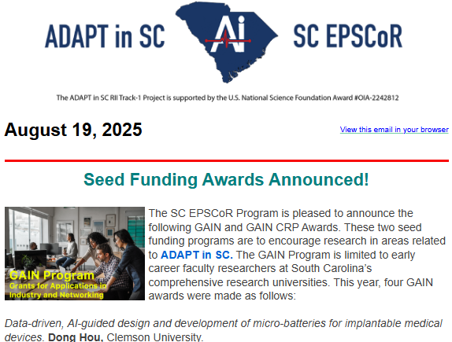
Stay Connected with SC EPSCoR
Biweekly e-Newsletter
  Focus articles related to the ADAPT in SC project
  Seed funding announcements
  Announcement of new funding initiatives
  NSF information
  Other jurisdiction related information
Monthly Webinar Series
  Faculty and Student Research
  Industry partners
  Technology Transfer and IP
  Others

Slide 39
Questions?
Nadim.Aziz@scra.org
Megan.Souter@scra.org
Steve.Ramirez@scra.org www.scepscor.org

Slide 40
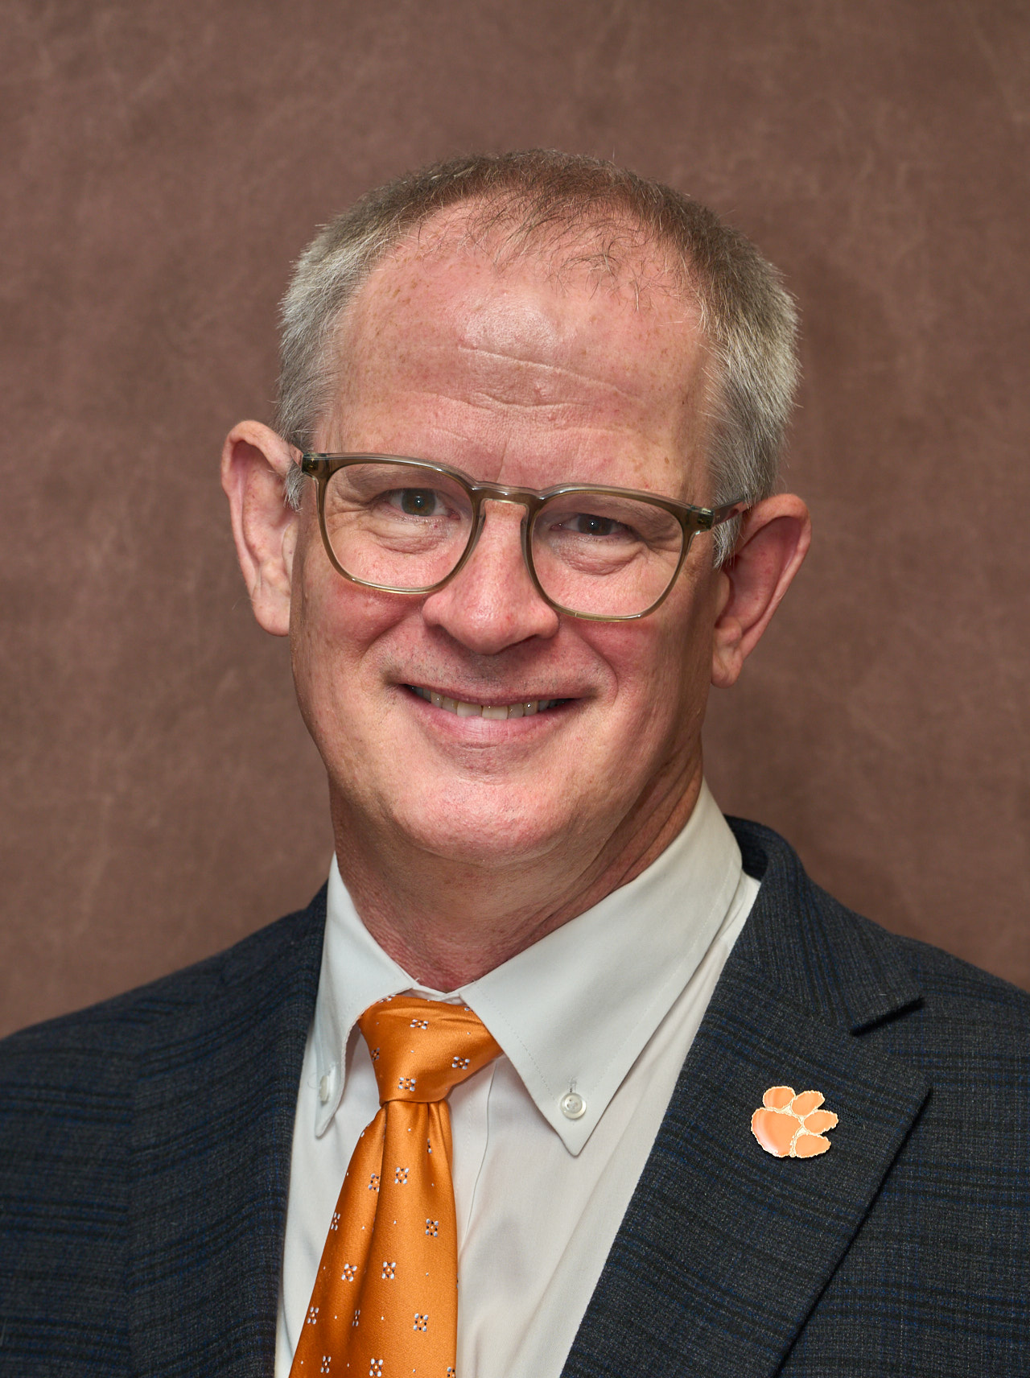

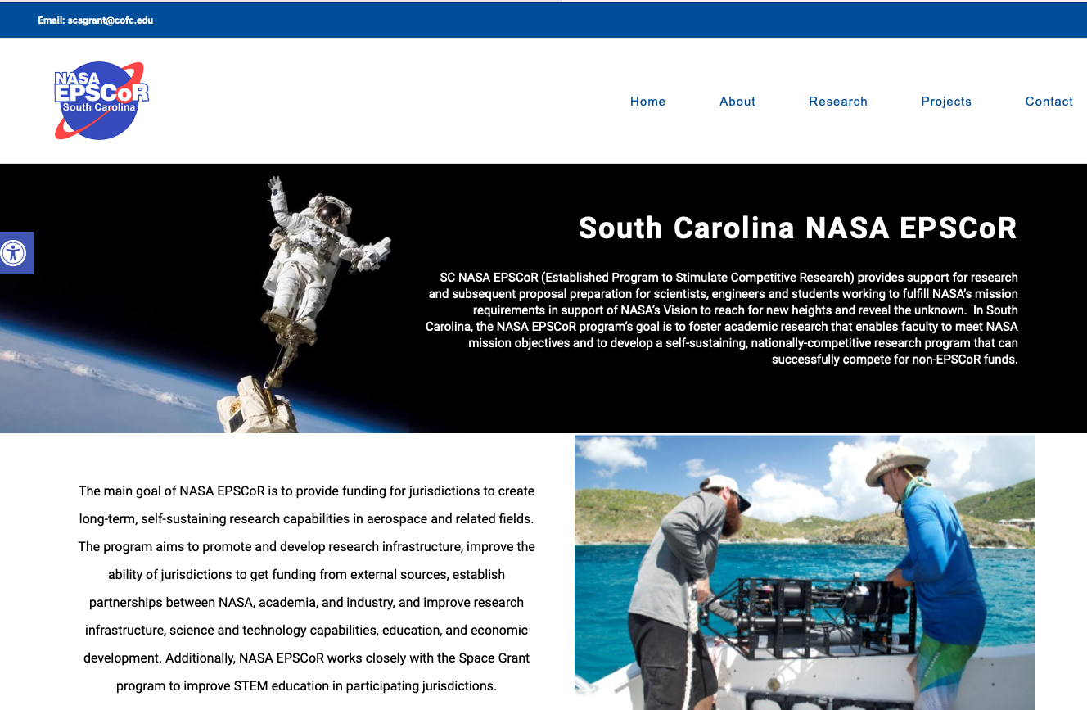
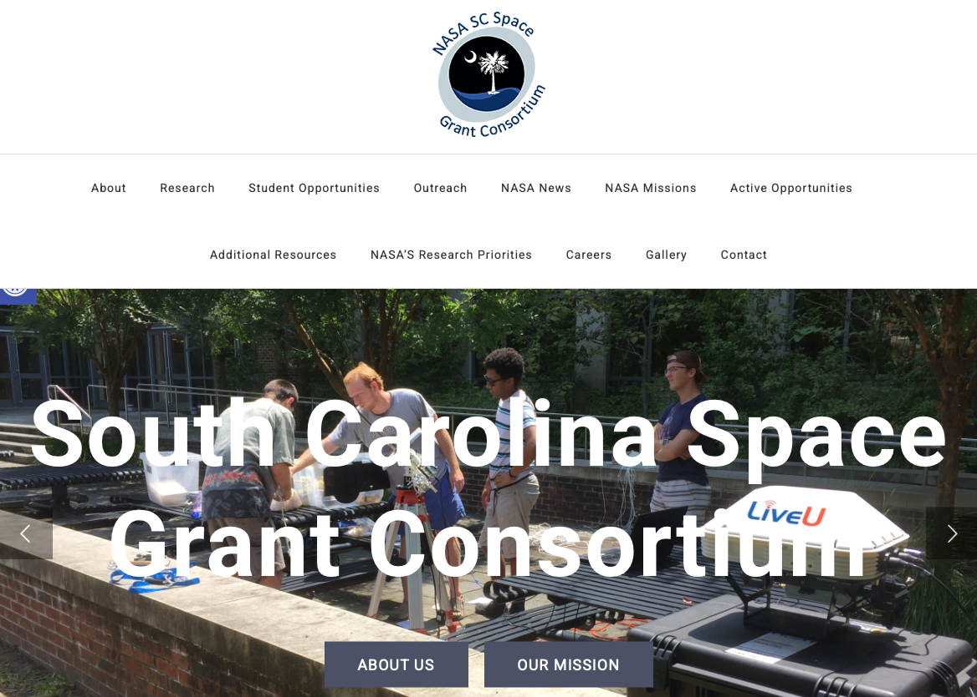
SC NASA EPSCoR
Presented by Steve Creager, Associate Dean in SCIENCE and Clemson liaison for the SC NASA Space Grant program
SC NASA EPSCoR
SC NASA Space Grant
https://scnasaepscor.charleston.edu
https://scspacegrant.charleston.edu
CAUTION: This material is pending approval of the FY26 budget.

Slide 41
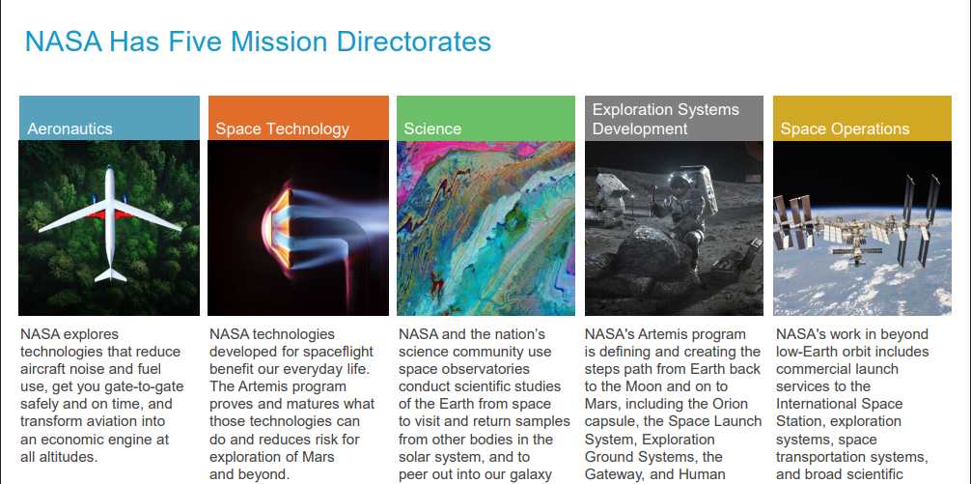
NASA Has Five Mission Directorates
ARMD
STMD
SMD
ESDMD
SOMD
Notes:
ARMD: Aeronautics. NASA explores technologies that reduce aircraft noise and fuel use, get you gate-to-gate safely and on time, and transform aviation into an economic engine at all altitudes.
STMD: Space Technology. NASA technologies developed for spaceflight benefit our everyday life. The Artemis program proves and matures what those technologies can do and reduces risk for exploration of Mars and beyond.
SMD: Science. NASA and the nation’s science community use space observatories to conduct scientific studies of the Earth from space, to visit and return samples from other bodies in the solar system, and to peer out into our galaxy.
ESDMD: Exploration Systems Development. NASA’s Artemis program is defining and creating the steps path from Earth back to the Moon and on to Mars, including the Orion capsule, the Space Launch System, Exploration Ground Systems, the Gateway, and Human
SOMD: Space Operations. NASA’s work in beyond low-Earth orbit includes commercial launch services to the International Space Station, exploration systems, space transportation systems, and broad scientific

Slide 42










Office of STEM Engagement (OSTEM)
Separate from the Mission Directorates
MUREP
Awards assist faculty and students in research and provide authentic STEM engagement related to NASA missions
EPSCoR
NASA Research opportunities supported by faculty, undergraduate, and graduate students
01
03
05
Space Grant Opportunities for higher education students that
support and enhance science and engineering education and research
New Generation of Aerospace Engineers and Scientists
Next Gen Stem Focus on K-12 STEM activities that stimulate interest in Space Careers
02
04
Notes:
Next Gen STEM: Focus on K-12 STEM activities that stimulate interest in Space Careers
MUREP: Awards assist faculty and students in research and provide authentic STEM engagement related to NASA missions
Space Grant: Opportunities for higher education students that support and enhance science and engineering education and research
EPSCoR: NASA research opportunities supported by faculty, undergraduate, and graduate students
New Generation of Aerospace Engineers and Scientists

Slide 43






NASA EPSCoR Components
01
03
05
NSF Research Infrastructure Improvement (RII) – Track 4
@NASA (Faculty Fellowships)
Rapid Response Research (R3)
Research Infrastructure Development (RID), which funds the Research Grant Program (RGP) in SC
Research
(The “$750K” program)
International Space Station (ISS)
02
04
Increasing Technology Readiness Levels (TRLs)

Slide 44

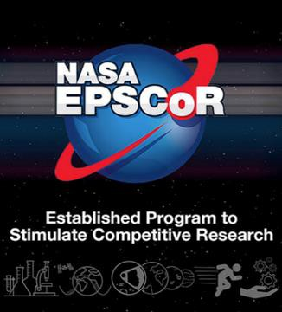












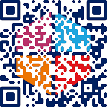
NASA EPSCoR Funding; National Totals 2024-2025
28 RID Awards
($5.6M)
16 Research Awards ($11.6M)
40 Rapid Response Research
(R3) Awards ($4M)
5 ISS Flight Opportunity Awards ($500K)
~ $200 K each (made to states)
~ $750 K each (made to individuals)
~ $100 K each (made to individuals)
~ $100 K each (made to individuals)

Slide 45

NASA / NSF EPSCoR Partnership
NASA, NSF Collaborate to Strengthen Research Capabilities
Fifteen research investigators will advance their science and technology projects while contributing to NASA’s research priorities through an agency collaboration with the U.S. National Science Foundation (NSF).
NSF awarded $4.5 million in funding through its (EPSCoR) program to strengthen research infrastructure and NASA is providing $600,000 in matching funds
The partnership provides NSF EPSCoR Research Fellows access to the space agency’s expert workforce and unique facilities and equipment. Fellows will learn new techniques, develop new connections, and advance their research, all while boosting the research capacity at their institutions.
10 FY24 NSF-NASA
Research Fellows @NASA &
5 NSF-NASA R3
(NASA matching funds
$600,000)

Slide 46
South Carolina NASA EPSCOR Funding 2024 – 2025
Research Grant Program (RGP)
Award size approx. $35K each from NASA plus match, typically 2:1
Six seed grant projects in 24-25, four in 25-26.
Research areas for current awards: AI, Astrophysics, Earth Science, Engineering and Physics
Basic Research (“The $750K program”)
Award size $750K from NASA plus $375K match (2:1)
Three awards in SC since 2019
  Physics-based design & manufacturing
  Producing pure O₂ from CO₂ & Storing electricity
  Peroxide-producing microbial fuel cells
SC allowed only one applicant per year in a national competition. We select the applicant via internal competition
Rapid Response Research (R3)
Award size $100K, no match needed
Two current active awards in SC
  CO₂ Capture & Utilization
  Composite materials
SC allowed only one applicant per year in a national competition. We select the applicant via internal competition

Slide 47
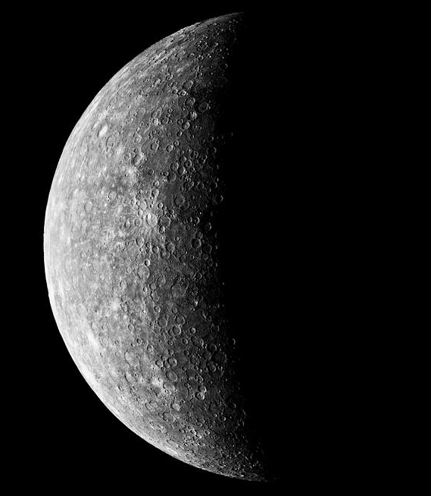
2025-2026 SC Updates
PROGRAMS THAT PROBABLY WILL CONTINUE;
Basic Research Program ($750K per award)
In the past, announcement came in Sept with proposals due in Oct. This year is different…
Announcement expected in January 2026 with proposals likely due Feb 2026
The continuance of this program is pending due to federal budget considerations
Research Grant Program (RGP, $35K per award)
Call for proposals expected in January 2026
PROGRAMS CURRENTLY ON PAUSE
Rapid Research Response (R3)
ISS

Slide 48
SC NASA Space Grant programs
Mission: “…We promote activity in research, education, and public service related to NASA”
Research and Education Awards Program (REAP)
  Research facilitation award (up to $20K)
  Education research award (up to $8K)
  Curriculum development award (up to $4K)
  Travel award (up to $2K)
Awards for 12 months, requires 1:1 cost sharing
Student opportunities
Graduate Research Fellowship (up to $16K from NASA, requires 1:1 match)
Kathryn Sullivan Earth and Marine Science Fellowship
Undergraduate Student Research Award
Technical College Research Award
Ray Green Technology Internship
NASA student internship
Palmetto Academy Research (for students)
Palmetto Academy (for faculty)
  Funding request can vary between $15K and $32K depending on number of students to be supported.
  Requires 1:1 cost sharing

Slide 49
Reminder
All of this is pending survival in the FY 26 budget!

Slide 50
Questions?

