Slide 1

EARLY-STAGE INVESTIGATOR OPPORTUNITIES
Jane Jacobi, Office of Research Development
October 30, 2025

Slide 2
AGENDA
1. Office of Research Development
2. Early-Stage Investigator
Programs
4. Questions
3. CAREER Academy and NIH
Accelerator

Slide 3

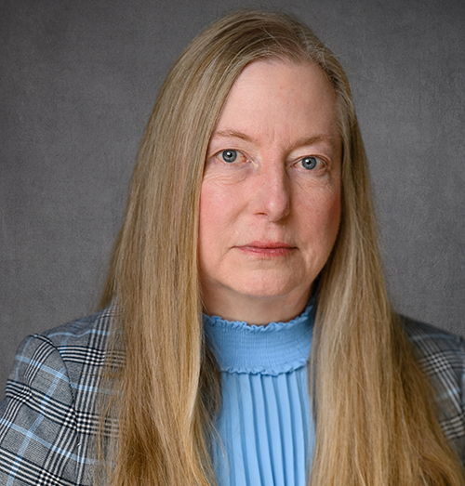
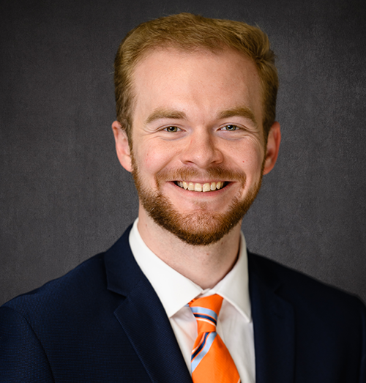
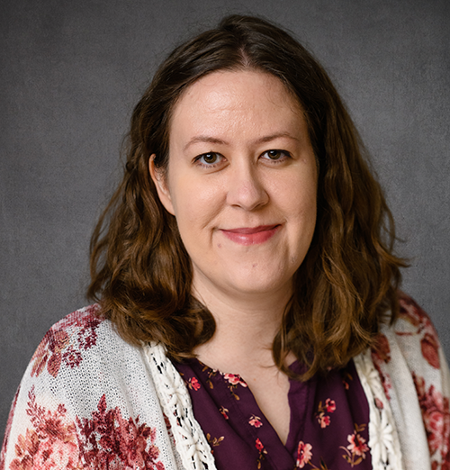
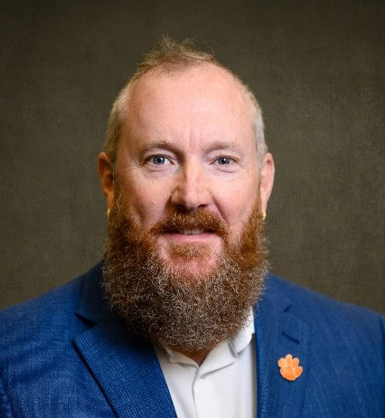
ORD TEAM
Shelia Cotten Assoc VP for Research Development
Jane Jacobi
Team Lead
Brett Levi
Program Manager
Morgan Simpson
Research Development
Specialist
Brad Walters
Program Manager
Visit the Office of Research Development team and selected Sponsored Programs guests during office hours on Thursdays from 10:30 to 11:30 in Rm 238 of the Strom Thurmond Institute. You can also join via Zoom: clemson.zoom.us/my/janejacobi
https://www.clemson.edu/research/division-of-research/offices/department-ord/index.html

Slide 4

ORD Introduction
ORD positions faculty to be competitive in responding to federal and private funding opportunities.
To build Clemson’s research culture, we encourage applications to early investigator programs.
This presentation focuses on federal early investigator programs as means of “getting a foot in the door.”

Slide 5
Things to Note
Things to note:
Not an inclusive list.
Service to PIs but also the agency.
Emphasis on acculturation of PIs = need to be aware of audience.
Variation in definitions of “early career,” “early stage,” “young,” and “new” investigators.
Variation in prohibition of Co-PIs.
Variation in degree of emphasis on education, workforce development.
Buyer beware: Webpages are not being updated; budgets not approved.

Slide 6

Department of Agriculture (USDA) National Institute of Food and Agriculture (NIFA) New Investigators

Slide 7
NIFA NEW INVESTIGATORS
https://www.nifa.usda.gov/grants/programs/agriculture-food-research-initiative/faq/new-investigators
This is not quite a “program” but a mechanism for making awards. There are no set-aside funds for new investigators, but those submitting proposals for New Investigator Standard Grants and New Investigator Seed Grants may receive special consideration in the review process.

Slide 8
NIFA NEW INVESTIGATORS (con’t)
Eligibility:
A “new investigator” is a lead project director of an application to an AFRI program area priority who is beginning their research career, does not have an extensive scientific publication record, and has less than 5 years of postgraduate, career-track experience.
The new investigator may not have received competitively awarded Federal research funds as Project Director (PD) except for the pre- or post-doctoral grants, equipment grants, education grants, extension grants, and AFRI Seed Grants.
The PI does not have to be a U.S. citizen.

Slide 9
Institute of Education Sciences (IES) Early Career Development and Mentoring Program for Education Research

Slide 10
IES EARLY CAREER PROGRAM
https://ies.ed.gov/funding/research/programs/research-training-programs-in-the-education-sciences/early-career-development-and-mentoring
Purpose: Support early-career faculty who are developing education research careers. Each award provides funds for research (including salary for protected time to conduct research) and career development (including training under the guidance of an experienced mentor or mentors). IES seeks to prepare PIs to conduct the type of research IES funds in its research grant programs.
Unclear if it will be offered again; most recent
applications were due in March 2025.

Slide 11
Defense Advanced Research Projects Agency (DARPA) Young Faculty Award (YFA)

Slide 12
DARPA YOUNG FACULTY AWARD (YFA)
https://www.darpa.mil/work-with-us/communities/academia/young-faculty-award
Purpose:
Identify and engage rising stars in junior research positions in academia, particularly those without prior DARPA funding, to expose them to DoD needs and DARPA’s mission to create and prevent technological surprise for national security.
Provide high-impact funding to researchers early in their careers to develop innovative new research that enables transformative DoD capabilities.
Mentor the next generation of researchers focused
on national security issues.

Slide 13
DARPA YOUNG FACULTY AWARD
Scope:
Areas of interest to the offices of Defense Sciences, Biological Technologies, Information Innovation, and Microsystems Technology.
Innovative approaches that enable revolutionary advances in science, devices, or systems. Specifically excluded is research that primarily results in evolutionary improvements to the existing state of practice (= not “incremental”).
Concepts relevant to addressing national security challenges.

Slide 14
DARPA YOUNG FACULTY AWARD (con’t)
Eligibility:
Proposers must be employed at a U.S. institution in a current tenure-track faculty position or tenured faculty within 3 years of their tenure date and within 12 years of the receipt of their doctorate.
Proposers who have received funding greater than $500,000 from DARPA or $1,250,000 from all DoD sources combined as either a prime or subawardee are not eligible.
Award Info:
Each award will include a 24-month base period (a maximum of $500,000) and a 12-month option period (a maximum of $500,000). Each 12-month interval of the base period shall not exceed $250,000. Each award also has the potential for additional options concurrent to the base for a “U.S. Person” graduate student, not to exceed $350,000.
Due Date: January 20, 2026.

Slide 15
Army Research Office (ARO) Fundamental Research -- Early Career Program (ECP)

Slide 16
ARMY ECP
https://www.arl.army.mil/opportunities/arl-baa/
https://arl.devcom.army.mil/wp-content/uploads/sites/3/2025/01/DEVCOM-ARL-BAA_W911NF23S0001-Amendment-4_JAN-8-2025.pdf
Purpose:
Foster creative basic research in science and engineering; enhance development of outstanding early career investigators.
Increase opportunities for early career investigators to pursue research in areas relevant to the Army.

Slide 17
ARMY ECP (2/3)
Scope:
Proposals are sought for research that supports the ARO research topics: https://cftste.my.salesforce.mil/sfc/p/#t00000004XVq/a/Rw0000005iej/Yz.y8F94eEcaUliA6KjKJdp4dg.FTvpc3JU0g1L_vvY
This document goes on for 128 pages!

Slide 18
ARMY ECP (3/3)
Eligibility: Open to U.S. citizens, U.S. nationals, or lawful permanent residents who have held a tenure-track position at a U.S. institution of higher education for fewer than 5 years at the time of application.
Award Info: Typical awards are funded up to $120,000 per year for 3 years.
Due Date: Accepted anytime the BAA is open (until Nov. 2027).

Slide 19
Air Force Young Investigator Research Program

Slide 20
AIR FORCE YOUNG INVESTIGATOR RESEARCH PROGRAM
https://community.apan.org/wg/afosr/w/researchareas/12792/young-investigator-program-yip/
Purpose: Support individual early-in-career scientists and engineers showing exceptional ability and promise for conducting basic research. The program objective is to foster creative basic research in science and engineering; enhance early career development of outstanding young investigators; and increase opportunities for the young investigator to recognize the Air Force and Space Force mission and related challenges in science and engineering.

Slide 21
AIR FORCE YOUNG INVESTIGATOR RESEARCH PROGRAM (2/3)
Scope:
Constrained by “Research Interests of the Air Force Office of Scientific Research,” published annually on grants.gov.
Emphasis is on research areas that offer significant and comprehensive benefits to U.S. national war fighting and peacekeeping capabilities. These areas are organized and managed in 2 scientific departments (Engineering and Information Science; Physical and Biological Sciences) and 3 international offices.

Slide 22
AIR FORCE YOUNG INVESTIGATOR RESEARCH PROGRAM (3/3)
Eligibility: PI must be a U.S. citizen, national, or permanent resident (at time of proposal submission), employed on a full-time basis, and hold a permanent position. Must have received Ph.D. or equivalent degrees within the 7 years prior to submission date (check FY 2027 solicitation [not out yet] for specific date).
Award Info: Most awards are funded up to $150,000 per year for 3 years, for a total of $450,000.
Due Date: Sept. 2026, if pattern holds.

Slide 23
Office of Naval Research (ONR) Young Investigator Program

Slide 24
ONR YIP PROGRAM
https://files.simpler.grants.gov/opportunities/331d757d-9202-441d-adac-819d7deae07b/attachments/2530547d-62d8-423f-97d5-72f7010c8462/N0001425SF004_Amendment_2_rev.pdf
Purpose:
Support creative early-career faculty with potential to contribute to the advancement of the Navy’s Science and Technology program. Emphasis on national security and warfighter supremacy. Increase ability of faculty to obtain DOD research grant awards beyond YIP.
Educate, develop, and encourage next generation of scientists and engineers through knowledge transfer to
students and post-docs.

Slide 25
ONR YIP PROGRAM (2/3)
Scope:
PIs must tackle challenging naval warfighter issues by utilizing transformative approaches and pioneering new technologies.
Projects must address basic or applied research areas of interest to S&T Departments:
31--Command, Control, Computing, Communications, Cyber, Intelligence, Surveillance, Reconnaissance and Targeting
32--Ocean Battlespace Sensing
33--Sea Warfare and Weapons
34--Warfighter Performance
35--Air Warfare and Weapons

Slide 26
ONR YIP PROGRAM (3/3)
Eligibility:
PI must be a U.S. citizen, national, or permanent resident (on the date proposals are due), holding a first or second full-time tenure-track or tenure-track-equivalent faculty position, and have received his/her PhD or equivalent degree on or after 1/1/2018.
Award Info:
Less than 15% of applicants receive awards. In FY2025, more than 230 proposals resulted in 24 awards.
Budget of $750,000 max; $250,000/increment over 3 years.
Due Date: July 2026.

Slide 27
National Aeronautics and Space Administration (NASA) Early Career Research Programs

Slide 28
EARLY CAREER INVESTIGATOR PROGRAM IN EARTH SCIENCE
Purpose:
Empower the next generation of Earth science researchers to create a workforce that enables solutions to benefit society, respond to changes in the Earth’s system, and to support the Earth Science to Action initiative.
Support outstanding and innovative scientific research to advance NASA's mission in Earth System Science.
Enable greater participation in Earth Science by cultivating scientific leadership.

Slide 29
EARLY CAREER INVESTIGATOR PROGRAM IN EARTH SCIENCE (con’t)
Scope:
Projects focus across Earth Science priorities such as the use of space-based remote sensing, the integration of space-based remote sensing data with other datasets (e.g., surface, air) and into models, and the delivery of actionable Earth science ― making Earth science data more usable and impactful for the benefit of humanity.
Award Info: Award duration can be for up to 3 years. $$
Due Date: The ECIP-ES solicitation closed in August 2023. Proposals are solicited every 3 years. Opportunities will be announced on NSPIRES.

Slide 30
PLANETARY SCIENCE DIVISION (PSD) EARLY CAREER AWARD (ECA)
https://solicitation.nasaprs.com/ROSES2025
ECA Solicitation
Purpose: Help promising early career scientists play an increased and meaningful role in the planetary science community and pursue professional development in areas relevant to the PSD.
Scope: ROSES is an omnibus NASA Research Announcement. It contains ~35 different proposal opportunities. Read both the
General requirements and specific ECA ones.

Slide 31
PLANETARY SCIENCE DIVISION (PSD) EARLY CAREER AWARD (ECA) (con’t)
Eligibility:
The applicant must have received a terminal degree no earlier than January 1, 2015 (this is for current competition).
The applicant may not be a previous recipient of NASA-managed early-career funding that is similar in scope and size to the ECA (e.g., the PSD Early Career Fellowship Program, other SMD early career programs, Presidential Early Career Awards for Scientists and Engineers, etc.).
Award Info:
The ECA will only be awarded one time to any given proposer.
Awards may be for up to 5 years, though awards 1 to 3 years in duration are preferred. Each award, summed over all project years, is capped at $200K.
Due Date: December 4, 2025

Slide 32
SPACE TECHNOLOGY RESEARCH GRANTS EARLY CAREER FACULTY PROGRAM
https://www.nasa.gov/early-career-faculty-ecf/
https://www.nasa.gov/space-technology-mission-directorate/space-technology-research-grants/
Purpose:
Foster innovative, early-stage space technology research of high priority to NASA’s Mission Directorates.
Tap into the talent base at U.S. universities, challenging early-career faculty to examine the theoretical feasibility of new ideas and approaches critical to making space exploration, space science, and other civil space pursuits more effective, affordable, and sustainable.
Scope:
Space technologies at low Technology Readiness Levels.
Advanced Diagnostics for High-Enthalpy Test Facilities Simulating Spacecraft Atmospheric Entry
Planning for Autonomous Spacecraft Using ML Methods to Enable Onboard Guidance,
Navigation, and Control

Slide 33
SPACE TECHNOLOGY RESEARCH GRANTS EARLY CAREER FACULTY PROGRAM (con’t)
Eligibility:
The PI must be an untenured assistant professor on the tenure track at the sponsoring U.S. university at the time of award.
The PI must be a U.S. citizen, U.S. national, or have lawful status of permanent residency at the time of award.
Award Info:
6 awards total, not to exceed $750,000 per award
Duration of up to 3 years; amount in any one year may not exceed $250K
Due Date: July 10?

Slide 34
Department of Energy Office of Science Early Career Program

Slide 35
DOE EARLY CAREER PROGRAM
https://science.osti.gov/early-career
Purpose:
Support the research of outstanding scientists early in their careers; allow them to pursue new ideas and harness the resources of the user facilities to increase the potential for breakthrough new discoveries.
Stimulate research careers in the disciplines supported by the DOE Office of Science: Advanced Scientific Computing Research, Biological and Environmental Research, Basic Energy Sciences, Fusion Energy Sciences, High Energy Physics, Isotope R&D and Production, and Nuclear Physics.
Scope:
Constrained by DOE priorities

Slide 36
DOE EARLY CAREER PROGRAM (con’t)
Eligibility:
Must be an untenured, tenure-track assistant or associate professor at a U.S. academic institution who is within 10 years of having earned the doctoral degree.
Award Info:
Approximately $875,000 over 5 years.
Due Date:
Announcement was released in January of 2025 for full proposals due in April. Perhaps similar timing for 2026. Pre-applications are mandatory.

Slide 37
National Institutes of Health (NIH) Maximizing Investigators' Research Award (MIRA) Program

Slide 38
MIRA
https://grants.nih.gov/grants/guide/pa-files/PAR-23-145.html
Purpose:
Provides support for an investigator’s research that falls within the mission of the National Institute of General Medical Sciences (NIGMS).
Scope:
NIGMS supports research on basic biological processes as well as translational and clinical research in certain areas.

Slide 39
MIRA (con’t)
Eligibility:
Applicants who receive funding as the PD/PI of an R01, RM1, SC1, DP1, DP2, or any other type of disqualifying award prior to issuance of the MIRA become ineligible to receive the award.
Award Info: Because the MIRA is intended to support a significant and ambitious program of research, the PI is required to devote at least 51% of their total research effort to this award.
Due Dates: early Feb and early Oct, annually; February 4, 2026

Slide 40
National Institutes of Health (NIH) Career Development Awards (K Series)

Slide 41
Mentored Research Scientist Development Award (K01)
https://grants.nih.gov/grants/guide/pa-files/PA-24-176.html
Purpose:
Support individuals who have had some success with prior grant awards and publications but still require mentorship and guidance from a more experienced investigator.
Scope:
Framed as a mentoring program. Candidates must identify mentors who will supervise the proposed career development and research experience.

Slide 42
Mentored Research Scientist Development Award
Eligibility:
A candidate for the award must have a research or health-professional doctoral degree.
By the time of award, the individual must be a citizen or a non-citizen national of the United States or have been lawfully admitted for permanent residence.
At the time of award, the candidate must have a full-time appointment at the academic institution.
Candidates are required to commit a minimum of 75% of full-time professional effort (i.e., a minimum of 9 person-months) to their program of career development.

Slide 43
Mentored Research Scientist Development Award (con’t)
More Eligibility:
Current and former PDs/PIs on NIH research project (R01), program project (P01), center grants (P50), Project Leads of program project (P01), or center grants (P50), other major individual career development awards (e.g., K01, K07, K08, K22, K23, K25, K76, K99/R00), or the equivalent are not eligible.
Award Info: Duration of 3 to 5 years, not renewable.
Due Dates: Feb. 12, June 12, Oct. 12, 2026

Slide 44
National Institutes of Health (NIH) Trailblazer Award for New and Early Stage Investigators (R21 Clinical Trial Optional)

Slide 45
NIH TRAILBLAZER
https://grants.nih.gov/grants/guide/pa-files/PA-25-169.html
Purpose: Provide opportunities for new and early-stage investigators to pursue research programs that integrate engineering and the physical sciences with the life and/or biomedical sciences.
Scope: Project may be exploratory, developmental, proof of concept, or high risk/high impact, and may be technology design-directed, discovery-driven, or hypothesis-driven. Applicants must propose research approaches for which there are minimal or no preliminary data. Participating institutes (National Institute of Biomedical Imaging and Bioengineering, National Eye Institute,
National Institute on Aging) set priorities.

Slide 46
NIH TRAILBLAZER (con’t)
Eligibility: Eligible individuals must be a) NIH-defined early-stage investigators or b) NIH-defined new investigators (https://grants.nih.gov/policy/early-investigators/index.htm).
For applications with multiple PIs, all must be eligible to apply for this award.
Award Info: Application budgets may not exceed $400,000 direct costs over a maximum 3-year funding period.
Due Date: Feb. 16, 2026, after which a new solicitation will need to be issued.

Slide 47
National Institutes of Health (NIH) Stephen I. Katz Early Stage Investigator Research Project Grant (R01, Clinical Trial Not Allowed)

Slide 48
STEPHEN I. KATZ EARLY STAGE INVESTIGATOR GRANT
https://grants.nih.gov/grants/guide/pa-files/PAR-25-322.html
Purpose: Support an innovative project that represents a change in research direction for an early-stage investigator and for which no preliminary data exist.
Scope: Proposed research project can rely on the PI’s prior work, but must not be an incremental advancement, expansion, or extension of a previous research effort. The change in research direction could involve a new approach, methodology, technique, discipline, therapeutic target, and/or new paradigm. Project must be related to the programmatic interests of an NIH Institute or Center.

Slide 49
STEPHEN I. KATZ EARLY STAGE INVESTIGATOR GRANT (con’t)
Eligibility: PD/PIs must be designated early-stage investigators (completed their terminal research degree or end of post-graduate clinical training, whichever date is later, within the past 10 years and have not previously competed successfully as PD/PI for a substantial NIH independent research award)
Award Info: Duration of 5 years; “application budgets are not limited but need to reflect the actual needs of the proposed project.”
Due Dates: Jan. 27, May 27, Sept. 28, 2026 and similar timing thereafter

Slide 50
National Institutes of Health (NIH) Early Career Research (ECR) Awards

Slide 51
NIH ECR AWARDS (a couple of samples)
National Center for Medical Rehabilitation Research (NCMRR) ECR Award (R03)
https://grants.nih.gov/grants/guide/pa-files/PAR-25-124.html
Purpose: Support rehabilitation scientists who are establishing independent research careers. The research must be focused on one or more of the areas within the mission of NCMRR. The intent of this award is for the PI to obtain sufficient preliminary data for a subsequent R01 application.

Slide 52
NIH ECR AWARDS
National Institute on Deafness and Other Communication Disorders (NIDCD) Early Career Research (ECR) Award (R21 Clinical Trial Optional)
https://grants.nih.gov/grants/guide/pa-files/PAR-25-120.html
Purpose: Support scientists who are beginning to establish an independent research career. The research must be focused on one or more of the areas within the biomedical and behavioral scientific mission of the NIDCD. The award should allow the PI to obtain sufficient preliminary data for a subsequent R01 application.

Slide 53
National Science Foundation (NSF) EDU Core Research: Building Capacity in STEM Education Research (ECR: BCSER)

Slide 54
BUILDING CAPACITY IN STEM ED RESEARCH
https://www.nsf.gov/funding/opportunities/edu-core-research-building-capacity-stem-education-research/nsf22-548/solicitation#pgm_desc_txt
Purpose:
Capacity-building.
Facilitate the acquisition of expertise that will position the investigator to successfully conceive and execute STEM education research with the potential to meaningfully advance current knowledge about STEM learning and learning environments, broadening participation in STEM, and STEM workforce development.

Slide 55
BUILDING CAPACITY IN STEM ED RESEARCH (2/3)
Scope:
Individual Investigator Development (IID) track includes option for Research and Investigators New to STEM Education Research.
Supports activities that enable researchers to acquire the requisite knowledge and skills to conduct rigorous research in STEM education.
Relevant foci: operationalization of research questions and articulation of theories of change; study design, research methods, and data analysis techniques; advances in computational, quantitative, qualitative and evaluative research methodologies; educational innovation; synthesis of study findings via systematic review methodologies.

Slide 56
BUILDING CAPACITY IN STEM ED RESEARCH (3/3)
Eligibility: Standard PAPPG restrictions. Co-PIs not allowed.
Award Info: Up to 19 awards. Maximum award amount is $350,000 for 3 years.
Due Date: Feb. 27, 2026.

Slide 57
National Science Foundation (NSF) Faculty Early Development Career Program (CAREER)

Slide 58
NSF CAREER
https://www.nsf.gov/funding/opportunities/career-faculty-early-career-development-program/nsf22-586/solicitation
Purpose:
Support early-career faculty who are deemed to have the potential to serve as academic role models and to lead advances in the mission of their department or organization. Activities build a foundation for a lifetime of leadership in integrating education and research.
Scope:
Constrained by programs that participated in CAREER.
Project comprises both research and education.

Slide 59
NSF CAREER (con’t)
Eligibility:
Hold a doctoral degree and conduct research in a field supported by NSF.
Hold at least a 50% tenure-track (or tenure-track-equivalent) position as an asst. prof (or equivalent title); be untenured.
Cannot have received a CAREER award previously.
Co-PIs not allowed.
Funding:
Approximately 3,000 applicants submit proposals in a “normal” year; 500 typically are funded/year.
Amount: On average, $500,000 to $750,000 for 5 years.
Due Date: July 22, 2026.

Slide 60
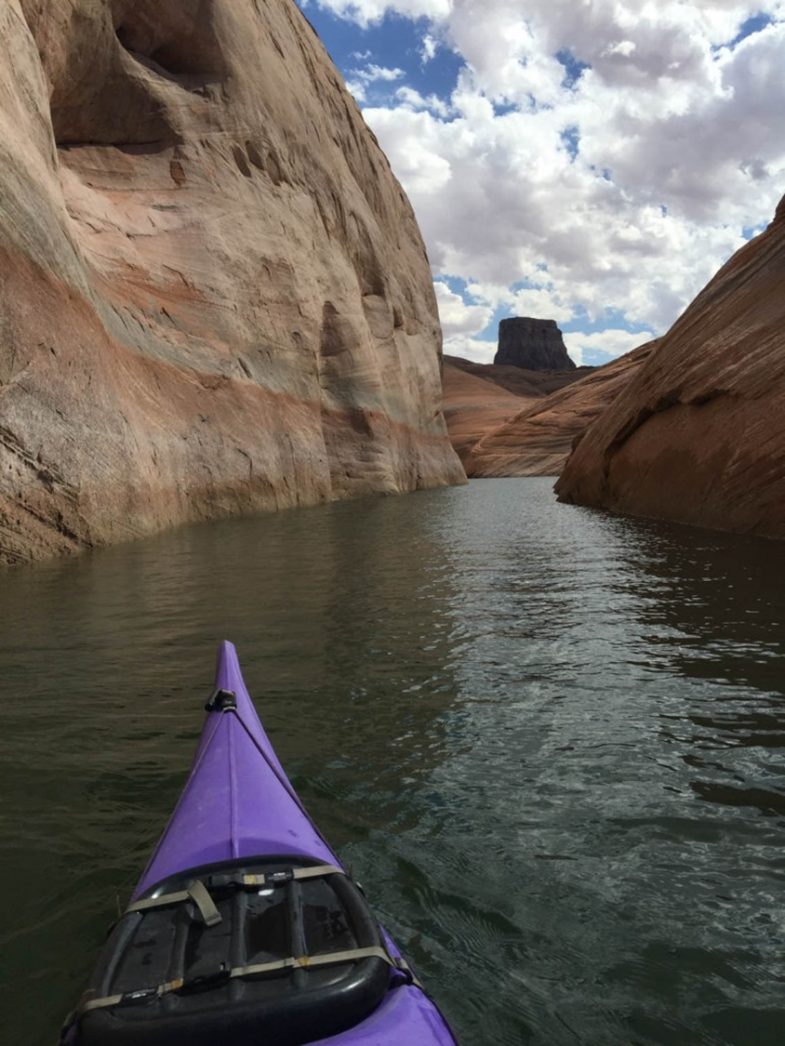
ORD CAREER Academy

Slide 61
CAREER ACADEMY 2026
Tenth cohort!
Our CAREER Academy is designed to help you win. Academy participants have a higher rate of success than do non-participants.
Academy participants learn strategies relevant not only for the CAREER proposal but for all proposals.
There is no limit on the number of times one can participate in the Academy.

Slide 62
CAREER ACADEMY 2026 (2/3)
Application portal will open November 3 and close December 3. Look for an email from your ADR and a link on the ORD webpage.
Notification of acceptance: December 8.
Criteria for acceptance: Number of previous attempts, fit with NSF areas, anticipated tenure date, balance among colleges.
Runs from January through July. Comprises presentations, group activities, peer reviews, individual consultations, heavy-duty editing. We have contact of some sort every week.
In January, individual Zoom conferences with accepted participants will be held to gauge readiness and tailor materials. Group sessions start the last week in January.
All workshop sessions will be held over Zoom and recorded.

Slide 63
CAREER ACADEMY 2026 (3/3)
Special benefits for Academy participants:
Privileged access to ORD editors after the Academy for other types of proposals, regardless of dollar value. We invest in your potential over the long term.
Potential to receive feedback on CAREER proposal from outside reviewers with subject-matter expertise (limited number of slots available, depending on VPR budget).
Debriefing to go over panel reviews and plan follow-up strategy.
Structured networking with other early-career faculty. Benefit from others’ expertise. Make friends!

Slide 64
NIH Accelerator

Slide 65
NIH ACCELERATOR 2026
Presented in collaboration with academic partner institutions (Clemson, Furman, and USC Medical School) and Prisma Health Education and Research Initiative (PHERI).
Extensive 9-month NIH academy for early-career investigators.
By the end of the program, participants will have a complete and competitive NIH grant application.
Led by Dr. Alain Litwin, Dr. Moonseong Heo, and Ashley King.

Slide 66
NIH ACCELERATOR 2026 (2/4)
Mentors and mentees meet twice monthly to discuss, present, and provide feedback on each mentee’s grant proposal.
NIH Accelerator mentors are present to provide consistent feedback and mentorship throughout the grant writing process based on their own expertise and proposal success within the NIH.
Each mentee is expected to have a primary mentor within their field ahead of the program start who can attend during the mentee’s scheduled presentations.

Slide 67
NIH ACCELERATOR 2026 (3/4)
Applicants should come prepared with a well-developed research question that fits within the aims of the NIH.
Applicants are strongly encouraged to have foundational knowledge of the NIH application process and the components of an NIH proposal.
Priority consideration is given to applicants whose aims align with Clemson Elevate or CU-PRISMA focus areas.

Slide 68
NIH ACCELERATOR 2026 (4/4)
Application process usually starts late summer.
Program runs from September–May.
Cohorts number 10–15.
Questions about the program can be directed to Ashley King (ashley.king3@prismahealth.org).

Slide 69

Questions?
QUESTIONS?
Contact us:
Jane Jacobi, jacobij@clemson.edu
Morgan Simpson, mesmpsn@clemson.edu
Ashley King, ashley.king3@prismahealth.org

