Slide 1
Supporting Your Journey to Zero Waste

Slide 2
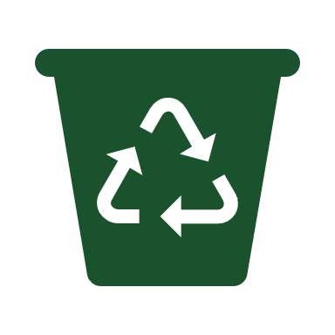
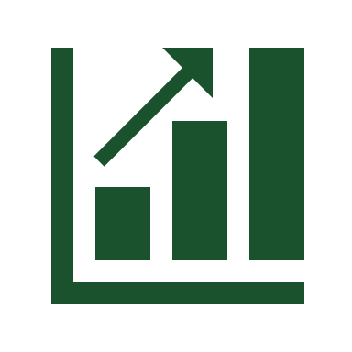
Kimberly-Clark Professional™ is the first manufacturer to offer a recycling program for non-hazardous PPE and Polypropylene wipes
Creates a lifecycle solution for single-use nitrile gloves, garments, and polypropylene wipes from laboratories, cleanrooms, industrial, high traffic areas and product packaging
Helps companies achieve their Corporate Social Responsibility and Sustainability goals
Since 2011, customers have diverted over 2160 MT, and 290 MT in 2022!
Notes:
RightCycle™ is the first of its kind! It is a post-consumer program managed by the manufacturer of single-use products. The program has been in market for 10 years.
It can drive successes within an organization’s Corporate Social Responsibility and Sustainability goals by diverting waste from landfill.

Slide 3
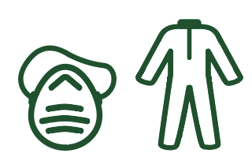
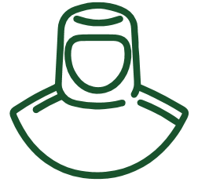
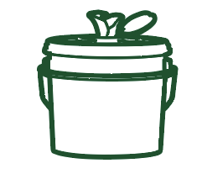
What can be recycled?
Kimberly-Clark Professional products* used in non-hazardous applications are eligible for recycling:
Nitrile & Latex Gloves
Garments/Apparel
Hoods
Bouffant Caps
Respirators
Beard Covers
Shoe & Boot Covers
Safety Eyewear
WetTask CriticalClean Wipes (06411, 06471, 77320)
Flexible Film Plastic Packaging
*Check our website for complete list of eligible products.

Slide 4
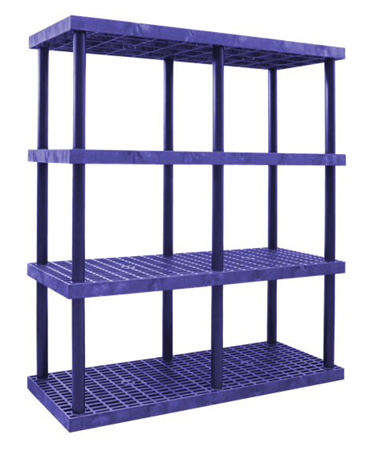
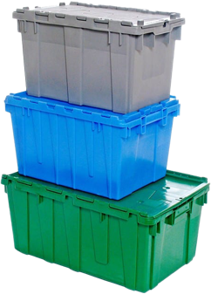
The RightCycle™ Process
Kimberly-Clark Professional products are worn in your facility.
Used products and packaging are collected and shipped to our recycling centers.
Used products and packaging are sorted and processed into plastic pellets.
Materials are molded into new plastic products and durable goods.

Slide 5
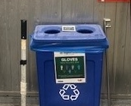
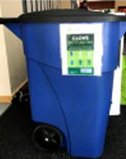
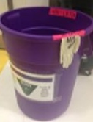
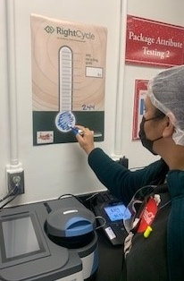
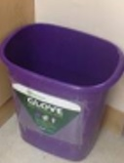
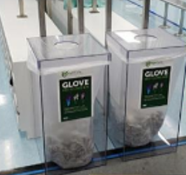
Collection of Used KCP Items
STEP 2
Bin placement and visual management are critical aspects of a successful recycling program and KCP can help with implementation.
How to Collect:
Gloves separate from all other materials
Wipes separate from all other materials or…
Commingled with apparel, respirators, eyewear, wipes
Gloves
Coveralls
Eyewear
Respirators
Polypropylene wipers
1
2
3
*KCP Flexible film packaging can be sorted with either gloves or all other products.
³ Average weight of African elephant (male) of 9,000 lbs.
www.seaworld.com
Notes:
Step 2 is Collection
Once the product is used, collect it in designated bins.
For recycling purposes, we ask that nitrile gloves are collected separate from apparel, eyewear, wipes and packaging.
Collect them using containers or corrugate you already have in your facility
Wipes MUST be dry before shipping to RightCycle™
A couple things we always consider at our manufacturing sites when staging collection bins are….
Placement: Placement of collection bins should be easy to access for the employees using Rightcycle™ approved products. Bin placement should also not change frequently to prevent incorrect disposal.
Visual management: It should be place above collections bins. It will reduce confusion and ensure successful segregation. KCP is happy to provide container labels, posters, and other visual management tools
These two things can help ensure a successful recycling program.

Slide 6
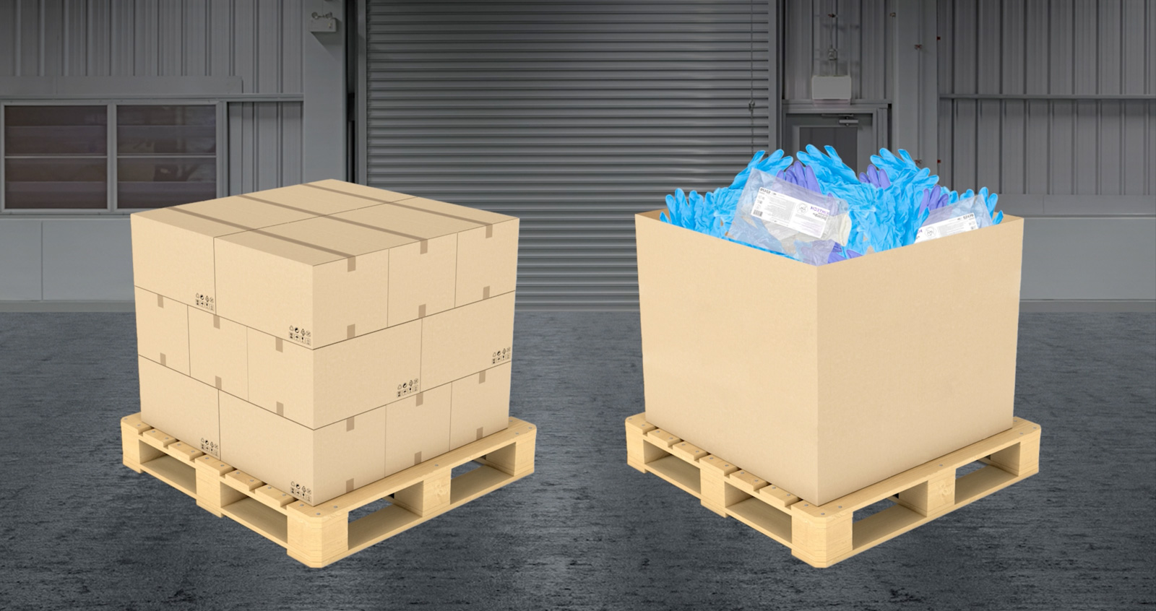
Used Products are Consolidated & Shipped
STEP 3
Used KCP products can be collected in either individual boxes or a gaylord box on a pallet.
Segregate gloves from all other KCP products.
Wet wipes must be verified DRY before shipping.
*KCP Flexible film packaging can be sorted with either gloves or all other used products.
*Wet wipes must be dry and free of free-standing fluids
³ Average weight of African elephant (male) of 9,000 lbs.
www.seaworld.com
Notes:
Step 3 Shipping:
Customers can consolidate the used products into a Gaylord on a pallet or into smaller boxes stacked on a pallet. All pallets ship to Millwood, WV to be processed and sorted.
Shipping is the ONLY expense the customer incurs!!.
Freightcenter.com can provide estimates for shipping costs to compare against current management costs. (Standard Work Doc’t available for review)

Slide 7
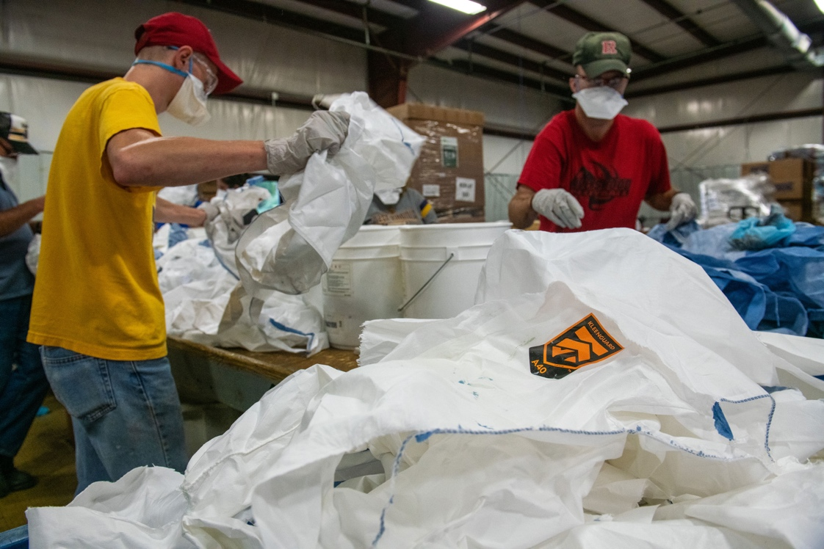
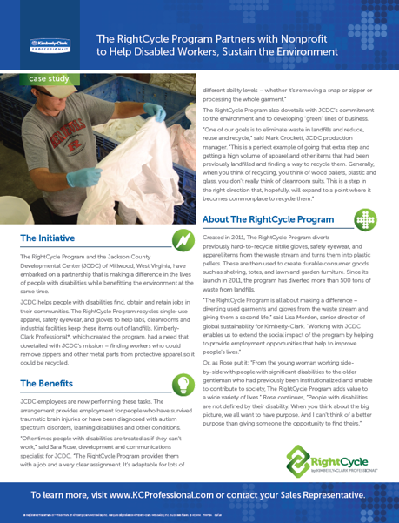
STEP 5
Used Products Shipped to Our Recycling Centers & Sorted
Jackson County Developmental Center
Non-profit social enterprise
Serves 6 counties in Millwood, WV
Provides job training and life skills for disabled and disadvantaged workers, including those with traumatic brain injuries
Helps address your Corporate Social Responsibility (CSR) goals
Notes:
Step 3 Processing
All processing and sorting is completed by a non-profit social enterprise, Jackson County Developmental Center (JCDC). KCP has partnered with them for 10 years! They provide job training and life skills for disabled and disadvantaged workers, including those with traumatic brain injuries.
Once the product is received in at JCDC, they sort, separate, remove contaminants and bale materials to be sent for recycling.

Slide 8
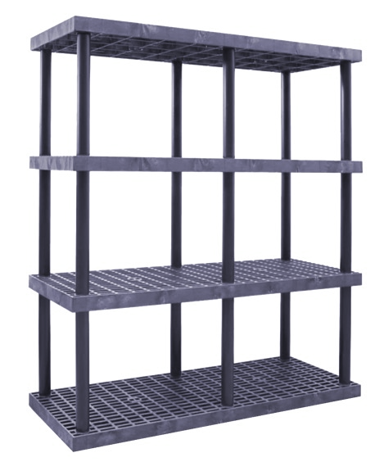
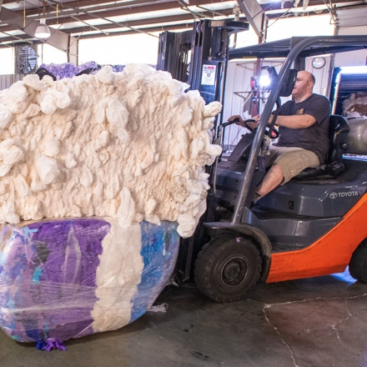
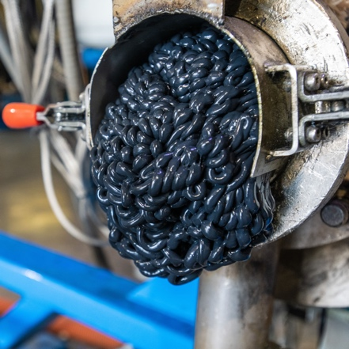
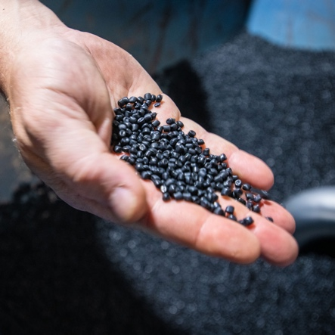
STEP 6
Used Products are Converted
The Cumberland Group (a.k.a. Somerset Recycling Services) processes all used products and works with various molding solutions to make new products.
KCP product processed into new resin
Resins molded into new consumer goods
³ Average weight of African elephant (male) of 9,000 lbs.
www.seaworld.com
https://youtu.be/CKErnDwoG0I
Notes:
Step 5: Conversion
Once a full load of baled, used product is ready, it ships to our recycling partner, Somerset Recycling Services, Inc. to be converted into new polymer resins to be sold into various molding applications to make new consumer goods!
Some of the key products that are being made with recycled PPE are:
Adirondack chairs
Industrial shelving and totes
The best part of the program is that all of the processing happens in the United States and the program is fully auditable!

Slide 9
Our Journey Towards Zero Waste
1,027 customers enrolled since 2011
4.08 MT = the average weight of a male African elephant
2160 MT* diverted since 2011
Active programs in North America & Europe
290 MT* diverted in 2022
529
Program has been in market 12 years
71

Slide 10
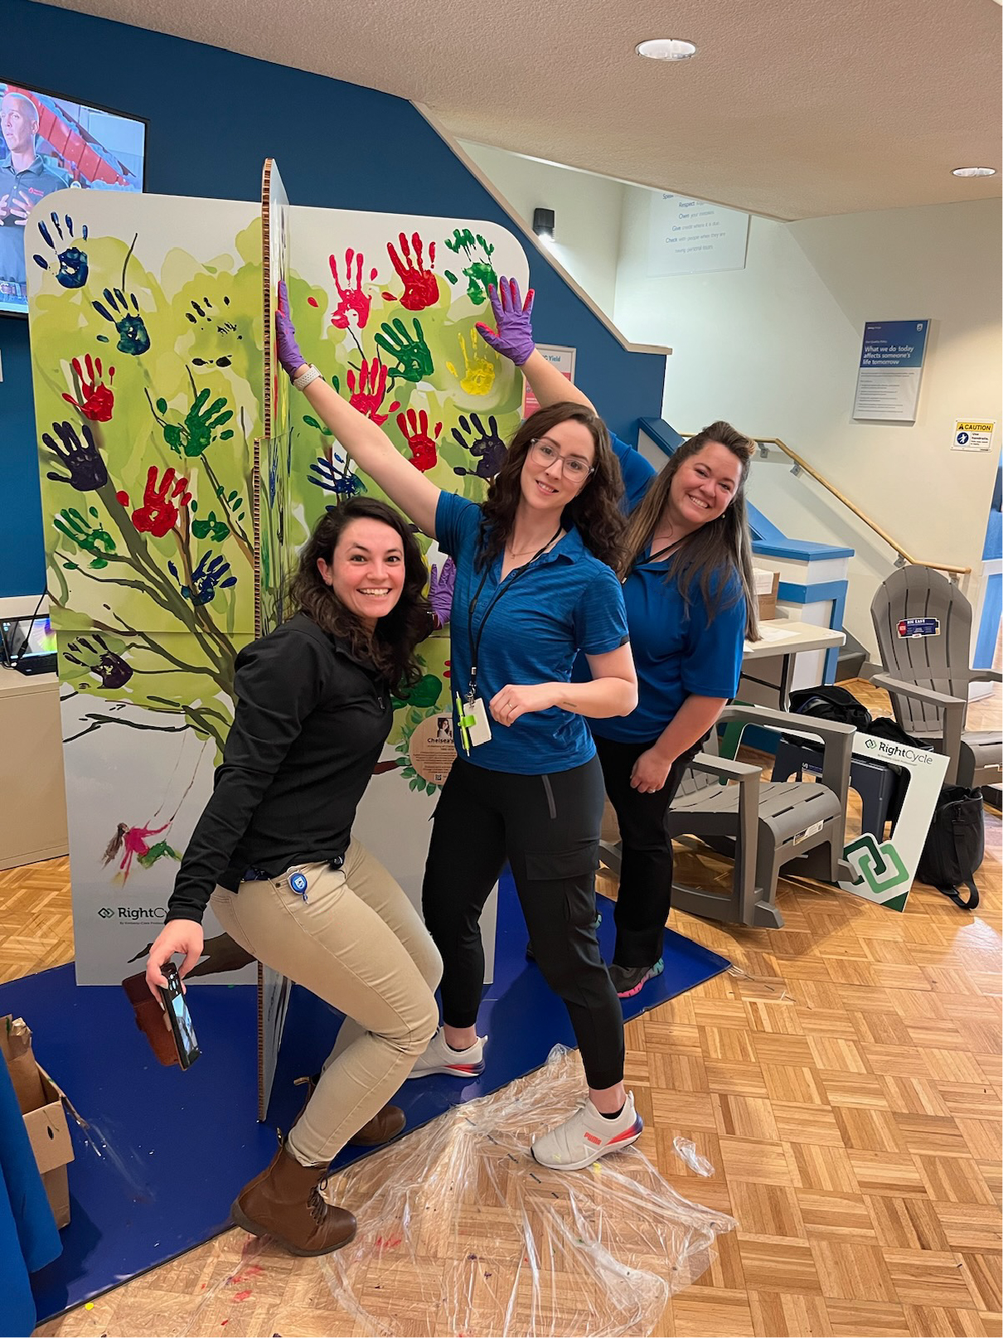
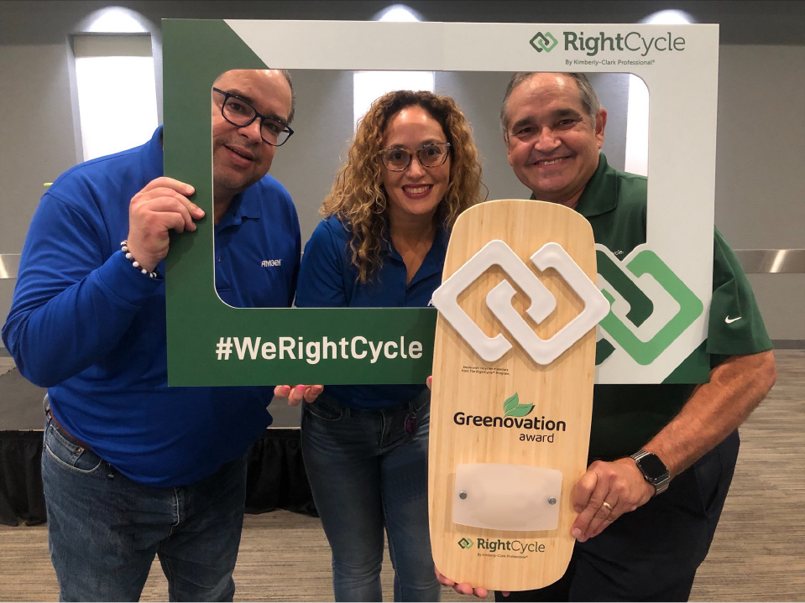
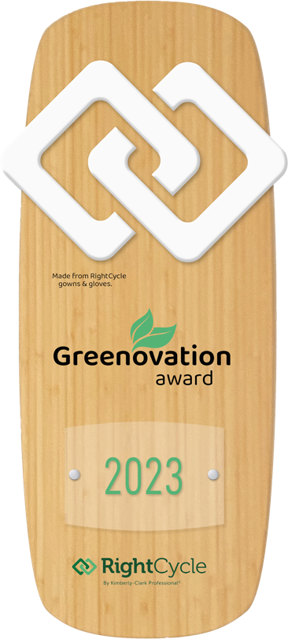
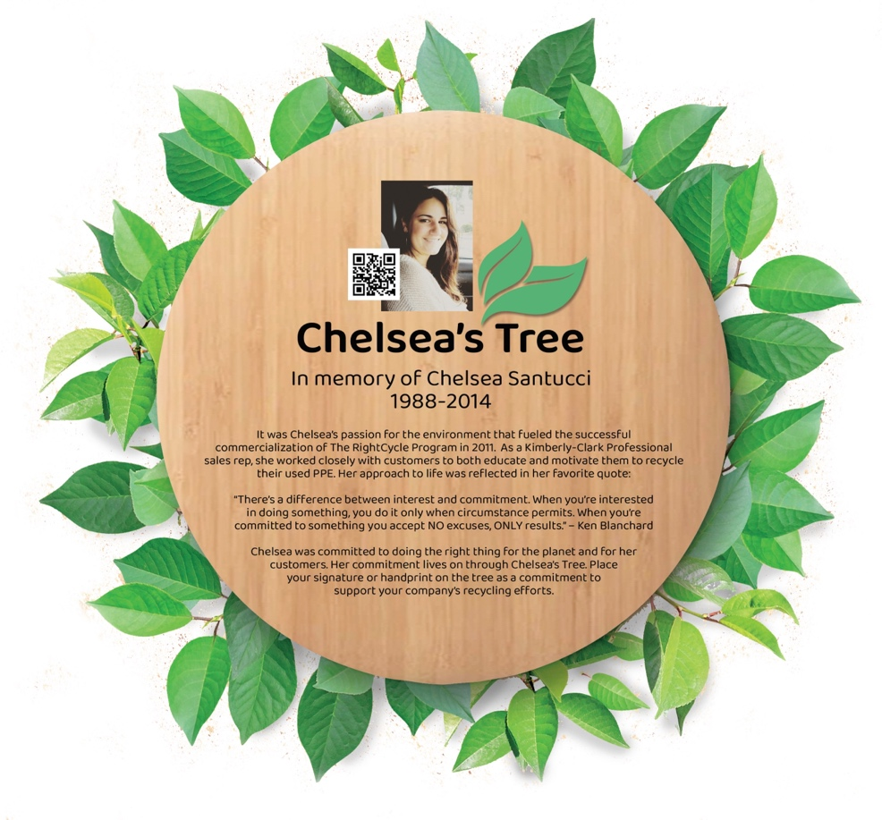
Greenovation Award Program A select number of RightCycle™ customers are chosen each year to receive the Kimberly-Clark Professional Greenovation Award.
Notes:
Awards
During Earth Month (April), we celebrate a select number of RC customers with the Greenovation Award. This award program was established in 2013 and has become a great source of PR and excitement for our customers. The plaques are presented at in-person events where employees can join in the celebrations. To create an engaging experience, and a reminder of why #WeRightCycle, we created Chelsea’s Tree to honor a Kimberly-Clark Professional employee who passed away from cancer at age 26. Chelsea Santucci was passionate about sustainability and instrumental in the creation of The RightCycle™ Program. It is our hope that her memory and her legacy will live on by sharing her story at these events.
Award winners are chosen by sales leadership, based on participation in The RightCycle™ Program and the customer’s sustainability leadership with other landfill diversion initiatives. In 2024, we will provide a scorecard for sales pros to share with customers so that they understand the nomination process.

Slide 11
Why partner with us?
Kimberly-Clark is a responsible partner that will support your Environmental, Social and Governance (ESG) commitments.
Aggressive, impactful and transparent 2030 sustainability goals.
Reviewed and approved by Science-Based Targets Initiative.
Responsible landfill diversion programs through The RightCycle™ Program.
Supports your zero or near-zero waste goals!
Resources before, during and after implementation.
WasteBits, dedicated RightCycle Specialist, visual management materials, KCP field sales support.
Transparency and tracking.
Real-time data, on-site or virtual audits of our recycling partners.
Notes:
Kimberly-Clark has aggressive, impactful and transparent 2030 sustainability goals around improving the lives of one billion people in underserved communities and reducing our forest, water and plastics footprint by 50%. We’re also committed to reducing our Scope 1 and Scope 2 emissions by 50% as well as our Scope 3 by 20%. All of these goals have been reviewed and approved by the Science-Based Targets Initiative (SBTi).
The RightCycle Program provides a landfill diversion solution for hard-to-recycle items (PPE, wet wipes, plastic packaging) and converts them into new consumer products
RightCycle is easy to implement (you can do it, we can help!) and we have kick-off materials, change & visual management, and help coordinate shipping. We also provide metrics, reports and awards on your environmental impact.
We’re here to help you achieve your personal and professional goals around sustainability

Slide 12
Q&A

