Slide 1
7.5 and 15 TB Test Bay Controlled Access
Developed, reviewed and approved by:
K. Bulgakov
K. Rayburg
J. Tuten
J.Fox
6/15/2016
Updated 9/19/18, 12/11/20, 1/11/21

Slide 2
Purpose and responsibilities
Goal:
This protocol is intended to ensure control of the test bench perimeter during testing and other operations . Access to areas are only by permission of operator. Entry is through control room. This plan is based on existing operational experience and barricade process. Periodic review of this protocol will be conducted by operations team.
Responsibilities of Test Engineers for 7.5 and 15 TB:
Secure the TB perimeter as per plan (with staff support where necessary)
Make decisions on perimeter opening on a daily basis (no barricades left without reason)
Open the perimeter when testing is complete. (end of each day)
Decision should be made regarding access outside the perimeter during extreme load or high dynamic testing.
Management / safety line responsibilities:
Plan is reviewed and revised annually (revised on 12/11/2020)
Perform periodic perimeter observation and safety review and assure barricades, poles, tape, signs, locks, etc. are available and in place

Slide 3
Q&A
Q: Can anyone work or be inside the closed perimeter during testing?
A: Yes, only personnel authorized by the operator for purpose of direct work duties. No walk through.
Q: How are danger signs and red barricade tape applied to the MHU doors?
A: MHU will be included in the controlled access area. This will help to avoid entrance to closed perimeter area from MHU when Nacelle is not running (no audible noise). Only authorized personnel are expected to be inside the hydraulic corridor.
Q: May visitors access mezzanine area during perimeter closed testing?
A: No. There is a hydraulic and rotating shaft exposure.

Slide 4
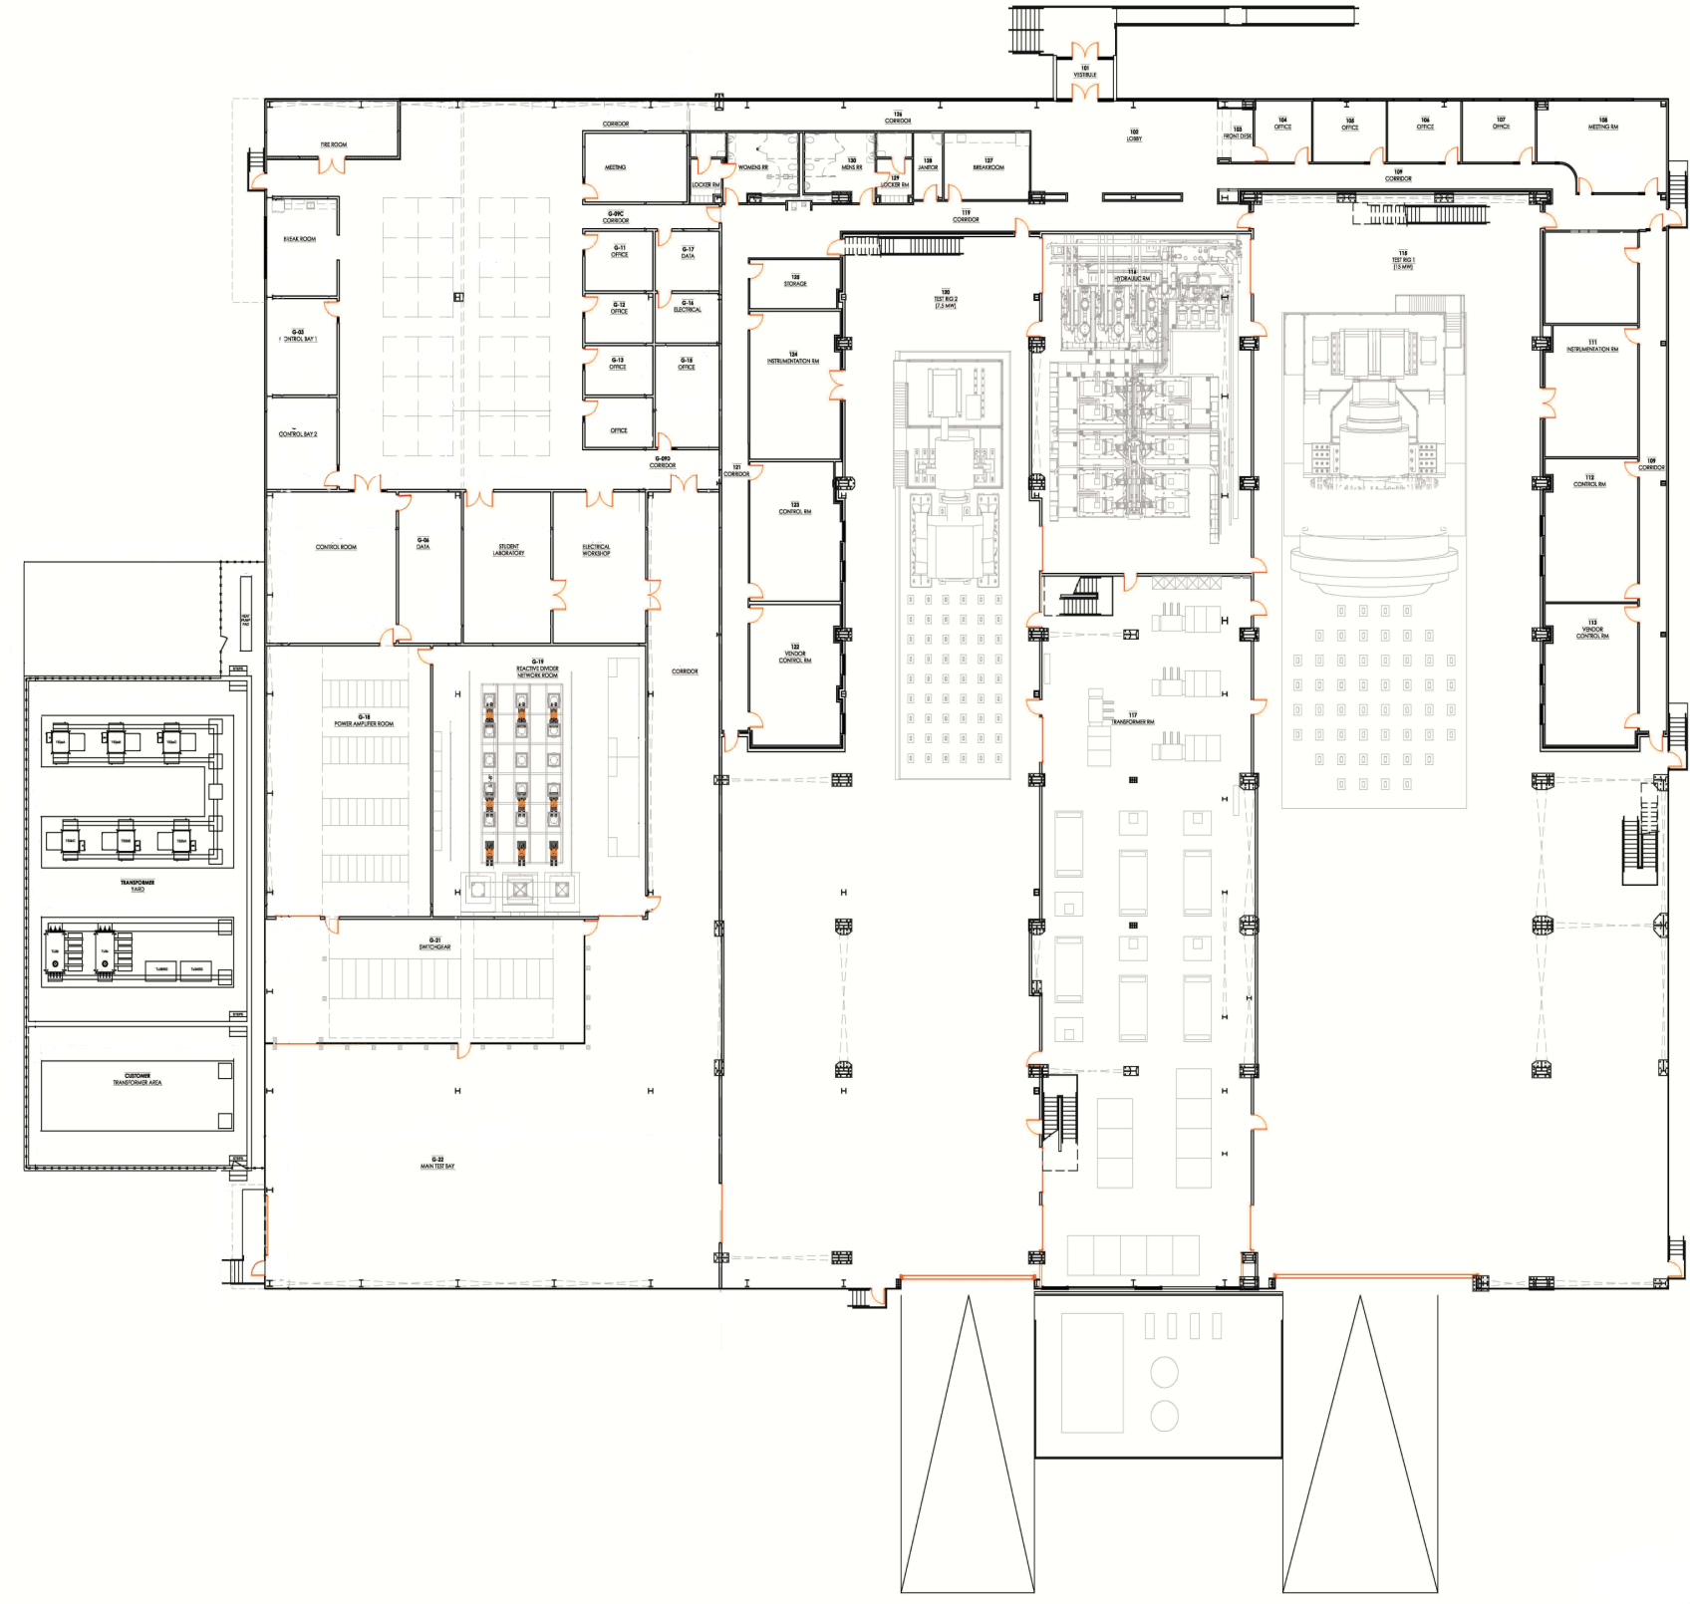
Facility layout with controlled perimeter and visitors area
VISITORS
7
8
4
VISITORS
9
5
6
10
Test Specific
1
2
3
VISITORS
VISITORS

Slide 5
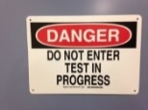
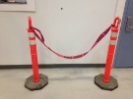
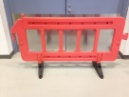
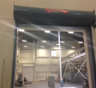
7.5 TB perimeter
Map | Point of perimeter | Action
1 | Entry | barricade |  |  | x
2 | Entry | barricade |  |  | x
3 | Visitor line | barricade |  | x
4 | Door | Add barricade tape | x | X
5 | Door | add barricade tape | x | X
6 | Door | add barricade tape | x | X
7 | Door | add red tape | x | X
8 | Door | add red tape | x | X
9 | Door | add red tape | x | X
10 | Door | add red tape | x | X

Slide 6
Step by step perimeter closure check procedure 7.5 TB
Week of ______________
N | Action | MON | TUE | WED | THR | FRI
 | TEST OPERATOR INITIALS:
 | Test Engineer: close perimeter before testing
 | Are barricades set for zones 1-3?
 | Are their 7 signs with tape on the doors for zones 4-10?
 | Is anyone in Nacelle? (is warning chain across Nacelle entry and camera in operator room verifies?)
 | Is anyone on the mezzanine?
 | Inform staff / contractors if anyone is working on the floor in the test bay.
 | Test Engineer: open perimeter after testing
 | Remove barricade for zone 1,2,3 and 7 signs for 4,5,6,7,8,9,10
*See adopted xls file for print and operational check up

Slide 7
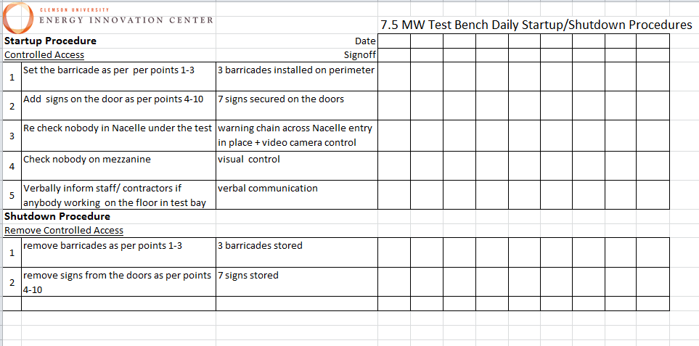

Slide 8
Test Bay Operational Indicator
Test Rig Status | Purpose
Starting a Test | Horn: Warning before a Test is started or manual by Operator All personnel evacuate controlled area
Alarm is active | One or more Alarms are active
Warning is active | One or more Warnings are active
Test Mode | Test bench is in Test Mode Do NOT enter controlled area
Setup Mode | Test bench is in Setup Mode

Slide 9
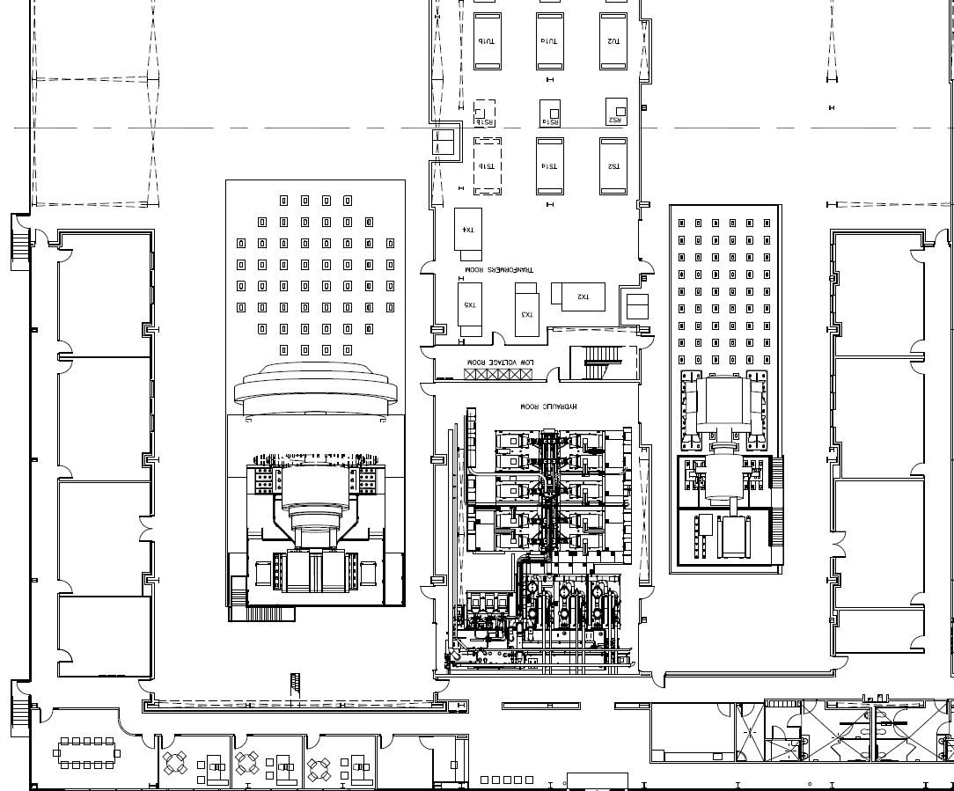
15 MW Controlled Access Test Mode
Test Specific
2nd floor

Slide 10
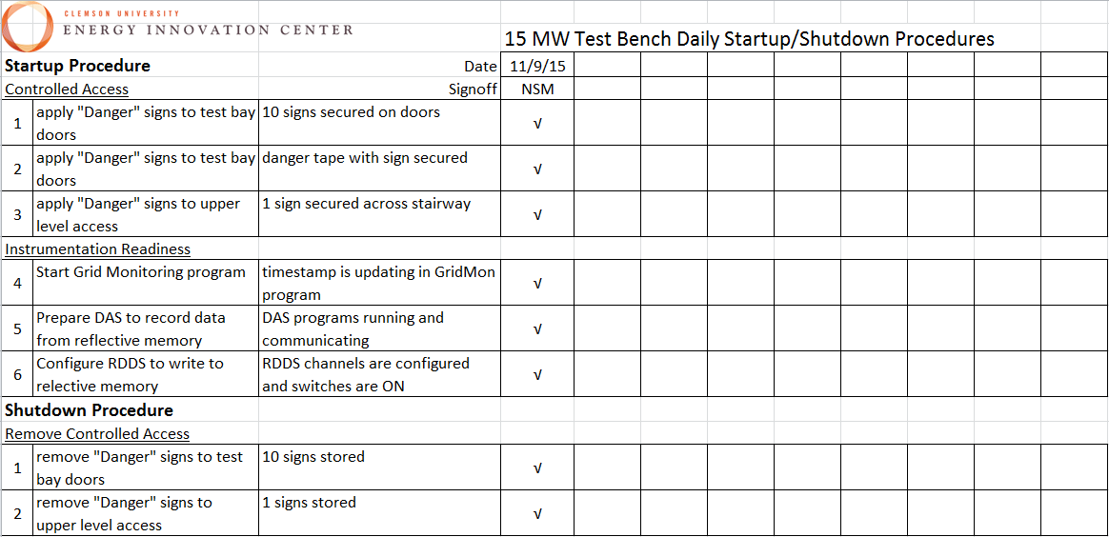
Checklist Example
Print from excel file for binder pages

