Slide 1
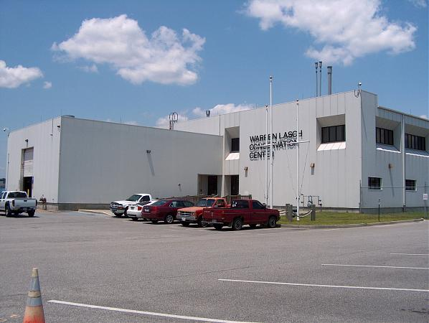
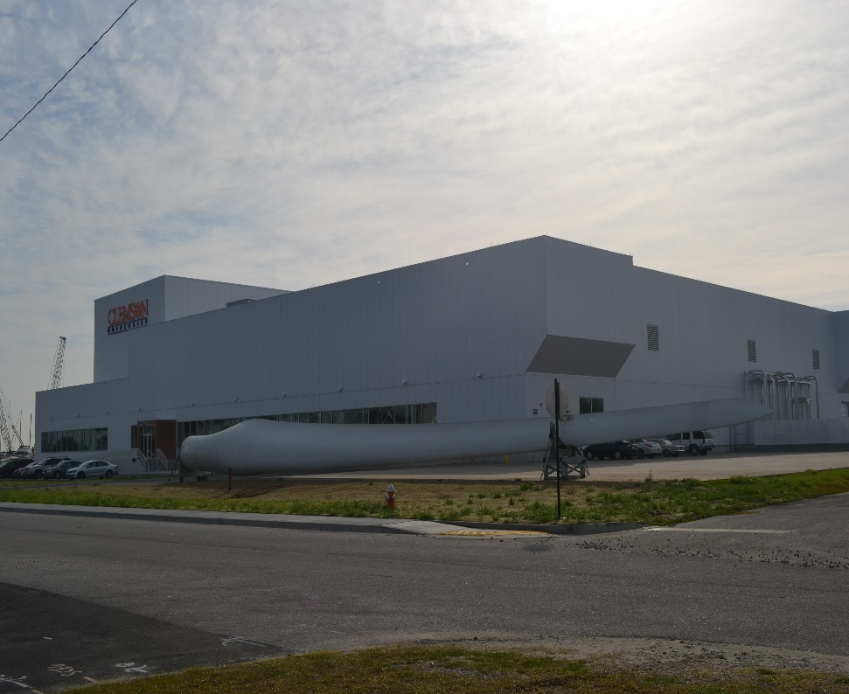
Clemson University Fall Prevention and Protection Training
Presented by:
Kurt Rayburg, CSP, CPEA
Safety Manager - CURI

Slide 2
Elevated Work Policy
Fall Prevention Program June 29, 2020

Slide 3
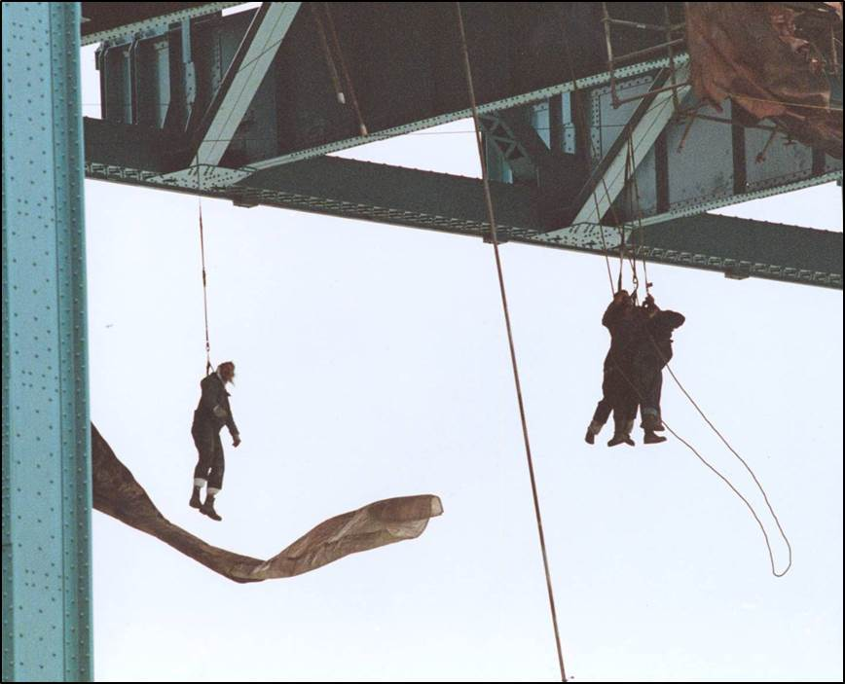
Fall Injury Statistics
According to data from the Bureau of Labor Statistics 687 workers were killed from falls to the same or lower level.
Falls to a lower lever caused 541 of those fatalities
Notes:
http://www.bls.gov/news.release/cfoi.nr0.htm
Fatal falls, slips, or trips took the lives of 666 workers in 2011, or about 14 percent of all fatal work injuries. Falls to lower level accounted for 541 of those fatalities. The revised Occupational Injury and Illness Classification System (OIICS) added the capability of recording the height of the fall. In 2011, the height of the fall was reported in 451 of the 541 fatal falls from higher level. Of those 451 cases, about one in four (115) occurred after a fall of 10 feet or less. Another fourth (118) occurred from a fall of over 30 feet
These are the Lucky ones…6 of their Buddies were not

Slide 4
Anatomy of a Fall
.33sec./2 feet
.67 sec./7 feet
1/3 of a second to become aware.
1/3 of a second for the body to react.
7 feet in 2/3 of a second.
1 sec./16 feet
2 sec./64 feet

Slide 5
Scope
Fall Prevention or Protection must be used anytime an employee is working from an unprotected elevation of 4 feet* or more above the ground or the next level.
This program applies to all CURI facilities and sites
*Program does not apply to ladders

Slide 6
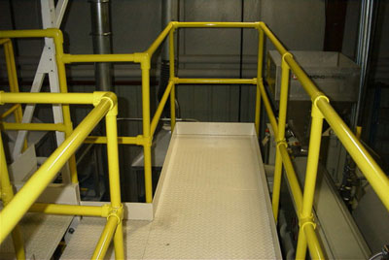
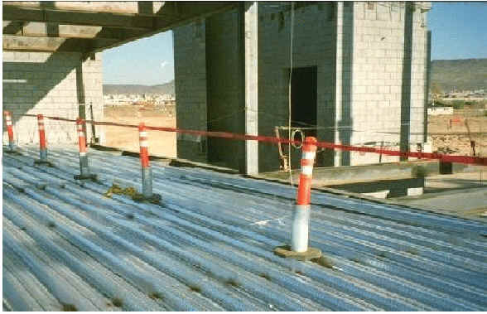
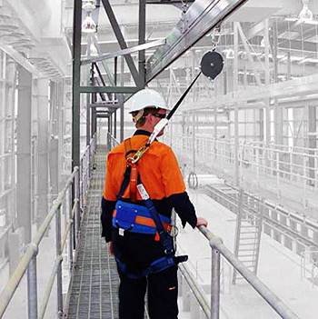
Methods to control fall hazards in order of priority
Elimination/Engineering
Lower the work to a safe height
Install guard rail systems
Administrative
Limit access
Roof Permit
Warning Line W/ Monitor
Safe Operating Procedure (SOP)
PPE
Personal Fall Restraint System
Personal Fall Arrest System

Slide 7
Responsibilities
Employees have the primary responsibility for proper care, use and inspection of their assigned fall protection equipment, as well as act in accordance with the Fall Prevention and Protection Program.
All employees have the primary responsibility to assess the job/task to be performed to ensure they have the proper equipment for fall protection utilizing the fall hazard assessment form.
Managers / Directors have the responsibility for the implementation of the Fall Prevention and Protection Program at their site.

Slide 8
Fall Hazard Assessment
A fall hazard assessment (attachment 1 in Fall Protection Program) is required to be conducted to recognize fall hazards and implement the best means of fall prevention or protection for each situation.
When a new fall hazard is recognized, the manager, supervisor, and / or safety coordinator must address the situation.

Slide 9
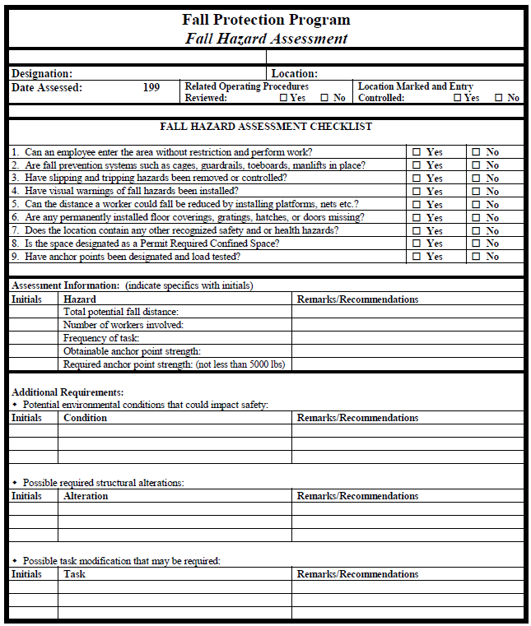

Slide 10
Personal Fall Protection System

Slide 11
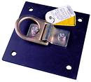
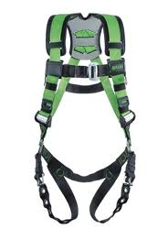
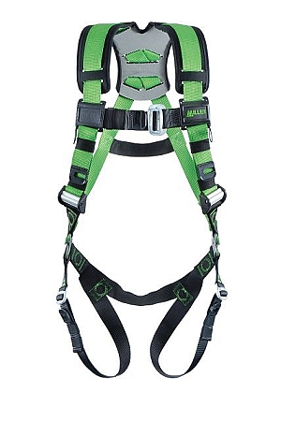
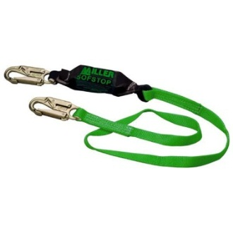
Components of Personal Fall Protection System
Anchor point (temporary or permanent)
Body Harness
Connecting device (Lanyard, retractable, etc.)
Remember: The ABC’s of fall protection!
Personal Fall Protection System

Slide 12
Always Inspect Fall Protection Equipment BEFORE USE
Always read the label!
STEP 1: Webbing Straps
STEP 2: D-Rings
STEP 3: Buckles
STEP 4: Stitching
STEP 5: Pads
Notes:
Demonstrate inspection

Slide 13
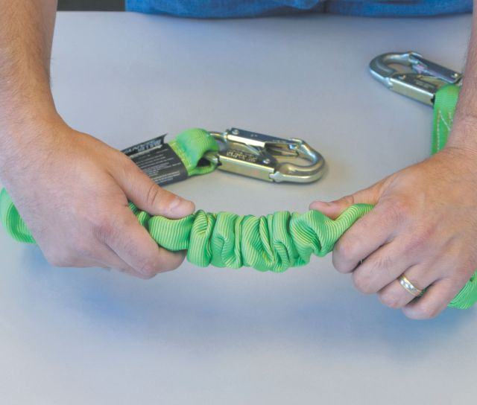
Lanyard Inspection
When inspecting lanyards, begin at one end and work to the opposite end, slowly rotating the lanyard so that the entire circumference is checked.
Step 1) Hardware
A) Snap hook gate (Top Picture)
Step 2) Webbing
Step 3) Shock Absorber
Example of Snaphook with 3600 lb gate
Notes:
Demonstrate inspection

Slide 14
Inspection Notes
If a proper inspection cannot be done due to dirt, dust, etc build-up, the harness and or lanyard cannot be worn and must be cleaned immediately.
If a defect is noticed during the inspection, it must be removed from service immediately.
Bring to your Manager / Director for removal and for a new harness.

Slide 15
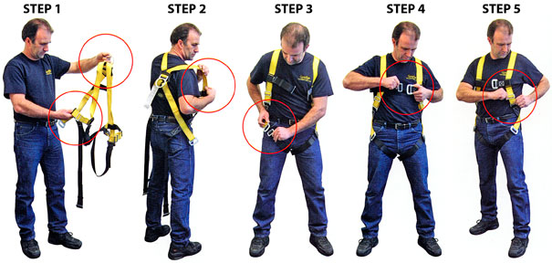
Donning a Harness

Slide 16
Donning A Harness: 5 easy steps that could save your life
NOTE: Harness styles vary. Always refer to the instructions enclosed with your harness.
Hold the harness by the back D-ring. Shake the harness to allow all straps to fall in place.
If chest, leg, and/or waist straps are buckled, release the straps and unbuckle at this time.
Slip the straps over shoulders so the D-ring is located in middle of the back between shoulder blades.
Pull the leg strap between legs and connect to the opposite end. Repeat with the second leg strap. If belted harness, connect the waist strap after the leg straps. The waist strap should be tight, but not binding.
Connect the chest strap and position in the mid-chest area. Tighten to keep the shoulder straps taut.
After all straps have been buckled, tighten all buckles so the harness fits snugly but allows full range of movement. Pass excess strap through loop keepers.
**Demonstrate how to properly don a harness with the employee and have then them demonstrate they can properly don the harness

Slide 17
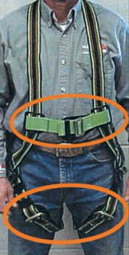
Donning A Harness
Only form of body wear acceptable for fall arrest is the full-body harness.
Should be selected based on work to be performed and the work environment.
Side and front D-rings are for positioning only.
Incorrect Harness Fit
Chest strap positioned incorrectly. Should be located at mid-chest to keep shoulder straps snug. Leg straps are too loose.
Premium Harness
“Photos/Illustrations/Information courtesy of Miller® Fall Protection”

Slide 18
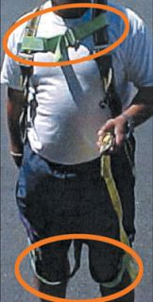
Incorrect Harness Fit
Chest strap positioned too high and too loose. Leg straps are positioned improperly.
“Photos/Illustrations/Information courtesy of Miller® Fall Protection”

Slide 19
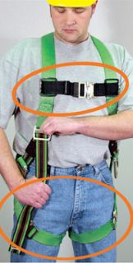
Correct Harness Fit
Chest and Leg Straps Offer a Snug Fit
“Photos/Illustrations/Information courtesy of Miller® Fall Protection”

Slide 20
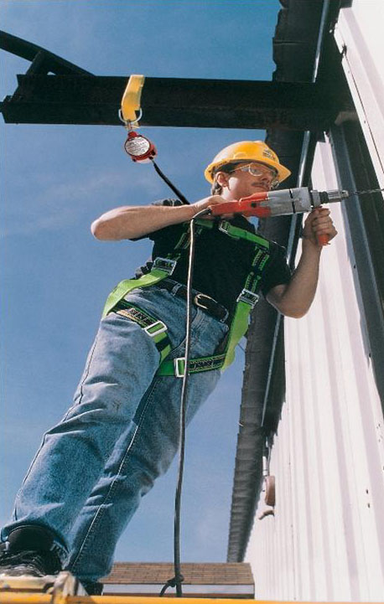
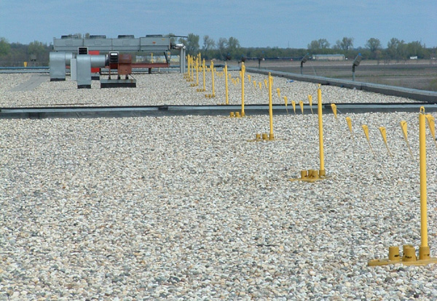
Types of Fall Protection
Prevention
Guardrails
Restraint/Positioning
Warning Lines
Safety Monitors
Protection
Personal Fall Arrest
Safety Nets

Slide 21
Fall Restraint Vs. Fall Arrest
FALL RESTRAINT
Stop employee from reaching the fall hazard
Anchorage point must support 1000 lbs per employee
Can connect to any D-ring on the harness
FALL ARREST
Prevents an employee from falling to a lower level once a fall has occurred
Anchorage point must support 5000 lbs per employee
Can only connect to the D-ring on the back of the harness

Slide 22
Fall Restraint
Travel Restraint system is an anchor, lanyard, and body harness used to limit travel to prevent an employee from reaching a fall hazard. Fall restraint is typically the preferred means to protect employees from falling as it prevents the user from reaching the fall hazard and suffering an injury resulting from a fall.
Anchors may be temporary or permanent.
Temporary fall restraint anchors must be capable of supporting a 3000 lbs. load per employee.
Permanent (Engineered) restraint anchors must be designed to support 3000 lbs. force per employee or at minimum twice the maximum force needed to keep the employee from the fall hazard.

Slide 23
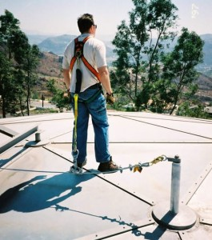
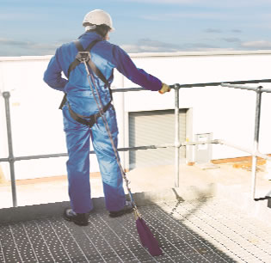
Fall Restraint Examples
Work near the edge of a roof (within the 6ft boundary).
Walkway with open sides

Slide 24
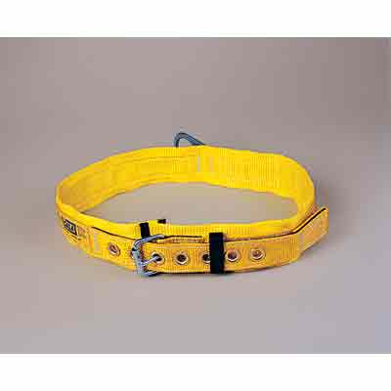
Fall Arrest Requirements
Personal fall arrest system
Should only be considered when Prevention is not Feasible!
is a system used to arrest an employee’s fall from a working surface. It is comprised of an anchor, lanyard with shock absorber, and a full body harness. The use of body belts is prohibited.
ALWAYS INSPECT YOUR HARNESS BEFORE USE!!!!!!!!!!!!!!!

Slide 25
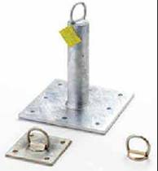
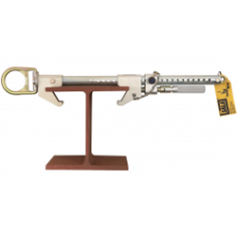
Anchorage Point
Must support 5000 lbs. per employee attached for fall arrest,
Or as part of a complete personal fall arrest system which must withstand twice the maximum arresting force (MAF) and designed by a competent person
5000 lbs per employee attached

Slide 26
Fall Protection Systems Personal Fall Arrest Systems
Must be inspected prior to each use.
Equipment worn in fall event must be retired from service
Full body Harness must limit arresting force to 1800lbs.
Nylon strap harness = 2800lbs
Nylon rope lanyard = 2300lbs
Steel rope lanyard = 4000lbs
Shock absorbing lanyard = 900lbs

Slide 27
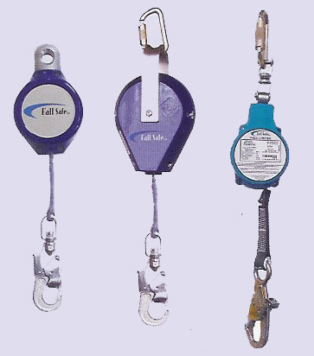
Fall Protection Systems Personal Fall arrest Systems
Lanyards must have breaking strength of 5000 lbs.
Lanyard to attach on harness between employee shoulders
Self retracting lifelines must stop a fall in 2’maximum and have 3000 lb strength

Slide 28
Fall Protection Systems Positioning Device Systems
Positioning devices to be rigged so that employee will not fall more than 2’.
Positioning device to be secured to an anchor point that will support the maximum impact load of 3000lbs.
Letter of interpretation for use of positioning devices for work on rebar allows up to 24
feet while using positioning alone.

Slide 29
Anchor Point
Never wrap lanyards around sharp or rough anchor points.
Ensure that the anchor point is at a height that limits free-fall distance to six feet or less.
The anchor point is at a height at or above the harness D Ring
When selecting an anchorage point, always remember that shock absorbers may elongate up to 3-1/2 feet.
Never use an anchor point which will not allow snap hook or carabineer keeper to close.
Try to work directly under the anchor point to avoid a swing-fall injury.

Slide 30
Choosing an Anchor Point for Fall Arrest
Personal fall arrest systems should not be attached to guardrails.
Exceptions
Guardrail must be capable of supporting at least 5,000 pounds per employee attached.
OR
Is able to withstand twice maximum arresting force) and under the supervision of a qualified person. (GENERALLY 3600 lbs)

Slide 31
Choosing an Anchor Point for Fall Arrest
There can only be ONE employee tied off to an anchor point
Anchors must be connected as directly overhead as possible, especially when using a retractable lanyard.
Free fall distance must be limited to 6 feet or less
In most cases, pipes and conduit are not capable of supporting 5000 lbs. of force. The contents of pipes should also be considered when evaluating whether to use as an anchor – steam, corrosive acid, high volumes of water, etc.

Slide 32
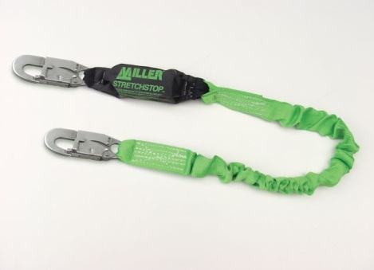
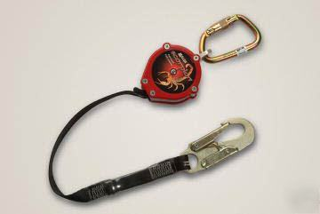
Lanyards
Shock absorbers are required in ALL fall arrest situations. It may be installed permanently in a retractable lanyard, permanently in a fixed length lanyard, or as a separate system component.
Retractable lanyards are preferred in most fall arrest situations, because the overall stopping distance is shorter than fixed length lanyards. If a fixed length lanyard is used, the shortest possible lanyard must be used.

Slide 33
Lanyards
Only compatible connections between the snap hook and anchor or body harness are allowed.
Fall protection equipment must only be used as it was designed.
Lanyards must not be choked (tied back to itself) unless it is designed as such.
Two snap hooks must not be connected to together.
Rebar or pelican hooks must only be used vertically.
Only one snap hook must be connected to one D-ring at a time.
Snap hooks must not be connected to horizontal lifelines unless designed as such.
Lanyards must be used only within their weight capacity limitations.
Review the types of fall arrest lanyards used onsite!

Slide 34
Fall Arrest Examples
Discuss where to use fall arrest at your site!

Slide 35
Swing Fall
Don’t forget to take into account “swing fall” when using a RL
Line angle should not be greater than 30 Degrees
Consult with your Supervisor or Safety Professional when in doubt

Slide 36
When There Is No Tie-off Point for Fall Arrest
Examine possible alternatives.
Engineering controls
Ex: guard rails
Travel restraint (only requires 3000 lb capacity)
Manlifts
Temporary anchors

Slide 37
Rescue
Employees who fall using a personal fall arrest systems must be rescued promptly

Slide 38
Suspension Trauma (Harness Hang)
Suspension trauma or harness hang syndrome death is caused by orthostatic intolerance. Orthostatic intolerance can occur any time a person is required to stand quietly for prolonged periods and may be worsened by heat and dehydration.
Your body’s normal reaction is to pass out because it is easier for blood to return to the heart while in a horizontal position…this cannot happen while suspended upright in a harness
Symptoms include:
Nausea
Dizziness
Sweating
Confusion
If you have suffered a fall be sure to keep your legs moving
Lift knees to your chest or use your legs to push off the side of a structure if you are able
This will help keep blood circulating until a rescue has been completed

Slide 39
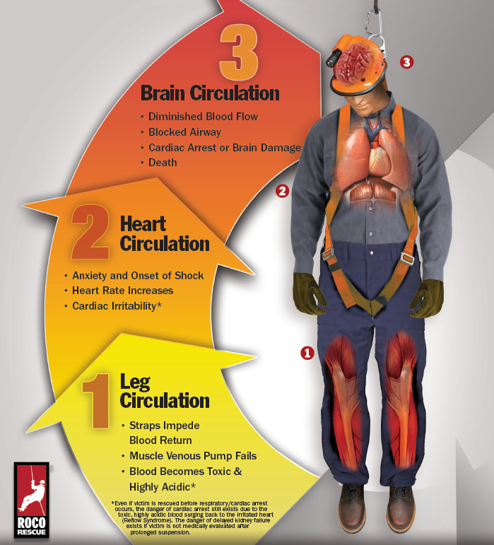

Slide 40
Rescue
Before employees perform work requiring the use of a personal fall arrest system, a rescue process must be developed.
Analyze rescue for specific task and document in the fall hazard assessment.
Develop means for emergency team (or supervisor) to be notified in the case of a fall.
Employee must understand the emergency notification system and have tools to notify.
The people that perform rescue for a fallen employee must have prior training and equipment needed to rescue.

Slide 41
Rescue
Preferred rescue techniques are listed below in priority order.
The employee can self-rescue without placing himself or anyone else in danger.
A trained scissor or aerial lift operator can safely perform the rescue.
The local trained fire department performs the rescue.
CU employee trained rescue team.

Slide 42
Rescue
Trained employees may perform rescue only within the scope of their training (e.g. aerial lift trained).
Scissor lift and aerial lifts may be used by trained operators.
No employee will endanger a fallen employee by using equipment not designed for the situation. For example, come-alongs, crane hook, fork-truck and a pallet must not be used.
Working surfaces must be capable of supporting the load imposed on the surface (i.e. the employee, materials, tools, and equipment utilized).

Slide 43
Roof Access
Before work is performed on a roof where it is not normally traveled, verification must be made to ensure the roof is designed to hold the employees, materials, tools, and equipment to be used and it is in good condition.
Stay 6 ft away from edge at all times.

Slide 44
Roof Access Permit

Slide 45
Storage
Fall Protection Equipment must be stored in a cool, dry and clean environment out of direct sunlight. Avoid areas where chemical vapors exist. Employees using fall protection equipment must return the equipment to its proper storage area, unless you have been assigned your own equipment (i.e. full body harness).

Slide 46
Inspection and Maintenance Requirements
Competent person inspections
All fall protection equipment (anchors, lanyards and body harnesses) must be inspected at least annually
If equipment is used routinely or is exposed to rugged working conditions the site must increase competent person inspection frequency to quarterly or monthly depending on the need
Documentation must be maintained for the period of time the equipment is in service
The life expectancy of fall protection equipment is determined by the manufacturer (typically 5 years).
If equipment is questionable or does not pass inspection it must be removed from service and destroyed or re-certified per manufacturer instructions.

Slide 47
Training requirements
Verification that employees understood classroom training through use of a quiz or other means.
Employees must display competence by demonstrating their ability to physically don and use the PPE and equipment.
Retraining shall be provided as need if determined by supervision, deficiencies are found in procedures or employee performance. Modifications or changes are made to fall hazards or fall hazard control equipment. If additional training or retraining is requested by employees

Slide 48
Retraining
When determined by supervision due to deficiencies or employee actions
When training becomes obsolete due to workplace changes
When the fall protection system changes
When employee(s) request additional training or retraining for any reason

