Slide 1
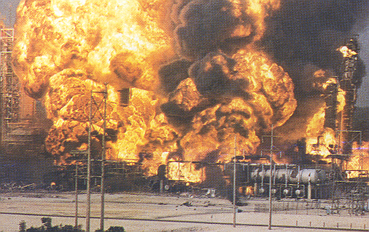
Means of Egress and Fire Protection
Notes:
This presentation is designed to assist trainers conducting OSHA 10-hour General Industry outreach training for workers. Since workers are the target audience, this presentation emphasizes hazard identification, avoidance, and control – not standards. No attempt has been made to treat the topic exhaustively. It is essential that trainers tailor their presentations to the needs and understanding of their audience.
This presentation is not a substitute for any of the provisions of the Occupational Safety and Health Act of 1970 or for any standards issued by the U.S. Department of Labor. Mention of trade names, commercial products, or organizations does not imply endorsement by the U.S. Department of Labor.

Slide 2
Introduction
Fires and explosions kill more than 200 and injure more than 5,000 workers each year
There is a long and tragic history of workplace fires in this country caused by problems with fire exits and extinguishing systems
OSHA requires employers to provide proper exits, fire fighting equipment, and employee training to prevent fire deaths and injuries in the workplace
Notes:
In 1995, more than 75,000 workplace fires cost businesses more than $2.3 billion
Means of Egress: 29 CFR 1910 Subpart E
Fire Protection: 29 CFR 1910 Subpart L
More complete information on means of egress can be found in the National Fire Protection Association document:
NFPA 101: Life Safety Code

Slide 3
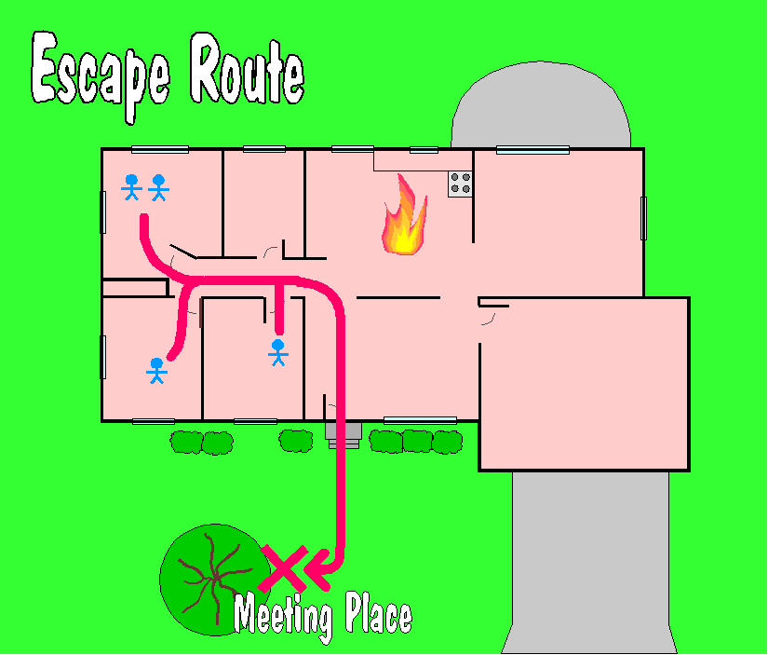
Escape Route
A continuous and unobstructed way of exit travel from any point in a building or structure to a public way (a street, yard, court or other open space leading to the street)
Three parts to an escape route:
  the way of exit access;
  the exit; and
  the way of exit discharge.
Notes:
1910.35(a)
Another term for “means of egress” is “escape route.”
Emphasis is on escaping from fires, however some additional hazards include:
Explosion
Earthquake
Bomb threat
Toxic vapors
Storms (tornadoes, hurricanes, etc.)
Compounding factors that may interfere with safe escape include:
Panic and confusion,
Poor visibility,
Lack of information, and
Misinformation.
These factors frequently cause more injuries and fatalities than the hazard itself.

Slide 4
Escape Routes
General Requirements
Fire alarms are required if a fire could start without providing adequate warning to occupants
There must be enough exits in the proper arrangement for quick escape
Adequate and reliable illumination must be provided for all exit facilities
Escape Routes:
  Minimum width = 28 inches
  Minimum ceiling height = 7-½ feet
Notes:
1910.36(b)(1), (6) & (7)
1910.37(f)(6)
1910.37(i)
Fire alarms also facilitate the orderly conduct of fire exit drills.

Slide 5
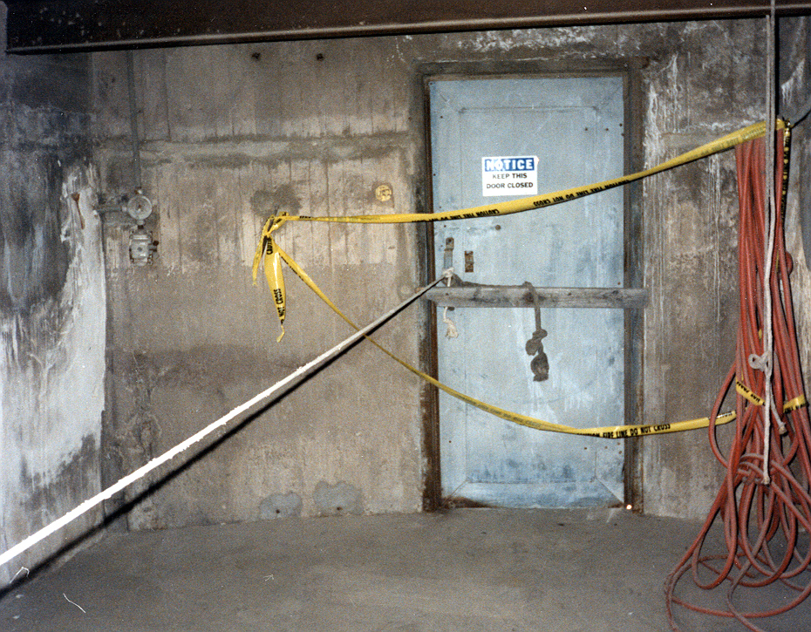
Locking Exits
Must not install any lock or fastening that impedes or prevents escape from the inside of any building.
Locked and blocked exit
Notes:
1910.36(b)(4)
There is an exception for mental, penal, or corrective institutions where there is constant supervision.

Slide 6

Access to Exits
Exits must be readily accessible at all times
A door from a room to an exit or escape route must be a side-hinged swinging type, and swing in the direction of exit travel when the room is occupied by more than 50 people or contains high hazard contents
Notes:
1910.37(f)(1) & (2)
High hazard contents are those which are liable to burn with extreme rapidity or which may produce poisonous fumes or explosions in a fire. Examples include flammable chemicals and grain.

Slide 7
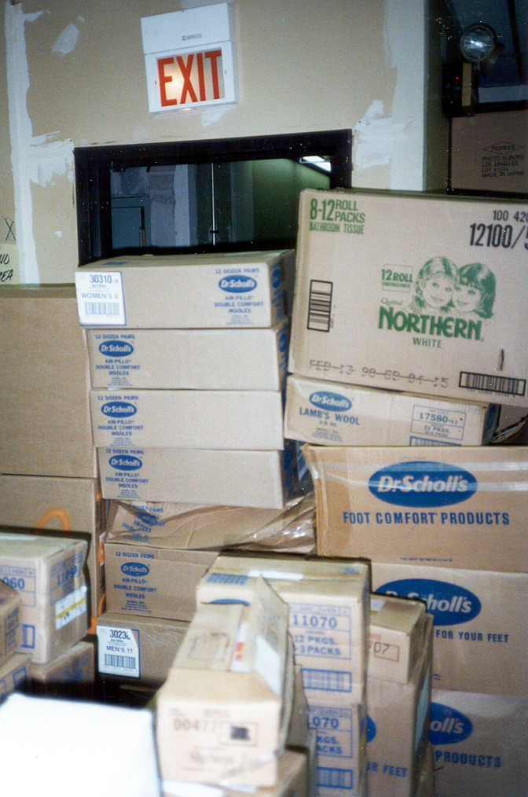
Maintaining Escape Routes
Escape routes from all parts of the building must be continuously maintained free of all obstructions in case of emergency.
Obstructed exit
Notes:
1910.37(k)(2)

Slide 8
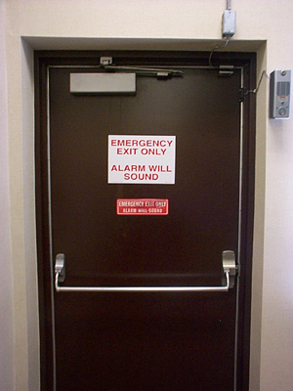
Exit Marking
Exits must be marked by a readily visible sign when the exit or way to reach it is not immediately visible to occupants.
Notes:
1910.37(q)(1)

Slide 9
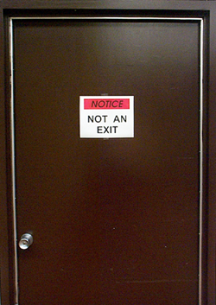
Exit Marking (cont’d)
If a door, passage, or stairway is not an exit or a way of exit access, but may be mistaken for one, it must be identified by a sign reading “Not an Exit”, “Storeroom”, “To Basement”, etc.
Notes:
1910.37(q)(2)

Slide 10
Exit Marking (cont’d)
A sign reading “Exit” with an arrow indicating the directions must be placed in every location where the direction of travel to the nearest exit is not immediately apparent.
Notes:
1910.37(q)(5)

Slide 11
Emergency Action Plan
Describes actions that must be taken to ensure employee safety in emergencies
Includes floor plans or maps which show emergency escape routes
Tells employees what actions to take in emergency situations
Covers emergencies the employer may reasonably expect, such as fires, explosions, toxic chemical releases, hurricanes, tornadoes, blizzards, and floods
Notes:
1910.38(a) applies to all emergency action plans required by a particular OSHA standard, such as the Fire Brigades or Permit-Required Confined Spaces standard. The emergency action plan must be in writing, except for firms with 10 or fewer employees. These businesses can communicate the plan orally to employees.
Emergency plans include, as a minimum:
- Escape procedures and escape route assignments
- Critical plant operations shutdown procedure
- Procedure to account for all personnel
- Assignment of rescue and medical duties
- Means for reporting emergencies
- Identification of responsible persons to contact for further information
Employee training is necessary and an alarm system must be in place which has a distinctive signal.
See OSHA Publication 3088, “How to Prepare for Workplace Emergencies”, available at www.osha.gov for more information.

Slide 12
Fire Prevention Plan
The plan must include:
A list of the major fire hazards and handling, storage, and control procedures
Names or job titles of persons responsible for maintenance of equipment and systems to prevent or control ignitions or fires
Names or job titles of persons responsible for control of fuel source hazards
Training for all employees who have responsibilities in the plan
Notes:
1910.38(b) applies to all fire prevention plans required by a particular OSHA standard.
The fire prevention plan must be in writing, except for firms with 10 or fewer employees. Those businesses can communicate the plan orally to employees.
Accumulations of flammable and combustible waste materials and residues must be controlled so they do not contribute to a fire emergency.
Currently a fire prevention plan is required by OSHA only where an employer’s written policy:
- Requires immediate and total evacuation of the workplace upon the sounding of a fire alarm signal
- Establishes an appropriate emergency action plan
- Prohibits employee use of fire extinguishers
See 1910.157(b)

Slide 13
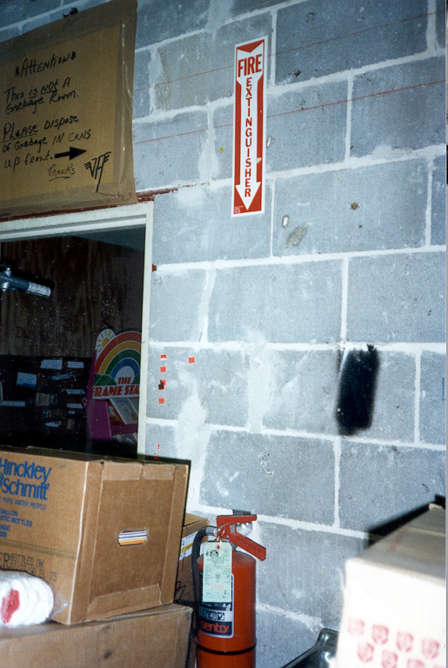
Portable Fire Extinguishers
If portable fire extinguishers are provided for employee use, the employer must mount, locate and identify them so workers can access them without subjecting themselves to possible injury.
Blocked extinguisher
Notes:
1910.157(c)(1)
Employers can choose whether to train their workers to fight fires or to rely on outside services.

Slide 14
Extinguisher Classification
Letter classification given an extinguisher to designate the class or classes of fire on which it will be effective.
Class A – ordinary combustibles (wood, cloth, paper)
Class B – flammable liquids, gases, greases
Class C – energized electrical equipment
Class D – combustible metals
Flammable
Electrical
Combustible
Ordinary
A
B
C
D
Combustibles
Liquids
Equipment
Metals
Notes:
The class of extinguisher should be on the extinguisher shell. The picture-symbol labeling system now in use is designed to make the operation of fire extinguishers more effective and safe to use through the use of less confusing pictorial labels. The system also emphasizes when not to use an extinguisher on certain types of fires.
Because of recent information outlining the difficulties inherent in the extinguishment of fires in cooking appliances that involve combustible cooking media (vegetable or animal oils and fats), a new classification (Class K) has been established. This classification is not listed in OSHA standards. NFPA 10 specifies that listed and labeled Class K fire extinguishers are to be provided in these cases.
Class A Class B Class C Class K

Slide 15
Extinguisher Rating
Numerical rating given to Class A and B extinguishers which indicate how large a fire an experienced person can put out with the extinguisher
Ratings are based on tests conducted at Underwriters’ Laboratories, Inc.
  Class A: 1-A, 2-A, . . . 40-A
  Class B: 1-B, 2-B, . . . 640-B
A 4-A extinguisher, for example, should extinguish about twice as much fire as a 2-A extinguisher
Notes:
Class C extinguishers have only a letter rating because there is no readily measurable quantity for Class C fires which are essentially Class A or B fires involving energized electrical equipment. Class D extinguishers likewise do not have a numerical rating. Their effectiveness is described on the faceplate.

Slide 16
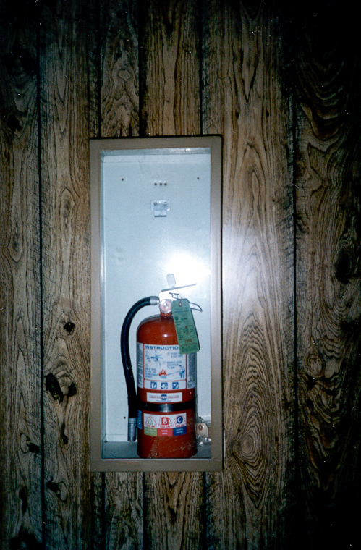
Maintaining Portable Fire Extinguishers
Must maintain in a fully charged and operable condition
Must keep in their designated places at all times except during use
Must conduct an annual maintenance check
Must record the annual maintenance date and retain this record for one year after the last entry or the life of the shell, whichever is less
Notes:
1910.157(c)(4)
1910.157(e)(3)

Slide 17
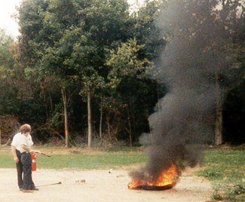
Portable Fire Extinguisher
Training and Education
Where portable fire extinguishers have been provided for employee use in the workplace, employees must be provided with an educational program on the:
  General principles of fire extinguisher use
  Hazards of incipient (beginning) stage fire fighting
Employees designated to use extinguishers must receive instruction and hands-on practice in the operation of equipment
Notes:
1910.157(g)
Training and education required upon initial employment/assignment and at least annually thereafter.
“Incipient Stage Fire” means a fire which is in the initial or beginning stage and which can be controlled or extinguished by portable fire extinguishers, Class II standpipe or small hose systems without the need for protective clothing or breathing apparatus. [1910.155(c)(26)]

Slide 18
Summary
There must be enough exits in the proper arrangement for quick escape
Escape routes must be marked, lighted, free of obstructions, and locks must not be used to impede or prevent escape
An emergency action plan and a fire prevention plan must be in place
Fire extinguisher classes and numerical ratings help a user understand its capabilities
Fire extinguishers must be inspected, maintained and employees must be trained in how to use them

