Slide 1
CURI Hot Work Safety Program
Hot Work Program
& Operational Guidelines
Kurt Rayburg, CSP, CPEA
Safety Manager, Clemson University Low- Country Operations

Slide 2
CURI Hot Work Safety Program
HOT WORK INTRODUCTION
Purpose: This program is designed to recognize the potential for fire and explosion hazards and to minimize or eliminate these hazards as it relates to hot work operations.

Slide 3
CURI Hot Work Safety Program
This program applies to all persons conducting hot work on Clemson University owned or leased property.
Note: This program is intended for areas that are not specifically designated as permanent hot work sites. (i.e. hot work performed outside the designated areas such as mobile operations, construction & maintenance operations, etc.).

Slide 4
CURI Hot Work Safety Program
APPLICABLE REGULATIONS
OSHA Standard for General Industry 1910.252
NFPA 51B

Slide 5
CURI Hot Work Safety Program
HOT WORK IS DEFINED AS:
Operations including cutting, welding, brazing, soldering(with torch), grinding, thermal spraying, thawing pipe, installation of torch- applied roof systems or any other ignition source producing situations.

Slide 6
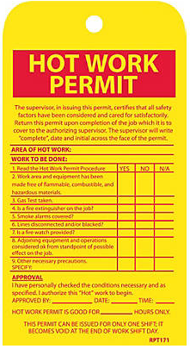
CURI Hot Work Safety Program
HOT WORK PROCEDURES
When it is necessary for anyone to perform work such as welding, torch soldering, cutting, brazing, heating metal, etc., they are required to obtain a Hot Work Permit. The permit will only be valid until the end of the shift.

Slide 7
CURI Hot Work Safety Program
Hot Work Permits will be issued and signed by the Hot Work Leader (HWL). After the permit precautions have been initiated and completed, the permit will be posted in the work area. At the completion of the work, the permit will be retained by the HWL for one year.

Slide 8
CURI Hot Work Safety Program
Hot work should be conducted in the designated hot work area. For any other area, a Hot Work Permit must be requested and issued to the person(s) who will be conducting the actual work.

Slide 9
CURI Hot Work Safety Program
Hot Work Permit

Slide 10
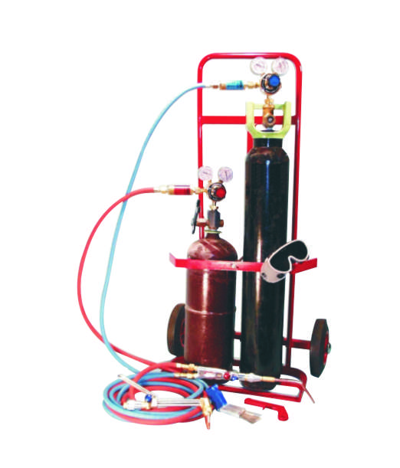
CURI Hot Work Safety Program
The hot work operator shall handle equipment safely. Only approved equipment such as torches, regulators, pressure reducing valves, acetylene generators, machines, manifolds, cables and hoses in good repair will be used.
Equipment must be inspected by
the operator prior to use.

Slide 11
CURI Hot Work Safety Program
The sprinkler protection system must be fully operational while hot work is being performed. If hot work is to be done within 3 feet of automatic sprinkler heads, noncombustible sheet material or damp cloth guards will be used to temporarily shield the individual heads. Removal of shields must be done after work is complete!

Slide 12
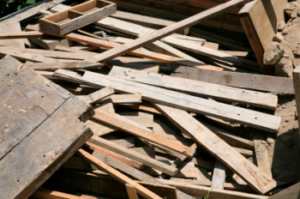
CURI Hot Work Safety Program
FLAMMABLES AND COMBUSTIBLES
Remove all fuel sources within a 25 foot radius of the work area. The area must be free of flammable liquids, lint, dust, or combustible materials. If the material can’t be removed, then fire blankets must be used to cover the materials from ignition from sparks or hot metal.

Slide 13
CURI Hot Work Safety Program
Openings in walls, floors, ducts and shafts within 25 feet from the operation must be tightly covered to prevent the passage of sparks or slag.
Surrounding floors must be swept clean and, if combustible, wet down.

Slide 14
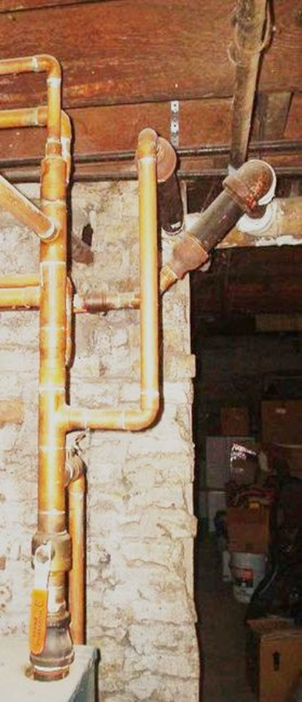
CURI Hot Work Safety Program
If hot work is conducted on one side of a wall, partition, ceiling, or roof, one of the following criteria shall be met:
Precautions shall be taken to prevent ignition of combustibles on the opposite side by relocating combustibles.
If it is impractical to relocate combustibles, a fire watch shall be provided on the opposite side from where the Hot Work is being performed.

Slide 15
CURI Hot Work Safety Program
Hot work shall NOT be permitted in the following situations:
In areas not authorized by the HWL
In buildings where sprinklers are impaired.
Where mixtures of flammable gases, vapors, liquids, or areas with an accumulation of combustible dusts which could develop explosive atmospheres.

Slide 16
CURI Hot Work Safety Program
HOT WORK PRECAUTIONS
Fully charged and operable fire extinguishers that are appropriate for the type of possible fire shall be immediately available at the work area. (Within 25 feet)
The employee and the HWL shall be responsible for notifying appropriate department/building personnel of the location(s) where hot work will be conducted in their building.
Notice: The EIC will be performing Hot Work in the 7.5 MW bay today

Slide 17
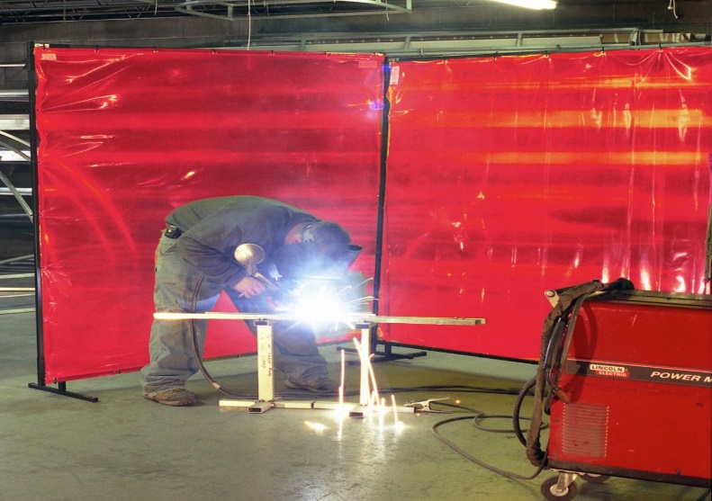
CURI Hot Work Safety Program
HOT WORK PRECAUTIONS
Appropriate PPE such as goggles, shields, helmets, etc. shall be utilized by the operator.
Adequate ventilation shall be provided during hot work operations.
Adequate shielding must be in place to protect non-workers from flash / burn / sparks.

Slide 18
CURI Hot Work Safety Program
HOT WORK IN CONFINED SPACES
Must have constant powered ventilation
No compressed gas cylinders are allowed in confined spaces (other than SCBA’s utilized by rescue personnel).
Check hoses & leads for leaks & damage.
Must have approved Confined Space & Hot Work Permits before starting hot work.

Slide 19
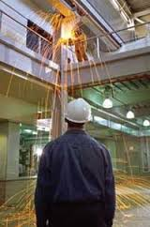
CURI Hot Work Safety Program
FIRE WATCH FOR HOT WORK
A fire watch shall be required:
Appreciable combustibles are within 25 feet.
Appreciable combustibles are >25 but are easily ignited.
Wall or floor openings within 25 ft. radius that exposes combustible materials in adjacent areas.
Combustible materials are adjacent to the opposite side of a barrier and are likely to be ignited.

Slide 20
CURI Hot Work Safety Program
HOT WORK –FIRE WATCH
A fire watch shall be provided during Hot Work activities, during lunch or rest periods and shall continue for a minimum of 30 minutes after the conclusion of the operation.

Slide 21
CURI Hot Work Safety Program
HOT WORK –FIRE WATCH
Responsibilities of Fire Watch Personnel:
Ensure safe conditions are maintained during hot work operations.
Have fire-extinguishing equipment readily available.
Personnel should be trained in the use and capabilities of extinguishing equipment.

Slide 22
CURI Hot Work Safety Program
USE AN EXTINGUISHER ONLY IF:
It won’t place you in immediate danger.
• The fire is in the incipient stage.
(trash can size or smaller)
• You know how to use it and you feel comfortable doing so.
Have tripped alarm or told someone to do so.

Slide 23
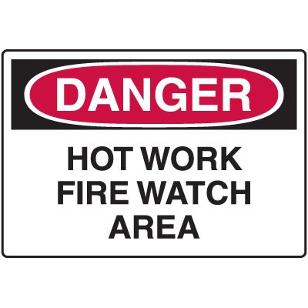
CURI Hot Work Safety Program
QUESTIONS?

