Slide 1
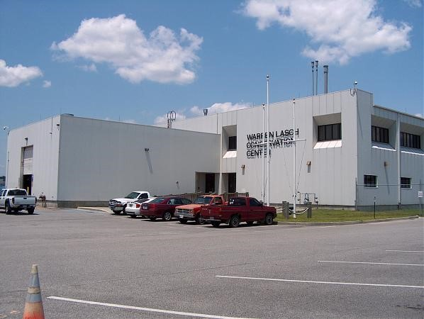
CURI Intern Orientation Program
Presented by:
Kurt Rayburg, CSP, CPEA
Safety Manager Clemson Lowcountry

Slide 2
CURI Intern Orientation Program
Objectives are to:
provide you with a basic understanding of the safety process and safety culture here at Clemson.
familiarize you with the campus environment, facilities and hazards.
help you understand your role in the safety process.
help in preventing any incident or property damage.

Slide 3
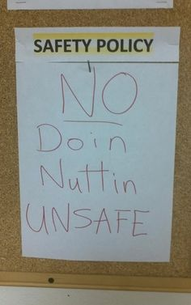
CURI Intern Orientation Program
Safety Rules
You are responsible for your own safety and the safety of others.
Personal Protective Equipment (PPE) must be worn while performing work and where the location / environment / hazard dictates it.
Use all equipment and tools safely and properly.
Go only where you are authorized to go.
No horseplay.
Barricades / restricted areas may not be entered without the responsible person’s approval.
Follow specific safety procedures and protocol.
Do not perform any task that you believe is unsafe.
Report all hazards and incidents.
Never be shy to ask for help or perspective.

Slide 4
CURI Intern Orientation Program
Facility Site Instructions:
Review of checklist – Emergency numbers needed
Fire, Evac & Emergency Procedures
Evacuate immediately to flag pole location when alarm sounds
Report fires immediately to employees or pull station
Do not fight fire unless trained to do so.
Tornado announcement - assembly in WT control rooms
Injury / Near Miss Reporting
Contact employee or mentor if assistance is needed
Report all incidents immediately
Incident investigation report completed within 24 hours

Slide 5
CURI Intern Orientation Program
Bloodborne Pathogens:
Micro Organisms in the blood
Highly contagious (ex. Hiv, hepatitis B)
Infection occurs when there is an exposure to blood or other potentially infectious material
Avoid blood and Other Potentially Infectious Material (OPIM’s)
Equipment Requirements:
Do not operate any equipment unless you are authorized
Equipment includes – Manlifts, Forklifts, machines, tools
Ladders – 3 point contact, if working outside the rails should use lift, inspect before use, 4:1 ratio angle

Slide 6
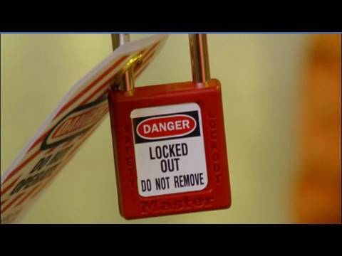
CURI Intern Orientation Program
Lockout / Control of Energy
When working on something that has energy (electric, pneumatic, potential) always control the energy by releasing the energy and putting a lock on it.
Interns are (Affected) by this rule which means understanding is important.
If you must work on equipment, you will be trained on lockout (Authorized).
Never work under someone’s lock.
Meaning of red/blue/yellow/green
Hazard Communication / GHS (Global Harmonization System)
Safety Data Sheets (SDS’s) located in Jim Tuten’s office
Interns will have limited contact with chemicals
If dispensing, need to affix a label
Online training will need to be completed
Inform mentor of any spill
Interns are not permitted to clean up spill unless they have received appropriate training

Slide 7
CURI Intern Orientation Program
Confined Spaces / Permit Required Confined Spaces (PRCS)
Spaces that have limited access and have potential to contain bad atmosphere
Interns are prohibited from entering any confined space.
CURI has a few of these spaces in the lab fenced area.
Electrical Safety
Know how to safely operate and handle the electrical equipment
Keep work area dry and inform mentor of any hazard
Do not overload circuits and assure proper grounding
Be aware of arc flash and use appropriate barricades to keep people out of arc flash boundary and work zone

Slide 8
CURI Intern Orientation Program
Hot Work
When you create an ignition source, you must obtain a permit from your mentor.
Make sure equipment is in good condition and never perform hot work in confined spaces.
PPE – Personal Protective Equipment
PPE must be worn in designated areas and whenever you are performing work.
The necessary equipment is dictated by the exposure or hazard.

Slide 9
CURI Intern Orientation Program
Site Specific Requirements
No picture taking.
Do not travel to any area that you are not authorized to go. (Hydraulic Corridor)
Barricades
-Red ones are danger. Do not cross without permission from responsible one.
-Yellow ones are caution. Cross only after evaluating exposure

Slide 10
CURI Intern Orientation Program
Perspective or Questions?
Let’s Tour

