Slide 1
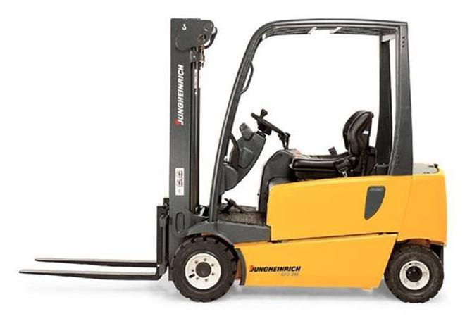

FORKLIFT TRAINING (OSHA 1910.178 Powered Industrial Trucks

Slide 2
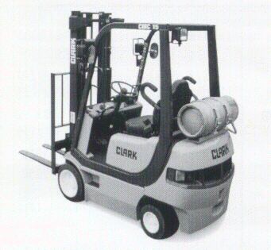
Current Statistics
Approximately 1.2 million fork lift operators in the United States
8% of all fork trucks are involved in an accident annually
68,400 fork truck accidents occur each year
85 fatalities occur annually
34,900 serious injuries occur annually

Slide 3
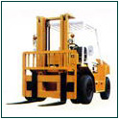
General Requirements
This section includes all types of fork trucks but does not include farm vehicles or vehicles used primarily for earth moving which have forks
Must conform to ANSI B56.1
Fork trucks must have a label or other identifying mark by a testing laboratory
Nameplates and markings must be legible

Slide 4
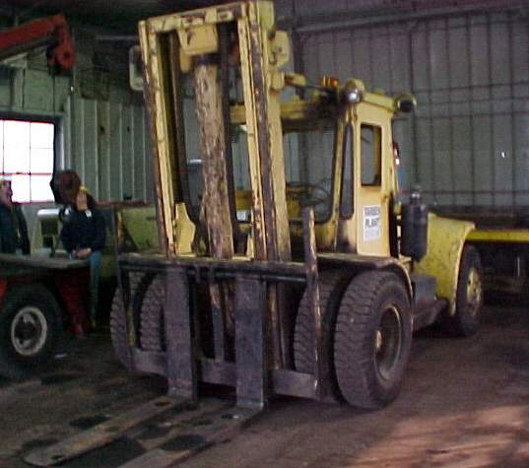
General Requirements, continued
Modifications and additions which affect capacity and safe operation shall not be performed by the customer without the manufacturer’s prior written approval

Slide 5
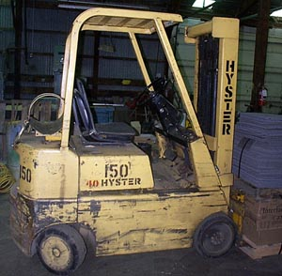
Designations
Eleven different designations of industrial trucks
D, DS, DY, E, ES, EE, EX, G, GS, LP, and LPS
Notes:
D - diesel
DS - diesel with safeguards to exhaust, fuel and electrical systems
DY - all of DS safeguards but do not have electrical equipment including ignition (also has temperature limitation features)
E - electrical
ES - electrical with safeguards to electrical systems to prevent emissions of hazardous sparks
EE - same as ES but electrical motors and equipment are completely enclosed
EX - designed so that the electrical equipment may be used in flammable atmospheres
G - gas
GS - safeguards to exhaust, fuel and electrical systems
LP - liquefied petroleum gas is used
LPS - safeguards to exhaust, fuel, and electrical systems

Slide 6
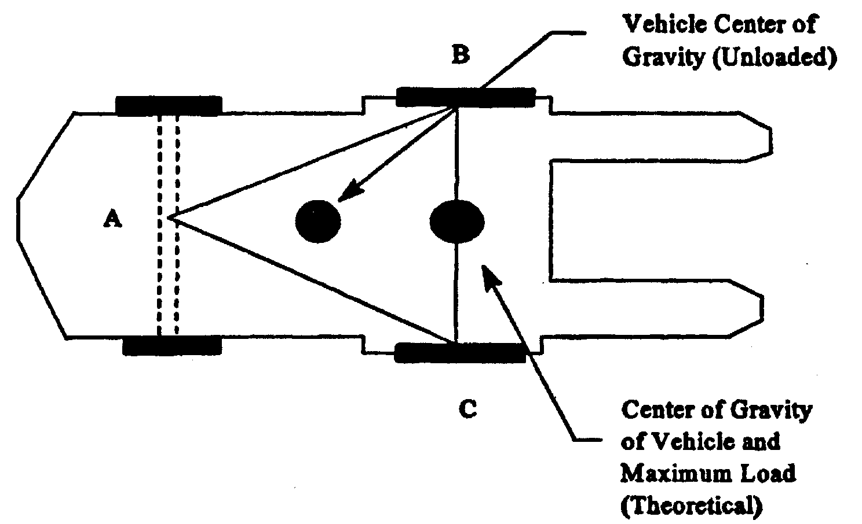
Stability Triangle

Slide 7
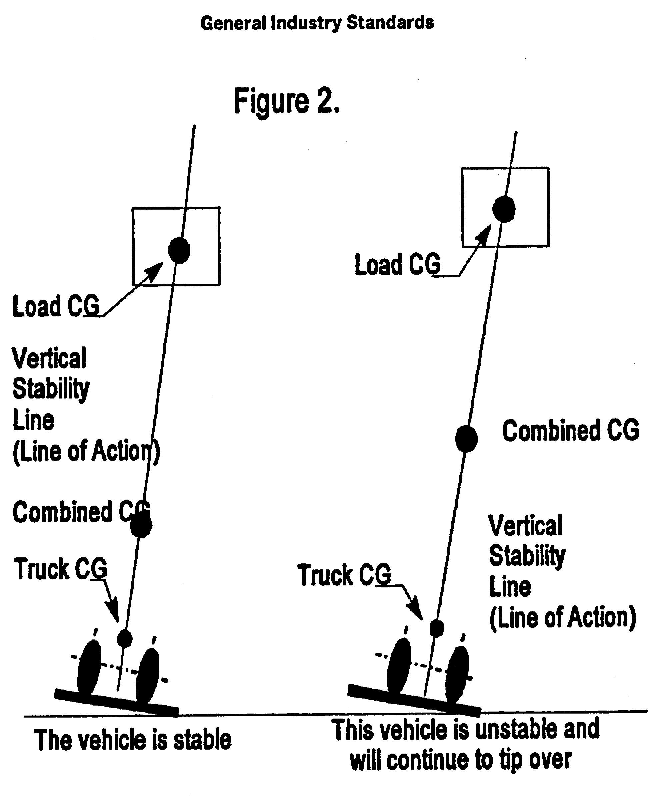
Vertical Stability

Slide 8
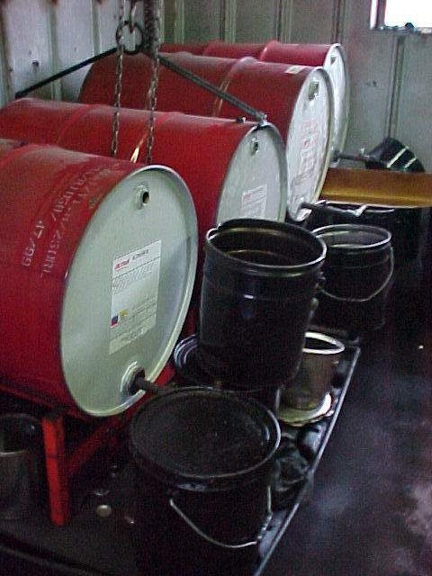
Fuel Handling and Storage
Gas and diesel storage and handling shall conform to NFPA No. 30-1969
LP gas storage and handling shall conform to NFPA No. 58-1969

Slide 9
Batteries
Changing and Charging Requirements
Changing and/or charging must be located in designated areas for that purpose
Area must have facilities to flush and neutralize spilled electrolyte
Eyewashes and showers must be available
Must have adequate fire protection
“No Smoking” in charging area

Slide 10
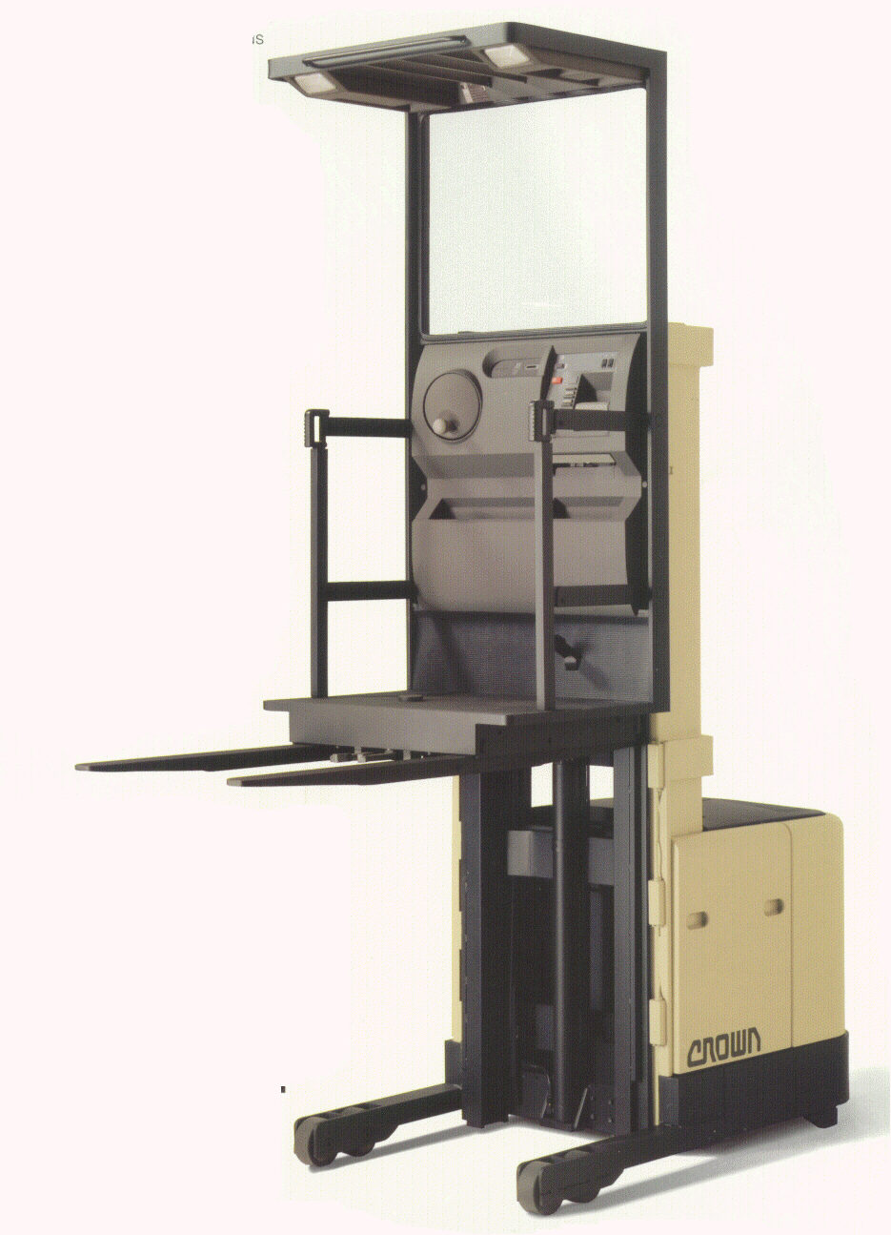
Batteries, continued
Must protect chargers from vehicle damage
Must adequately ventilate for vapors from gassing batteries
  hydrogen gas emitted
  very flammable
Overhead hoist or equivalent must be used to handle batteries
Notes:
29 CFR 1910.178 (g)Changing and charging storage batteries. (1) Battery charging installations shall be located in areas designated for that purpose
(2) Facilities shall be provided for flushing and neutralizing spilled electrolyte, for fire protection, for protecting charging apparatus from damage by trucks, and for adequate ventilation for dispersal of fumes from gassing batteries.
Levels of noxious gases and fumes, especially carbon monoxide, must not exceed levels from 1910.1000.

Slide 11
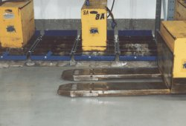
Batteries, continued
A carboy tilter or siphon must be provided
for handling electrolyte
Pour acid into water and not vice versa
Open battery lids and vent caps to dissipate heat
Prevent any open flames, sparks, or electric arcs in battery charging areas

Slide 12




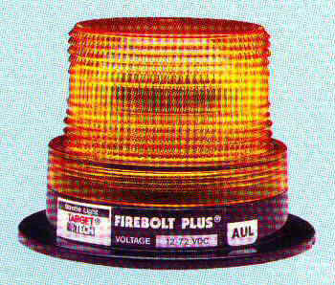


Lighting
Fork trucks must have lights on both ends where lighting is less than 2 lumens per square foot

Slide 13
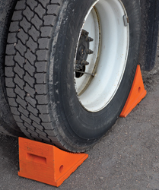
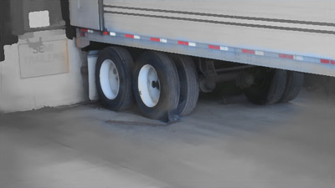
Trucks and Railroad Cars
All trucks and railroad cars must be chocked when boarded with powered industrial trucks
Fixed jacks may be necessary to support an empty semi-trailer when loading or unloading
Dock-boards shall support loads imposed upon them and be secured in position
All portable dock-boards must have handles

Slide 14
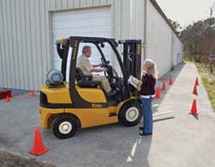
Operator Training
Only trained and authorized operators shall be permitted to operate fork trucks
Employer must ensure training has been provided to include formal instruction (classroom), practical training (hands on), and evaluation

Slide 15
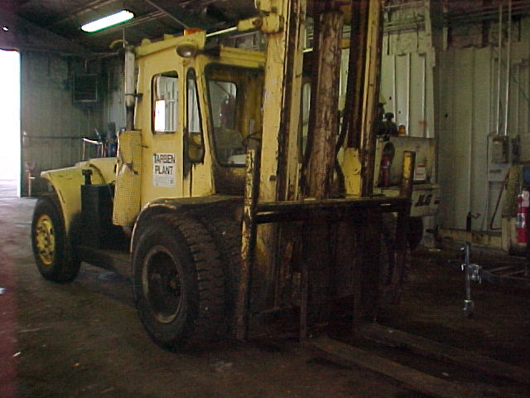
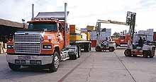
Refresher Training
Employee operating
in unsafe manner
Involved in accident
or near miss
Assigned to new
type truck
An evaluation shall be conducted at
least every 3 years

Slide 16
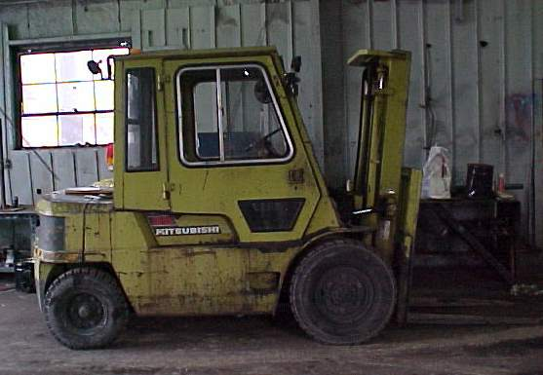
Training Content
Truck- related topics
Work-place related topics
Notes:
Changes under Section L (Training)
Refresher training: Should be evaluated every 3 years.

Slide 17
Truck Related Topics
Operating instructions, warnings, precautions for the authorized truck
Differences between truck and car
Truck controls and instruments
Engine/ motor operation
Steering and maneuvering

Slide 18
Truck Related Topics
Visibility
Fork attachment, adaptation, limitations
Vehicle capacity
Vehicle stability
Vehicle inspection
Refueling / Recharging
Operating limitations

Slide 19
Workplace Topics
Surface conditions
Composition of loads
Load manipulations
Pedestrian traffic
Narrow aisles, restricted places

Slide 20
Workplace Topics
Hazardous atmosphere locations
Ramps / sloped surfaces
Closed environment, ventilation for CO

Slide 21
Truck Operations
Trucks shall not be driven up to anyone standing in front of a bench or other fixed object
No person shall be allowed to stand or pass under the elevated portion of any truck
Only the operator shall be permitted to ride unless additional seats/seatbelts are provided

Slide 22
Truck Operations
Employees are required to keep arms and legs from being placed between the uprights of the mast or outside the running lines of the truck
If a truck is parked on an incline, the wheels shall be blocked
Keep materials being stored at least 18 inches below sprinklers and away from lights and pipes

Slide 23
Truck Operations, continued
On an unattended truck, (>25 ft. / not in view) the load shall be fully lowered, controls neutralized, power shut off, and the brake set
Fork trucks shall not be used for opening or closing freight doors
The flooring of trucks, trailers, and railroad cars shall be checked for breaks or weaknesses before entering

Slide 24
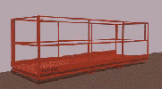
Safety Platforms
When using a safety platform, you must
        A. be firmly secured to
        the lifting carriage
        and/or forks
        B. be provided access
        to shut off power to
        the truck
Access to fire aisles, stairways, and fire equipment must be kept clear at all times

Slide 25
Traveling
All traffic regulations to be observed
Three truck lengths away from truck ahead
Stunt driving, racing, and horseplay are never permitted
Must drive slowly when floor is wet or slippery
Never run over loose objects on the roadway

Slide 26
Traveling
Only loads within the rated capacity shall be handled
Fork trucks with defective parts must be removed from service until repaired
Fork trucks must be thoroughly inspected prior to each shift of work

Slide 27
Traveling
Speed shall be reduced to a safe level when negotiating turns
Only stable or safely arranged loads shall be handled
Defects shall be immediately reported and corrected
Cross railroad tracks diagonally

Slide 28

Additional Requirements
Disconnect batteries when performing electrical repairs
Additional counter weighting shall not be done unless approved by the manufacturer

Slide 29
Additional Requirements
When grades are more than 10%, loaded trucks shall be driven with the load upgrade
Only safely arranged loads shall be handled
Do not operate trucks with leaks in their fuel systems

Slide 30

QUESTIONS?

