Slide 1
Crafting a Vision Statement
Office of Research Development
January 29, 2026

Slide 2
Learning Objectives
Participants will understand:
what a vision statement is
how a vision statement functions strategically
how a vision statement evolves
how to frame effective vision statements

Slide 3
Agenda
Definition of a Vision Statement
Example 1: Evolution of a Vision Statement
Example 2: Evolution of a Vision Statement
Exercise 1: Edit a Vision Statement
Exercise 2: Write Your Own Vision Statement
How the Vision Statement Functions Strategically
Closing

Slide 4
Definition of a Vision Statement

Slide 5
Context
Some solicitations explicitly require a vision statement as part of required conceptual overview; typically appears on p. 1.
Sometimes these vision statements are more like statement clusters.
Other solicitations do not specifically require a vision statement, which does not prohibit your articulating one as long as it has a function in the argument.
Recommend not naming one in a proposal unless it is required.

Slide 6
Vision vs. Other Means of Creating Order
Vision statement: paints a picture of an Eden---the future perfect world. The vision is static. The core of the vision statement is not a description of processes.
Mission statement: describes the general means by which the locus amoenus can be established and entered.
Goals, objectives (aims) and tasks: increasingly specific sections which delineate what activities will be performed.
Rationale: covers the motivation and need.
Strategic plan: shows how the project components inter-relate and support one another. NOT a list of activities.

Slide 7
Vision Statements Speak to Impact
Shift in paradigm, transformative breakthroughs
Policy influence and regulatory guidance
Industry partnerships and technology transfer
Educational innovation and workforce development
Community engagement and public understanding
The beginning anticipates the end, as the vision controls intellectual merit and broader (societal) impacts.

Slide 8
Vision Statements Change
Vision articulation is ongoing, not a one-time exercise.
Changes respond to both internal and external pressures, requiring a corresponding change in the vision.
-- strategy changes
-- scope changes
-- audience shifts
-- program changes

Slide 9
Example 1: Evolution of a Vision Statement

Slide 10
UIUC STC for Quantitative Cell Biology #1
Version 1 Source
The Science and Technology Center for Quantitative Cell Biology (QCB) aims to revolutionize our understanding of cells via the creation of whole-cell models that faithfully capture all aspects of cell function and emergent behavior. QCB will leverage the newest advances in computing, artificial intelligence, and super-resolution imaging, as well as state-of-the-art -omics and cellular measurements, to develop models with novel details and predictive capabilities. Ultimately, QCB aspires to unlock the secrets of living cells, to predict normal and abnormal cellular functions, and to design single cells and multicellular systems that provide solutions for human health, climate change, and agriculture, fueling the U.S. bioeconomy. QCB’s education, broadening participation, and knowledge sharing programs will ensure that a diverse workforce is well-trained in quantitative cell biology.

Slide 11
UIUC STC for Quantitative Cell Biology #2
Version 2 Source
QCB is working to develop 4D (space plus time) whole-cell models and experiments to transform our understanding of how cells function, forging a new scientific understanding of the cell that will have implications for human health, photosynthesis, evolution, and beyond. This will lead to a new research discipline–quantitative cell biology–that will transform our ability to understand and predict life processes while making quantitative cell biology tools and models widely accessible. Using cutting-edge imaging and simulation tools as well as experimental methods, the center is advancing the study of healthy and diseased cells, as well as accelerating research into metabolism, cell division, and gene expression. We’re also sharing science with communities of all ages through a partnership with the popular computer game Minecraft.

Slide 12
UIUC STC for Quantitative Cell Biology #3
Version 3 Source
QCB seeks to quantitatively describe the physical and chemical processes that define the functional state of a cell. Our goal: To make 4D (space plus time) computer models of whole cells functioning under normal and stressed conditions. The modeling will be guided by developing cutting-edge experimental tools that generate datasets with unprecedented resolution. This will lead to a new research discipline – quantitative cell biology – by developing new scientific training methods and democratizing cell biology for researchers, students, and society.

Slide 13
UIUC STC for Quantitative Cell Biology #4
The UIUC Science and Technology Center for Quantitative Cell Biology seeks to quantitatively describe the physical and chemical processes that define the functional state of a cell. We use experimental techniques as well as computer modeling and simulation.

Slide 14
Example 2: Evolution of a Vision Statement

Slide 15
ERC for Advanced Engineering Fibers and Films
The CU ERC, funded in 1998, was a Gen-2 ERC.
During the Gen-2 era, the NSF Engineering Research Center Program adopted the use of the word “vision” instead of “goals” to broaden the horizons of engineers beyond problem solving—i.e., a vision of a transformative systems technology goal to be achieved over the 10-year life of the ERC.
At the same time, the ERC Program launched use of the 3-plane chart to yoke the vision to a strategy.
This same model is used today and has been propagated to other programs (e.g., Engines).

Slide 16
ERC for Advanced Engineering Fibers and Films – Year 1
Year 1 Vision Statement – language borrowed from solicitation
The Center for Advanced Engineering Fibers and Films (CAEFF) will provide an integrated environment for the systems-oriented study of fiber and film processes and products. CAEFF will advance fiber and film knowledge, technology, and education through interdisciplinary, collaborative research, trusted partnerships with industry, and curriculum innovations. CAEFF will support the domestic fiber and film industries and ensure their global competitiveness.

Slide 17
ERC for Advanced Engineering Fibers and Films – Year 3
Year 3 Vision Statement – moving toward emphasis on modeling instead of materials research
The Center for Advanced Engineering Fibers and Films (CAEFF) will provide an integrated research and education environment for the systems-oriented study of fibers and films. Built on a solid science base, a new paradigm coupling molecular to continuum modeling will allow rapid, efficient development of new products and processes. CAEFF will support the domestic fiber and film industries and ensure their global competitiveness.

Slide 18
ERC for Advanced Engineering Fibers and Films - Revision
The ERC Program revised the 2002 solicitation to attempt to elicit more ambitious vision statements.
We were asked to articulate a long-term, strategic vision for an emerging engineered system with the potential to spawn a new or transform a current industry, service delivery system, or infrastructural element.

Slide 19
ERC for Advanced Engineering Fibers and Films – Year 6
Year 6 Vision (revision done live in a site visit)
The Center for Advanced Engineering Fibers and Films (CAEFF) provides an integrated research and education environment for the systems-oriented study of fibers and films. CAEFF promotes the transformation from trial-and-error development to computer-based design of fibers and films. This new paradigm for materials design – using predictive numerical and visual models that comprise both molecular and continuum detail – will ensure the global competitiveness of the domestic fiber and film industries.

Slide 20
ERC for Advanced Engineering Fibers and Films – Year 9
Year 9 “Systems Vision”
CAEFF’s vision is to become the international leader in the development of fibers, films, and related functional materials through integrated systems research and education programs that combine molecular understanding, process innovation, and multi-scale modeling to impact industry, academe, and society.

Slide 21
Exercise 1: Edit a Vision Statement

Slide 22
Common Vision Statement Pitfalls
It’s not you; it’s the solicitation.
Many solicitations are not optimally written, making it hard to discern exactly what goes in that vision statement.
ERCs now require a “systems vision” as well as a “research strategic plan,” within which is a “research vision.”
There usually is no instruction about how it should be written, but we can offer some pointers.

Slide 23
Common Vision Statement Pitfalls (2/3)
Doesn’t seem possible
Too possible: only spells out objectives/aims and tasks
Too broad: “Advancing human knowledge”
Too narrow: “Studying protein X in disease Y”
Too abstract: “Transforming the future through innovation”
Disassociated from the rationale/need and/or from mission, objectives, etc.
Doesn’t cover the entire vision (only focuses on research)

Slide 24
Common Vision Statement Pitfalls (3/3)
Claims work will be “transformative,” but the project will not revolutionize entire disciplines, create entirely new fields, or disrupt accepted theories and perspectives
Too much jargon
Includes citations
Repeats verbatim language from the solicitation
Ineffective sentence structure---important part buried in the middle
Tries to do too much/is unwieldy grammatically
Notes:
Ask them to brainstorm about this

Slide 25
Q-YODA Project Vision Statement
NSF-Research Infrastructure Improvement—Focused EPSCoR Collaborations
This program is about developing partnerships among EPSCoR jurisdictions to improve collective research capacity.

Slide 26
Draft Q-YODA Project Vision Statement
Q-YODA aims to unlock new regimes of quantum functionality and scalability, to design promising material platforms, and to develop controllable spin-coherence properties for integrated chip-scale architectures that provide innovative solutions for information technology, transportation, health care, and America’s energy dominance. Q-YODA’s education program will train the next generation of highly skilled quantum STEM professionals and engage learners with industry partners and national laboratories, promoting workforce readiness and economic development within EPSCOR states and beyond.

Slide 27
Exercise 2: Write Your Own Vision Statement

Slide 28
Try This
Basic logic: XXXX agency should fund this project because its vision aligns with agency priorities.
We envision a world in which [society will benefit]
We will realize this vision through [adopting an approach or project design]
We can make these advances by [achieving objectives].

Slide 29
How the Vision Statement Functions Strategically

Slide 30
Shaping
Articulate the vision to inspire hope and convince others that the dream can be realized.
Invite others to help modify/expand on/edit the collective dream.
Build this step into annual meetings, review boards, evaluation exercises.

Slide 31
Promoting
Use vision to guide communication and positioning. Communicate that vision to stakeholders and motivate them to embrace it.
Funding agencies: alignment with priorities
Potential collaborators: complementary expertise
Industry partners: practical applications
Broader scientific community: intellectual contributions
Institutions: sustainability

Slide 32
Wielding
  Spell out the mission, goals, and objectives.
  Drive development of a strategic plan (you need one even if it is not required).
  Guide allocation of resources.
  Inform creation of the team, partnership decisions, hiring.

Slide 33
Curating, Sustaining, Killing
Regular assessment and refinement
Structured retreats and stakeholder feedback
Need for balancing stability with capacity to adapt
Expect revisions; expect external pressures to threaten the vision
Sometimes the dream dies.

Slide 34
Questions?

Slide 35
Vision Statement Serves as Magnetic North
Provides direction without prescribing every step
Balances ambition with achievability
Creates space for serendipitous discoveries
Maintains strategic focus
Investing in crafting a good vision statement will provide dividends many times over.

Slide 36
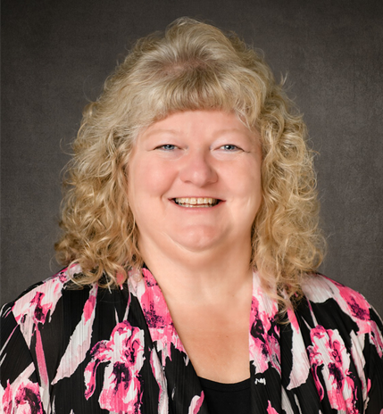
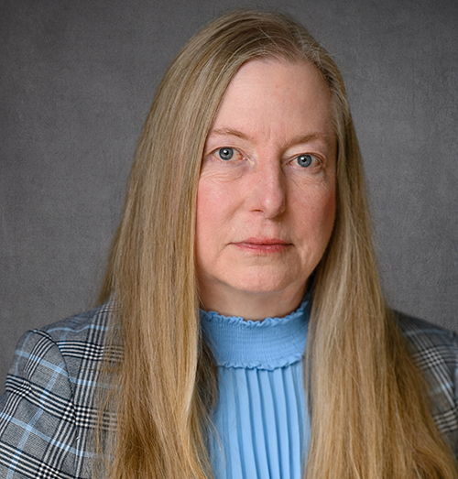
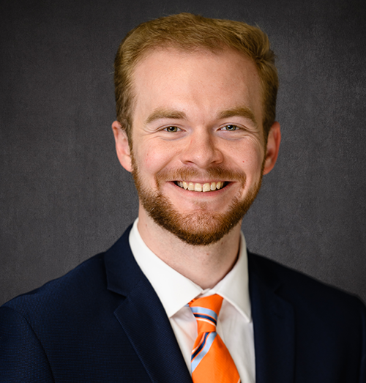
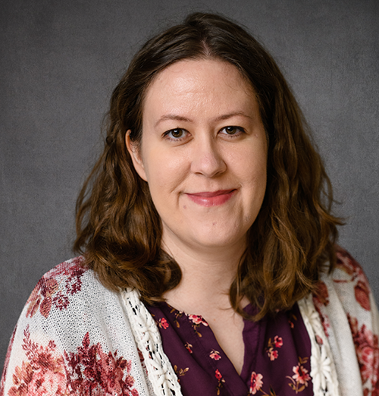
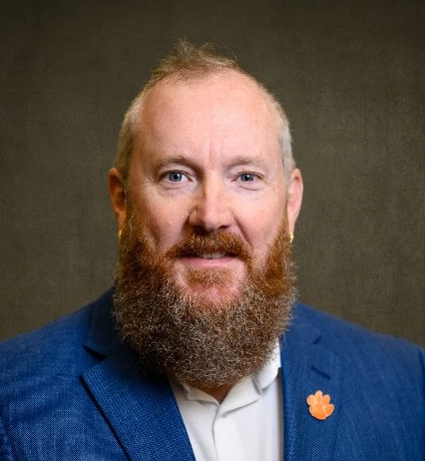
ORD Team
Shelia Cotten Assoc VP for Research Development
Jane Jacobi
Team Lead
Brett Levi
Limited Submissions and R-Initiatives
Morgan Simpson
Editing,
Workshop Logistics
Brad Walters
Graphics Support
Visit the Office of Research Development team and selected Sponsored Programs guests during office hours on Thursdays from 10:30 to 11:30 in Rm 238 of the Strom Thurmond Institute. You can also join via Zoom: clemson.zoom.us/my/janejacobi
https://www.clemson.edu/research/division-of-research/offices/department-ord/index.html

Slide 37
Additional Questions?

